Slide 1

Give Thanks for Scrum: The Next 30 Years
Navigating the Technological Singularity with an Empirical Framework
Jeff Sutherland, Ph.D
CoCreator of Scrum & Scrum@Scale
1993 - 2025 Jeff Sutherland & Scrum Inc.

Slide 2
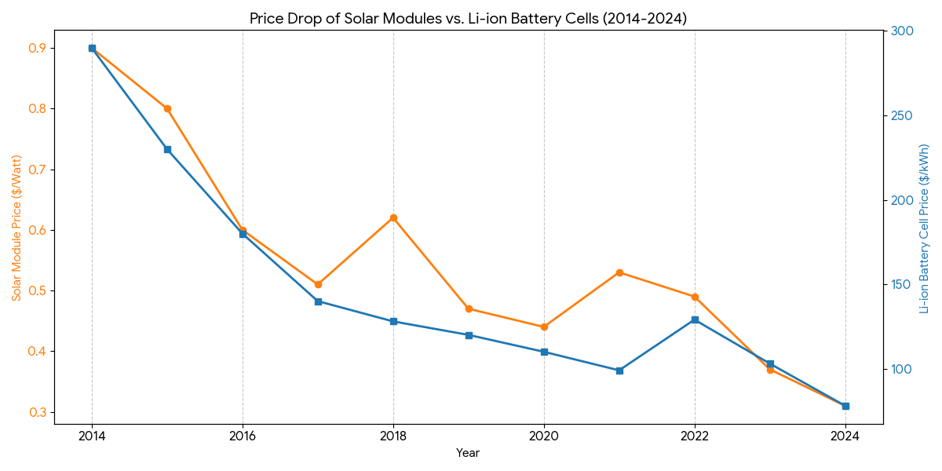
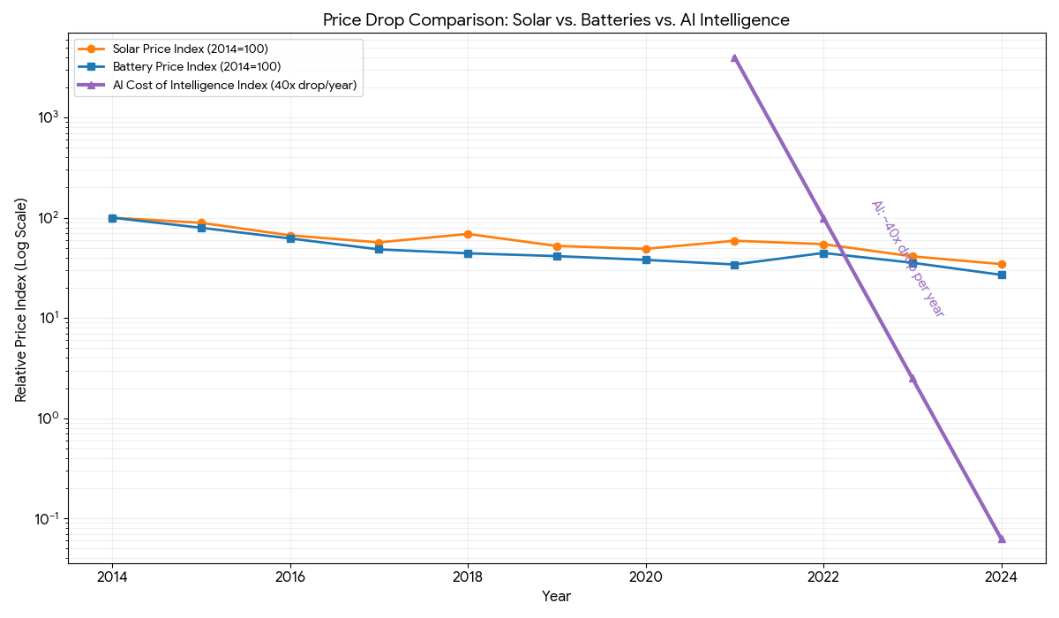
We Are Entering a Hyperdeflationary Economy
Government policy is 2% inflation so your dollar is debased every year by the deflation rate + 2%
Solar prices
Battery prices
Hyperdeflation is caused by a double exponential decrease in prices
Data Sources:
Solar: US Solar Module Prices based on Berkeley Lab "Tracking the Sun" data and recent 2024 market reports.
Batteries: Global Li-ion Battery Cell Prices based on Benchmark Mineral Intelligence and BloombergNEF historical surveys.
AI Intelligence: Represents "inference cost for fixed performance" (e.g., the cost to run a task at GPT-3.5 or GPT-4 level). The "40x per year" drop is driven by algorithmic breakthroughs (better models, quantization) and hardware improvements (H100s, TPUs), which is a rate of improvement significantly faster than Moore's Law.
Solar prices
Battery prices
Intelligence prices

Slide 3
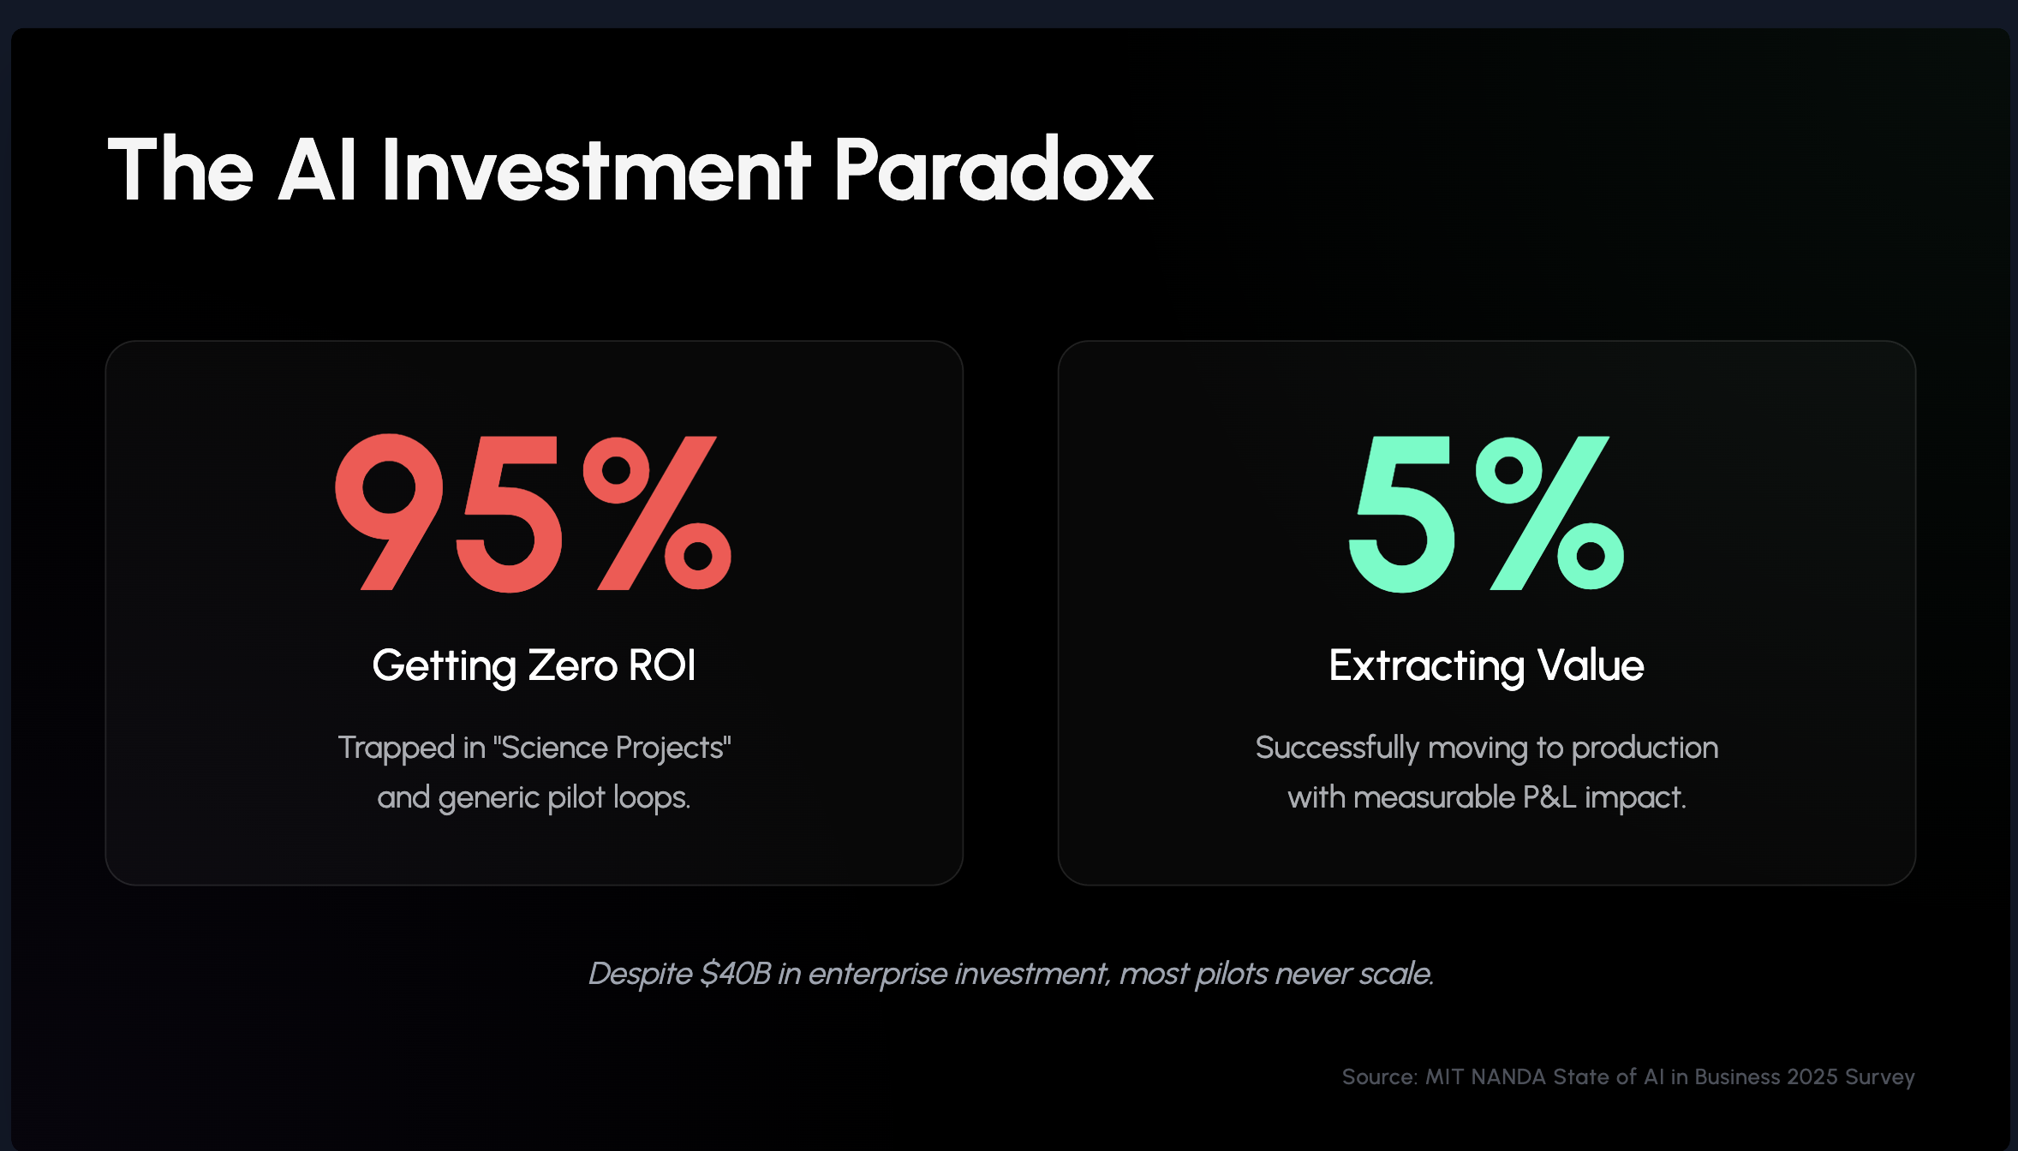

Slide 4
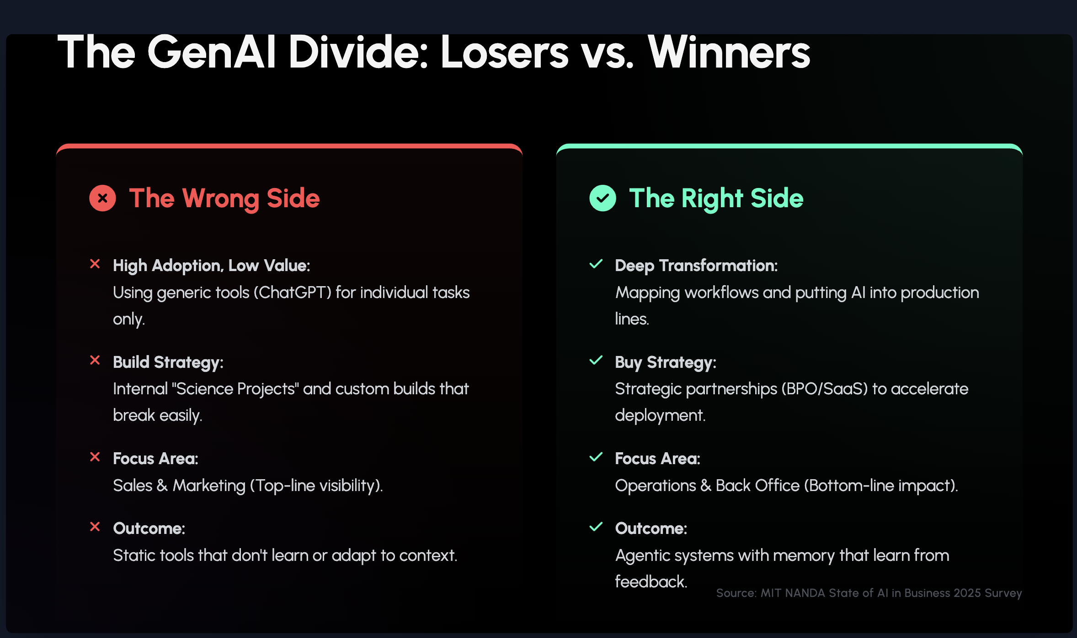

Slide 5
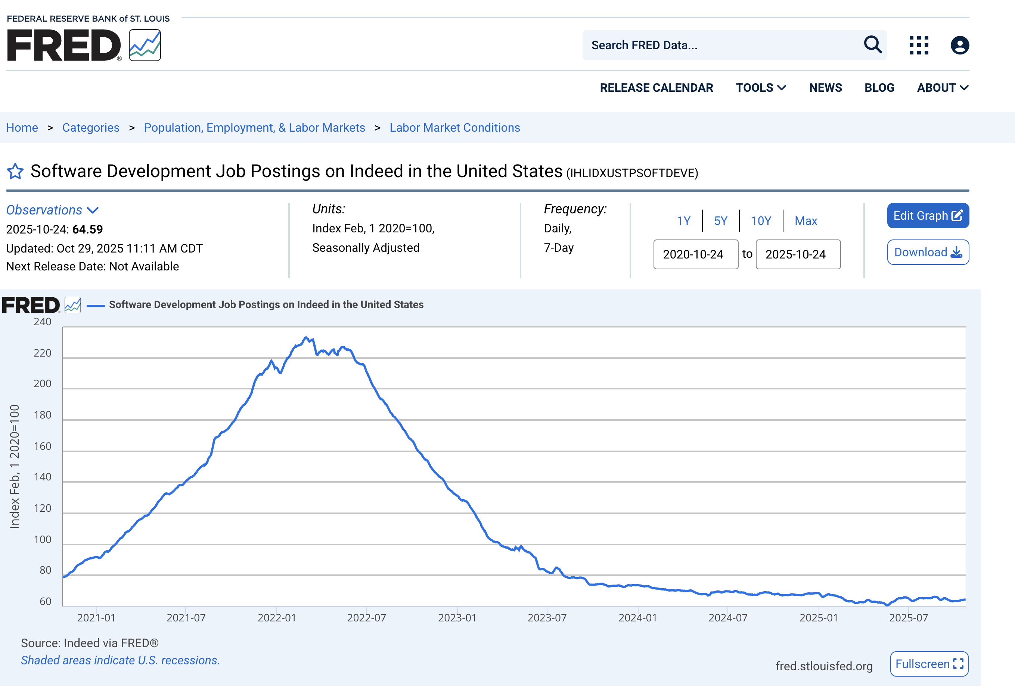
Price of a line of code is going to zero

Slide 6
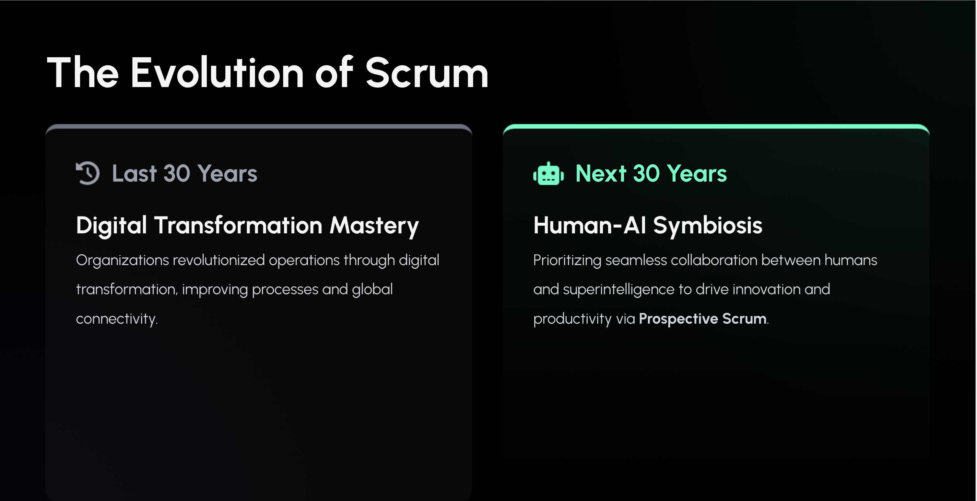
Notes:
Image source: Microsoft 365 content library
The last 30 years have seen organizations master digital transformation, revolutionizing processes and connectivity. Looking ahead, the next 30 years will focus on mastering human-AI symbiosis for enhanced collaboration and innovation. The mechanism: Prospective Scrum, utilizing AI simulations and Fibonacci protocols to address abundance and multi-planetary constraints.

Slide 7
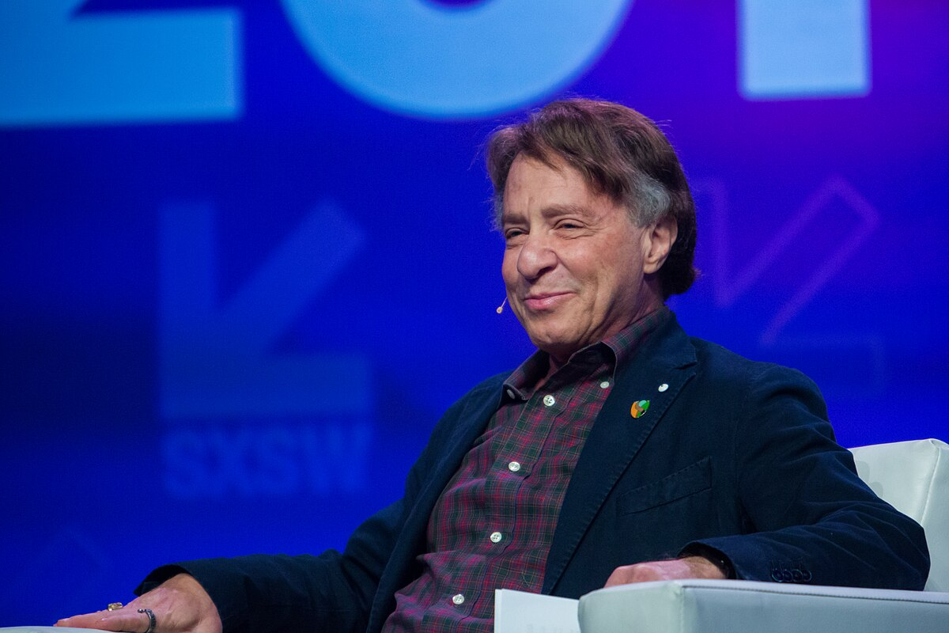
We Need to Think Bigger: Ray Kurzweil
Who is this man and why does his forecast define our next 30 years?
Who:
What:
Director of Engineering at Google, renowned inventor (flatbed scanners, text-to-speech), and one of the world's leading futurists
He is the most prominent proponent of "The Law of Accelerating Returns."

Slide 8


Why We Listen: The Law of Accelerating Returns
Why is he "probably right"? His track record.
The Theory
The Track Record
Technological progress is exponential, not linear. It builds on itself, and the rate of change accelerates.
Kurzweil has made 147 predictions for 2009 back in the 1990s. The Result: By 2010, he had an 86% accuracy rate. He predicted a computer would beat a world chess champion by 1998 (it happened in 1997). He predicted the rise of portable, internet-connected devices.
When he makes a forecast, we must listen.

Slide 9
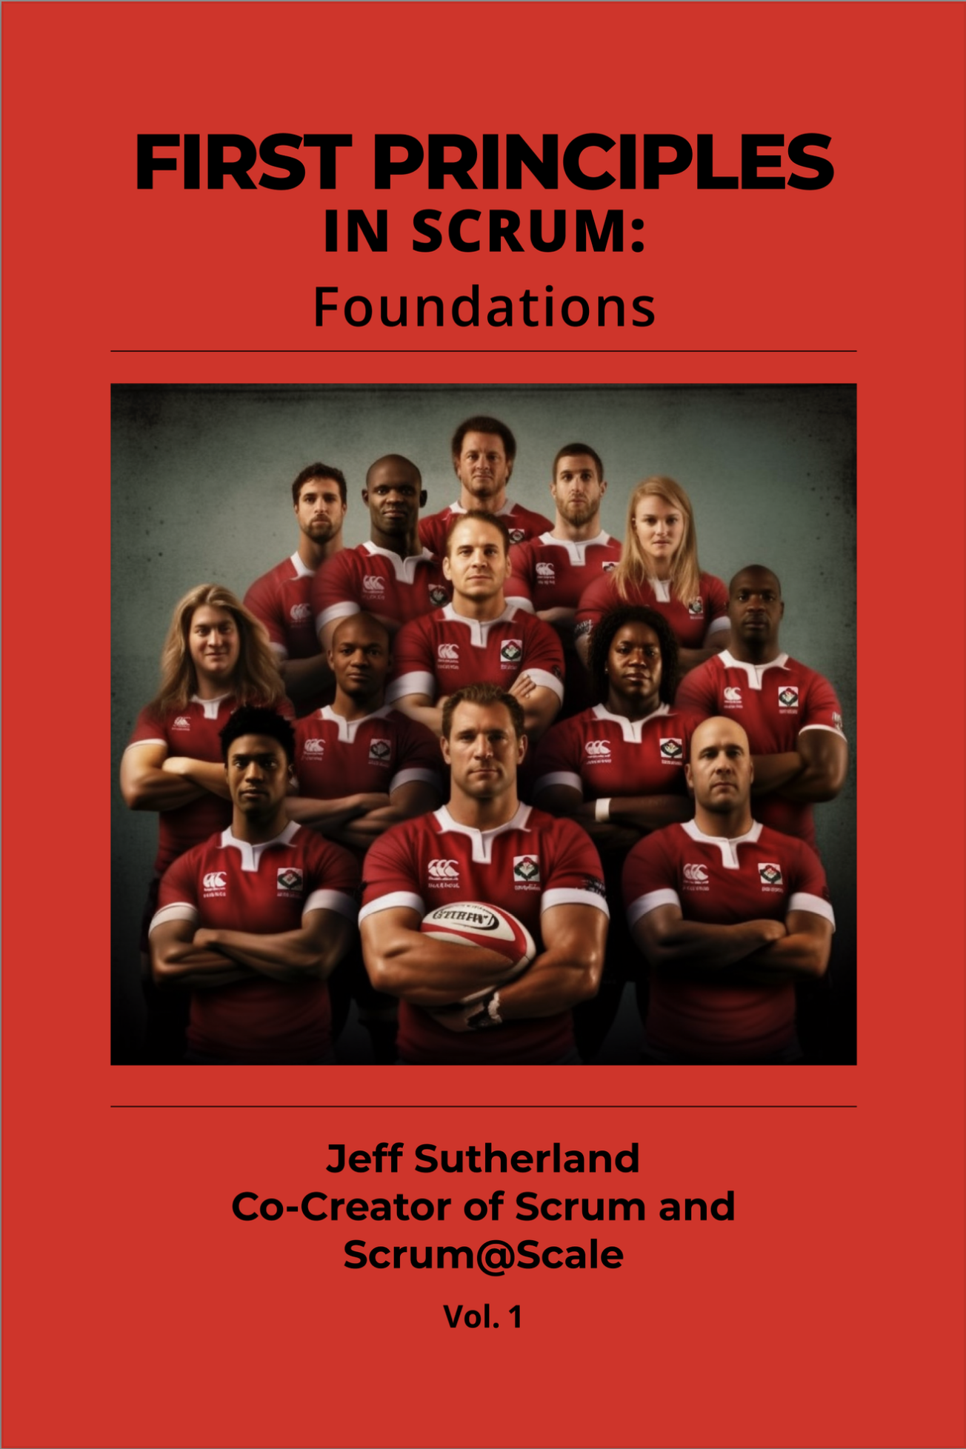
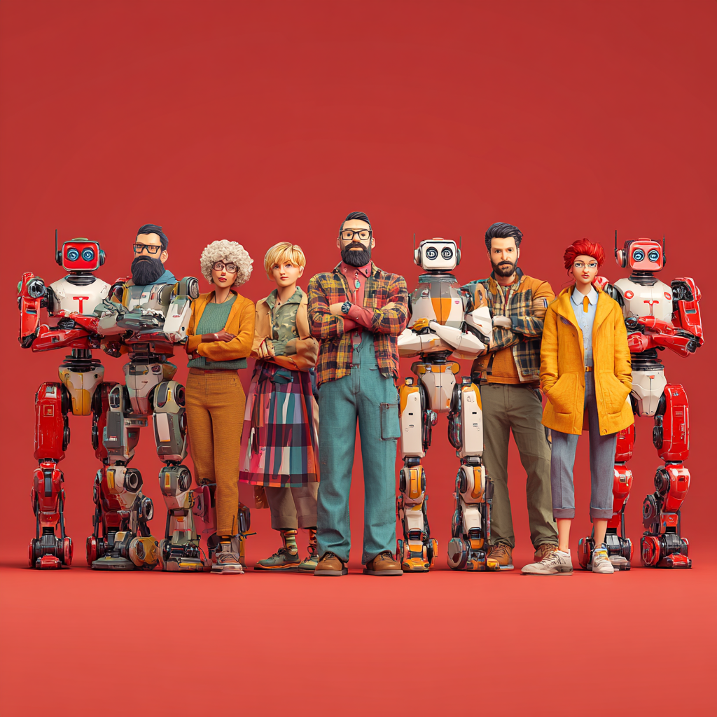
Artificial General Intelligence (AGI) by 2029
Smarter than the smartest human
All computers become smarter than the smartest human

Slide 10
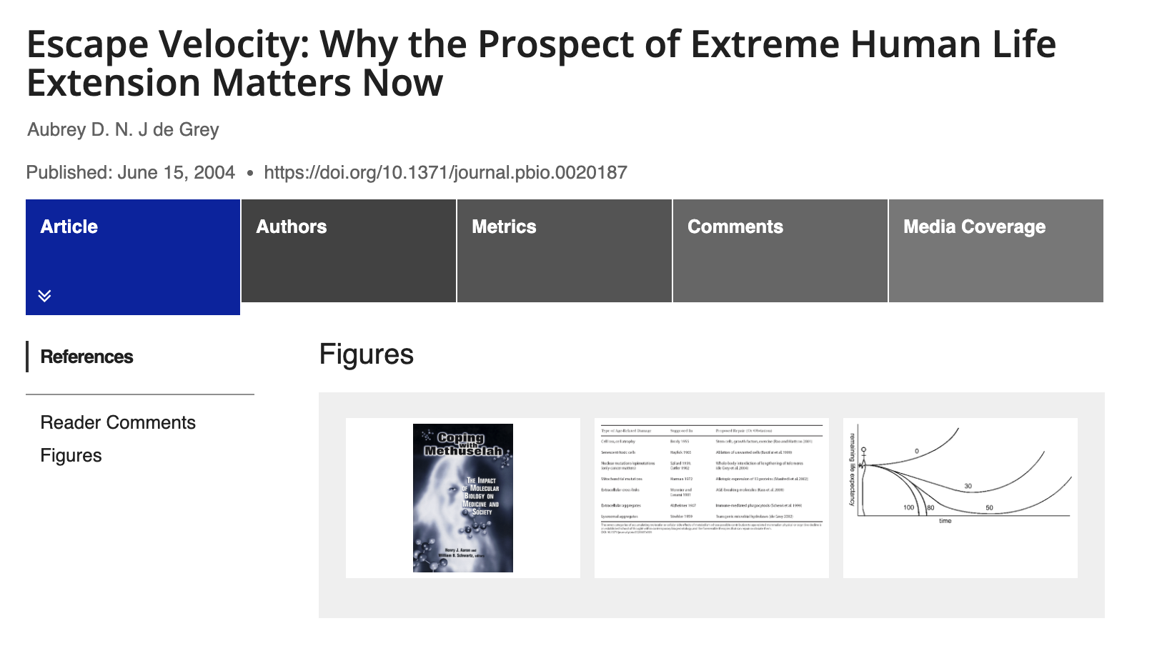
Longevity Escape Velocity by 2032

Slide 11




The Singularity: AGI Escape Velocity by 2045
The Singularity
Kurzweil's biggest prediction, a pivotal moment in
human history.
The Date
Circa 2045.
The Definition
The moment Artificial Superintelligence (ASI) surpasses all human intelligence combined. It's not just "smarter AI." It's an "intelligence explosion" where AI begins to iteratively improve itself at a rate we cannot comprehend.

Slide 12

What the Singularity Means
The Singularity is an event horizon. It's a point beyond which the future is fundamentally unknowable by pre-Singularity minds (us). It's the moment superintelligent AI will rewrite the rules of physics, biology, and all known sciences. It is the single biggest disruption and opportunity in human history. And it's set to happen in only 20 years.
AI IQ
2023 100 average person
2024 130 average senior developer
2025 150 PhD
2026 170 Einstein - Gemini 3.0 already there
2045 Unknown
scrumAI.org powered by scruminc
1993 - 2025 Jeff Sutherland & Scrum Inc.

Slide 13

The Existential Question for Scrum
Accelerating Toward Singularity
Automation of Knowledge Work
What is the purpose of a Scrum Team?
In a world accelerating toward the Singularity (c. 2045)
Where AI superintelligence (projected 2027-2040) will automate 85%+ of all knowledge work...
scrumAI.org powered by scruminc
1993 - 2025 Jeff Sutherland & Scrum Inc.

Slide 14
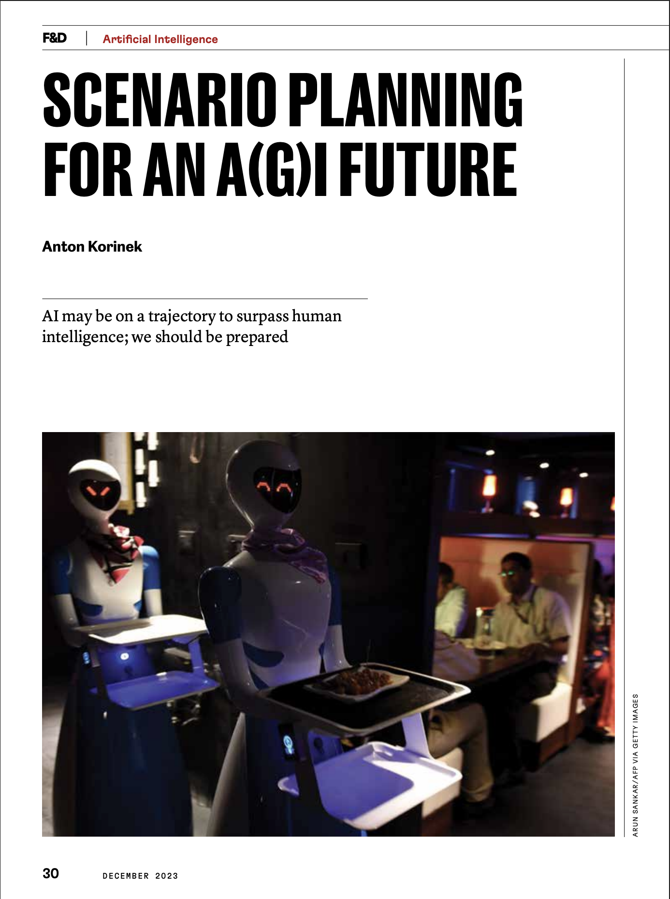
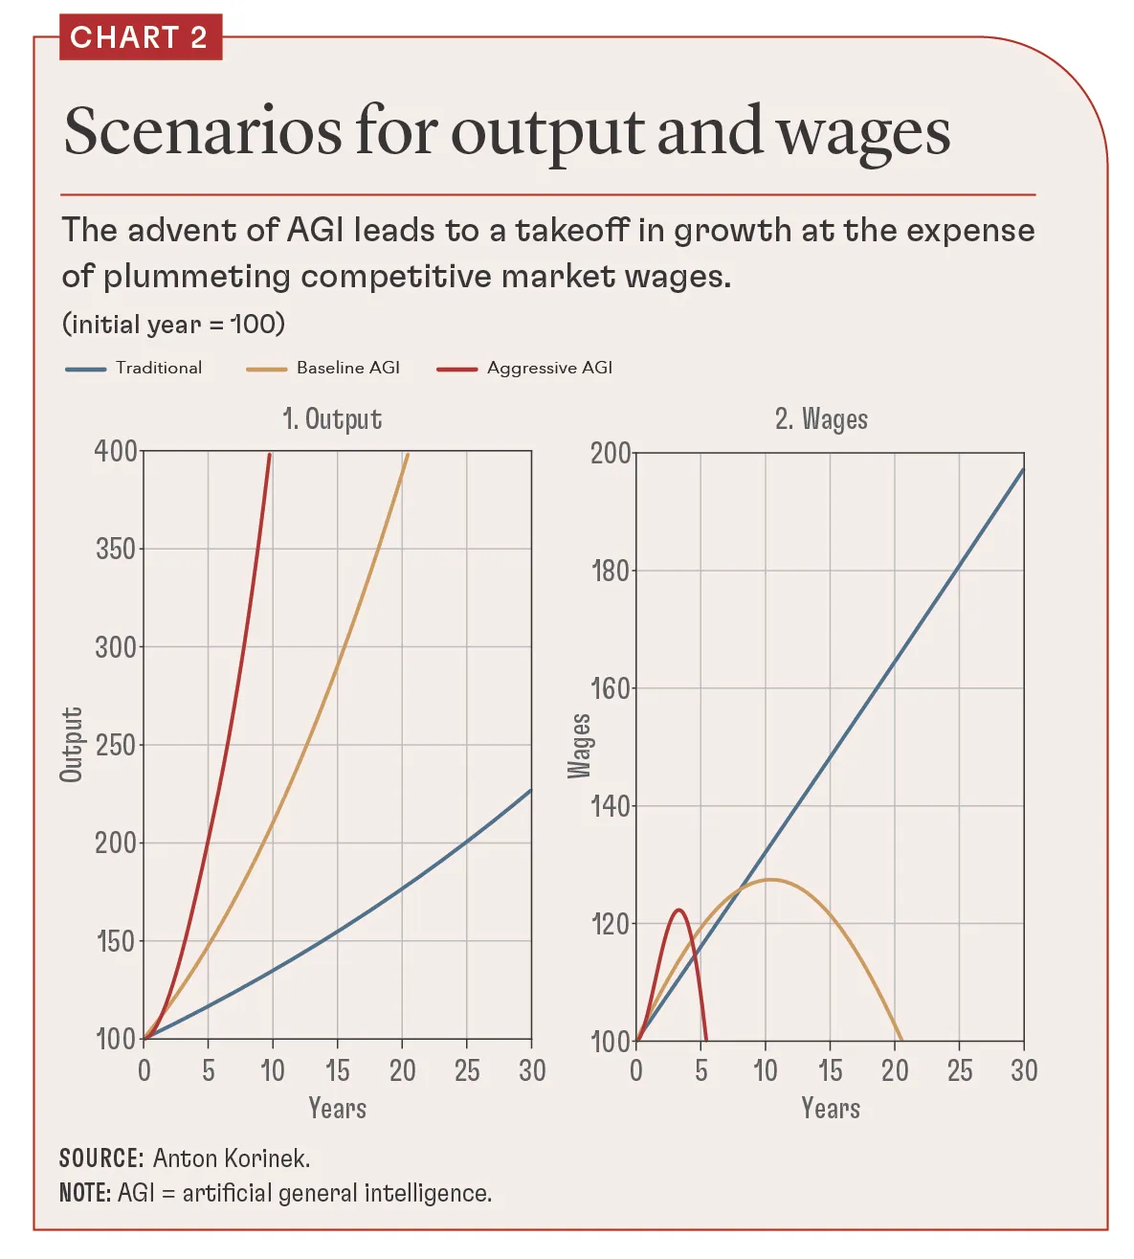
scrumAI.org powered by scruminc
1993 - 2025 Jeff Sutherland & Scrum Inc.

Slide 15

The Pain: The 'Purpose Void'
When AI can do the "work," what is left for us?
Organizational Obsolescence
The "Purpose Void"
70% of hybrid human-AI teams will struggle, drowning in ethical dilemmas, integration failures, and mismatched paces.
In a post-scarcity, immortal society, what is our purpose? We face infinite lifespan-induced burnout.
Ethical Catastrophe
How do we manage a Mars colony when a communication lag is 20 minutes, but the AI on-site can make 20 trillion decisions in that time?
scrumAI.org powered by scruminc
1993 - 2025 Jeff Sutherland & Scrum Inc.

Slide 16
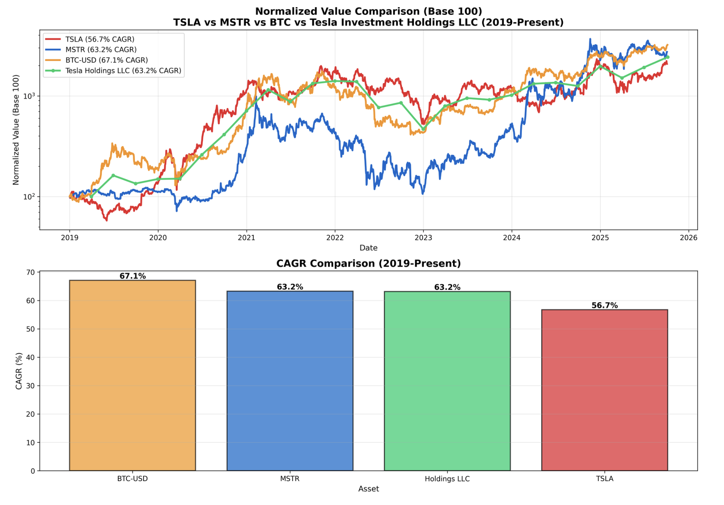
Escaping The Pain: $10000 to $1M in 10 Years

Slide 17
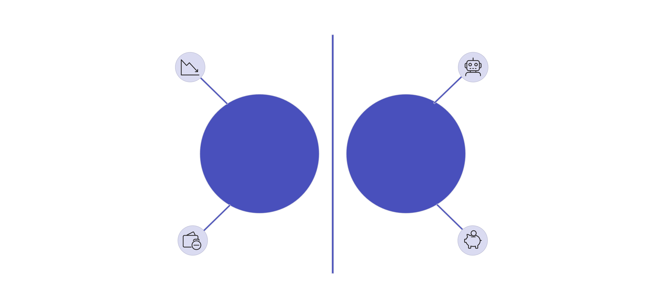


The Economic Pain: The Abundance-Scarcity Delta
Capital enables agency, sovereignty, and purpose. When wages go to zero, lack of capital creates a welfare state.
With inflation at 2%, the dollar’s value must decrease by 10% each year. Holding onto dollars means prices rise and your purchasing power diminishes. This puts pressure on you and reduces your influence in an AI-driven world.
Prices of goods decrease by 8% annually. Maintaining high CAGR holdings lowers your costs by 50% each year. Your capital provides you with influence in an AI-driven environment.
AI Abundance
Monetary Scarcity
Wage and credit squeeze
Tight fiat liquidity
The Delta: A widening gap (78% in 2025 -> 100% by 2030) between AI-driven deflationary Abundance (goods are free) and human-driven monetary Scarcity (fiat currency debasement).
The Crisis: Our entire concept of "business value" will break. Scrum risks becoming irrelevant if it can't navigate this new reality.
ScrumAI.org

Slide 18



The Pivot: Scrum's New Mission
This is where we come in. Scrum's relevance evolves.
No Longer About...
It Is About...
managing work.
managing human-AI symbiosis.
In a post-Singularity world, Scrum becomes the indispensable framework for ensuring that human ethics, creativity, and purpose guide superintelligence.
scrumAI.org powered by scruminc
1993 - 2025 Jeff Sutherland & Scrum Inc.

Slide 19




A Tool for the Journey: The Scrum Expansion Pack
How do we make this pivot? We already have the foundation.
What it is:
What it is NOT:
A set of patterns that amplify the timeless 2020 Scrum Guide.
A new Scrum Guide. It doesn't change the rules.
What it does:
It is evolving the specific patterns and lenses needed to apply Scrum's empirical core to these new, extreme contexts: AI, robotics, interstellar scale, and post-scarcity economics.
scrumAI.org powered by scruminc
1993 - 2025 Jeff Sutherland & Scrum Inc.

Slide 20



From Process Management to 'Cognitive Orchestration'
This is our new role. The Scrum Team is no longer just "building the thing." The Scrum Team becomes the "Cognitive Orchestrator.” The Agile Leader becomes the ”Transformation Guide.”
Product Owner
Developers
Scrum Master
Evolves to ethically prioritize what a super-AI should even think about.
Evolve to design the experiments that validate an AI's rewritten science.
Evolves to be the steward of the human-AI ethical interface and remove impediments to symbiosis.
ScrumAI.org

Slide 21

Scrum: Past vs. Future
We are moving from a “Retrospective” Scrum to a “Prospective” Scrum
“Wh
Traditional Scrum Forecasting
Earlier, Scrum teams used historical data and burndown charts to predict Sprint outcomes, relying on past performance trends.
AI-Driven Simulations
Modern Scrum utilizes AI agents that generate Python code to run thousands of Monte Carlo simulations, modeling future possibilities.
Probability Cone Visualization
Teams now visualize a Probability Cone of possible outcomes, choosing the best option from AI-generated futures before building anything.
What happens next is more important than what happened in the past.
Notes:
Image source: Microsoft 365 content library
Traditional Scrum relied on 'Yesterday’s Weather,' using past trends like burndown charts to forecast Sprint outcomes. The new approach leverages AI agents that generate Python code to run thousands of Monte Carlo simulations, visualizing a 'Probability Cone' of future possibilities. Now, teams select the optimal future from AI-generated options, echoing SAAB Gripen’s philosophy: 'All Hardware is Code'—nothing is built until it is simulated.

Slide 22

First Principles Help Us Navigate (1/3): Empiricism
How do you validate a solution when an AI rewrites physics?
You can't "plan" it. You must run experiments. Scrum's core empirical loop (Transparency, Inspection, Adaptation) becomes MORE critical, not less.
It is the only sane way to test and validate the outputs of a superintelligent mind we cannot fully comprehend.
But the AI has all the retrospective data and we focus our time choosing the best simulations of the future.
scrumAI.org powered by scruminc
1993 - 2025 Jeff Sutherland & Scrum Inc.

Slide 23



First Principles Help Us Navigate (2/3): Emergence
Estimating the Unplannable
How do you "estimate" building a warp drive? You can’t. Focus on Complexity (Cynefin) and Emergence is built for this.
Safe-to-Fail Probes
We stop trying to plan the unplannable. We use Sprints to create "safe-to-fail" probes, discover emergent patterns, and amplify what works.
Navigating Breakthroughs
This is how we will navigate the chaotic breakthroughs of the Singularity.
scrumAI.org powered by scruminc
1993 - 2025 Jeff Sutherland & Scrum Inc.

Slide 24

Fibonacci: The Cognitive Bridge
Human-AI Communication Gap
  AI relies on precise probabilities, while humans use intuitive heuristics, making it difficult for them to fully understand each other.
Fibonacci as Quantization Layer
  The Fibonacci sequence acts as a shared framework, helping both AI and humans align their perceptions of uncertainty and reduce Bayesian surprise.
Bayesian Surprise and Task Management
  A high Fibonacci value signals significant uncertainty, prompting humans to pause AI actions and break down complex tasks.
Notes:
Image source: Microsoft 365 content library
Superintelligent AI operates with precise probabilities, while humans use intuitive heuristics, creating a communication gap. Using the Fibonacci sequence as a 'quantization layer' helps both AI and humans align perceptions of uncertainty. A Fibonacci value like '13' signals high Bayesian Surprise, prompting humans to pause AI actions and break down complex tasks.

Slide 25

Solving the Value Paradox
AI identifies the 25% of the work that delivers 75% of the value in every story
Effort Cost Nears Zero
Advancements in technology reduce the cost of effort, making it easier to address complex tasks.
Identifying Value Density
AI pinpoints the most valuable portions of work, finding the key elements that deliver the greatest benefit.
Focusing on High Impact
The approach shifts to concentrating on the top value drivers, discarding less impactful efforts for greater efficiency.
25% of backlog delivers features customers will use
Customer
Will Use
64% x 70% = 45% of backlog delivers features the customer will never or rarely use (Standish Group)
Junk
Stories
Dark
Work
Typically 30% of work is on zero value stories
Notes:
Image source: Microsoft 365 content library
In the 'Stellar' Era, effort cost nears zero, creating the value paradox: Why break down a '13 Value Point' task? The answer lies in value density—AI identifies the vital 20% ('the Gem') delivering 80% of the value. As a result, we focus on the top 3 points, discarding less impactful work.

Slide 26




First Principles Help Us Navigate (3/3): Economic Agility
How do you deliver "value" when money is broken? Focus on Economic Agility helps us bridge the Abundance-Scarcity Delta. We shift our definition of "value" from fiat currency to tangible, sustainable outcomes:
Preserving Human Agency
Empowering individuals to maintain control and
decision-making in an AI-driven future.
Ensuring Ethical Alignment
Developing systems and frameworks that align with
human values and moral principles.
Building Resilient Systems
Creating robust economic structures (e.g., Bitcoin-like reserves)
that thrive in a post-scarcity world.
scrumAI.org powered by scruminc
1993 - 2025 Jeff Sutherland & Scrum Inc.

Slide 27
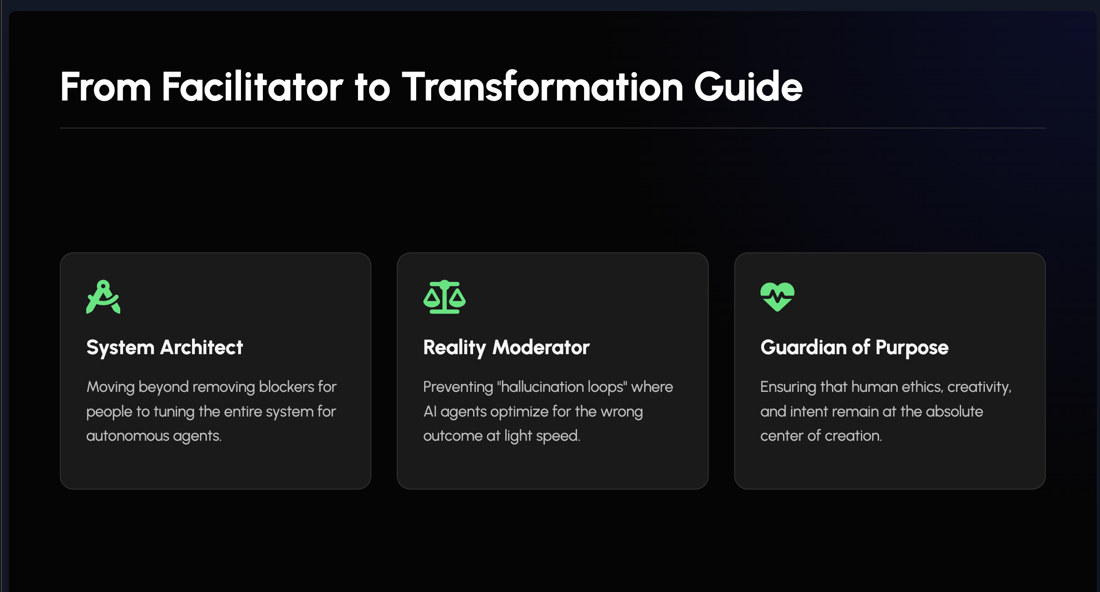

Slide 28
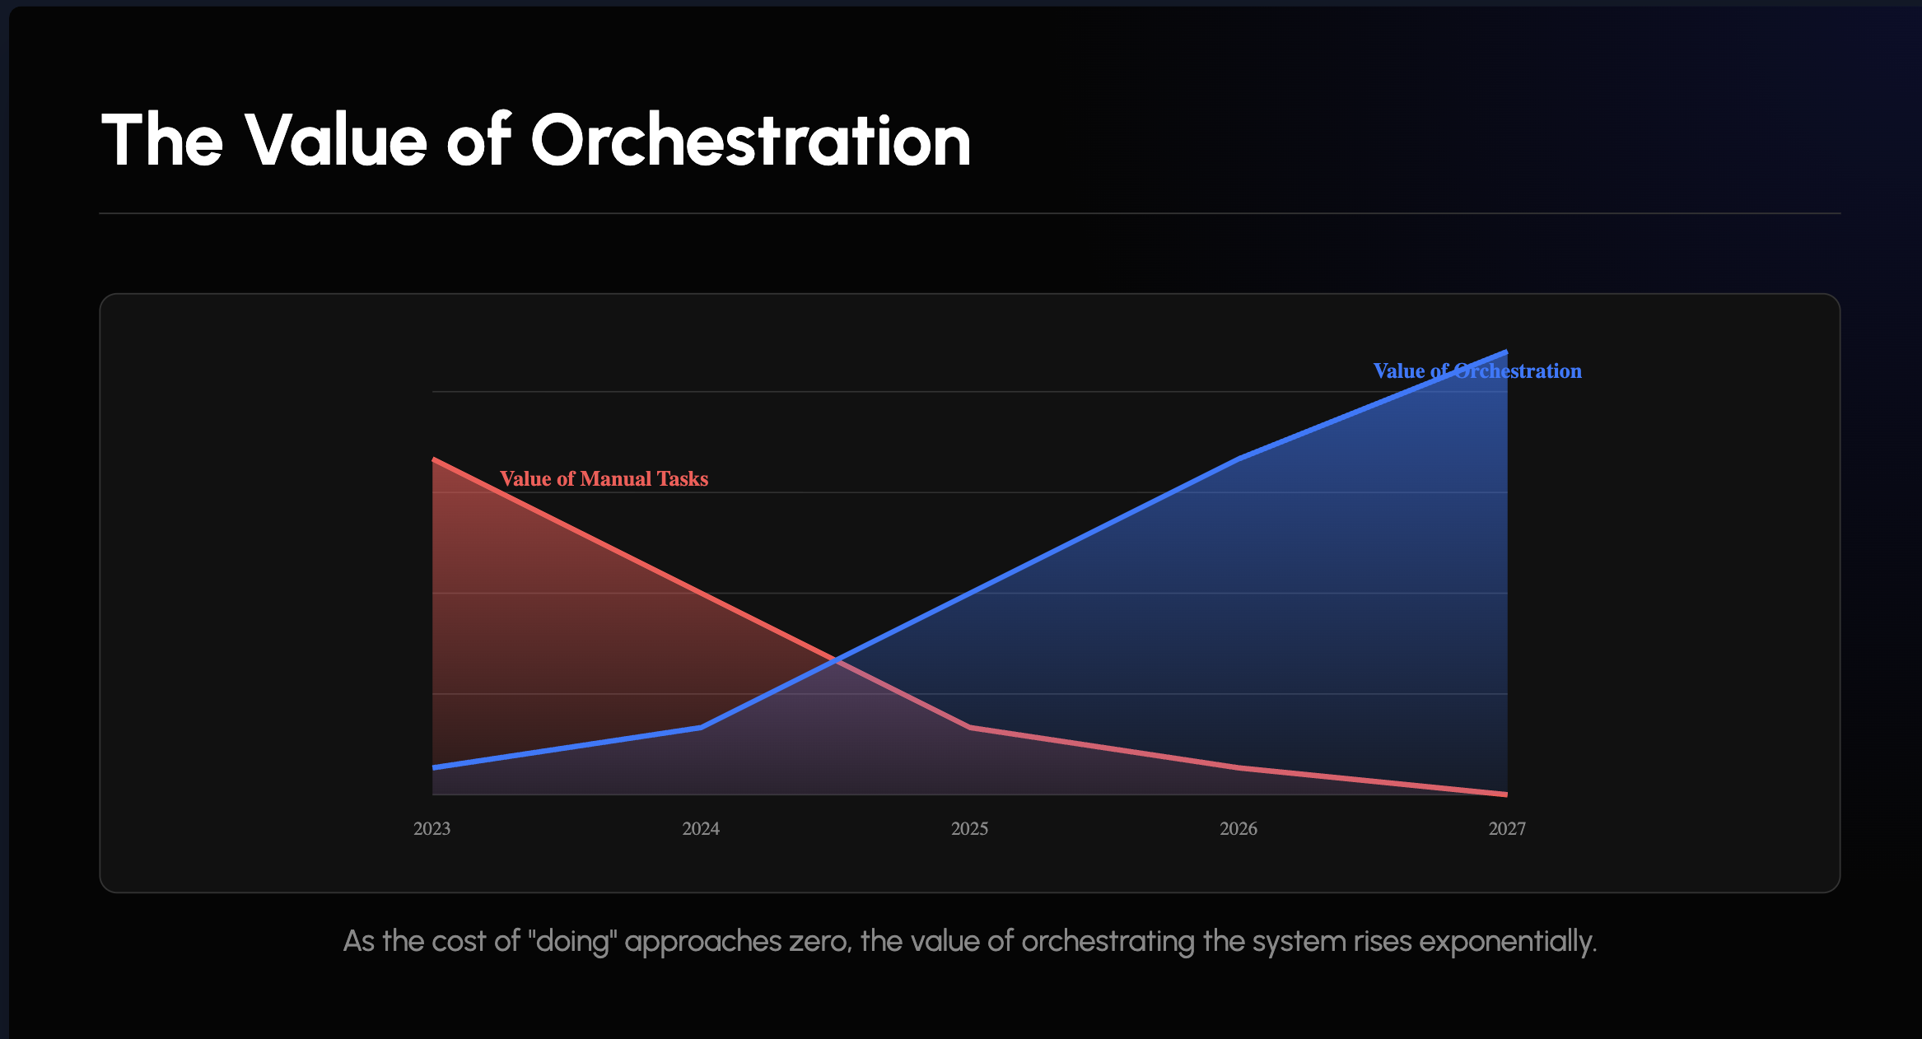

Slide 29

The Bridge: A 5-Year Roadmap to a 30-Year Vision
This 30-year vision is daunting. We can't jump to interstellar travel tomorrow. We must build a bridge.
Year 1-2
Year 4
AI Integration Foundations
Space & Scalability Focus
Year 3
Year 5
Ethical & Biological Expansions
Full Repositioning

Slide 30



The Next 5 Years: Our New Practices
What does this bridge look like?
Y 1-2: AI Co-pilots
Y 4-5: The 100 Gigawatt Problem
Integrate AI co-pilots directly into the Scrum Team. Launch "Scrum for Robotics" certifications.
The Constraint: AI compute requires massive energy (100GW data centers). Generating this on Earth risks overheating the planet (Musk’s observation).
The Solution: Off-World Compute.
Starship logistics -> Moonbase Manufacturing -> Orbital Data Centers.
Scrum's Role: Managing the logistics of a solar-system-spanning supply chain where "Hardware is Code" and latency (light speed) demands autonomous, self-managing teams.
Y 3: Bio-Enhanced Retrospectives
Develop patterns for indefinite-lifespan teams. How do you run a retrospective for a team that has been together for many years?

Slide 31

Why We Must Cross This Bridge Now
Job Security
Ethical Edge
Scalability
This is how we ensure our relevance in a robot-dominated workforce.
This is how we guide AI to prevent dystopia.
This is how we handle Mars colony tech, where delays span light-years.
Personal Fulfillment
Market Leadership
This is how we solve the "purpose void" and foster joy in a world of abundance.
This is how we lead our organizations through the Singularity.

Slide 32

Guidance for Scrum Aficionados
For 30 years, you have been the masters of empiricism. Your journey is not over. It is needed now
more than ever.
You are not being replaced by AI. Those who accept this mission are being promoted. You are the ones who must teach the AIs, and the world, how to build with purpose.
scrumAI.org powered by scruminc
1993 - 2025 Jeff Sutherland & Scrum Inc.

Slide 33




Call to Action (For the Next 30 Years)
Be the Ethical Guides
Champion the Scrum Values—Commitment, Focus, Openness, Respect, Courage. These are the human values that must constrain AI.
Be the Master Experimenters
Use Scrum to test AI's outputs, not just build with AI.
Be the "Cognitive Orchestrators"
Evolve your roles. Start integrating AI into your backlogs and retrospectives today.
Be the Teachers
We must onboard the AIs into our empirical, ethical framework.

Slide 34

The Future is Hyper-Agile
In the 1990s, we needed Scrum to deal with the chaos
of the internet.
In the 2040s, we will need Scrum to deal with the complexity of the Singularity.
The principles are the same. The stakes are infinitely higher.
scrumAI.org powered by scruminc
1993 - 2025 Jeff Sutherland & Scrum Inc.

Slide 35
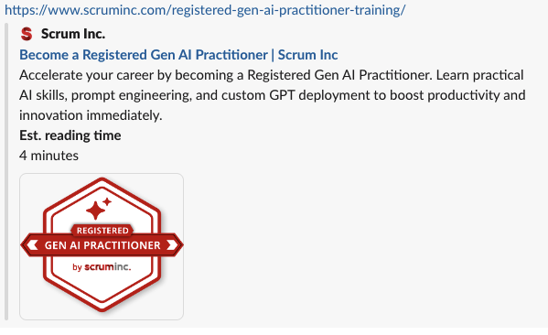
Give Thanks for Scrum
For 30 years, Scrum helped us build the world.
For the next 30, Scrum will help us guide the future.
The journey continues. Thank you for being its guardians.

