Slide 1
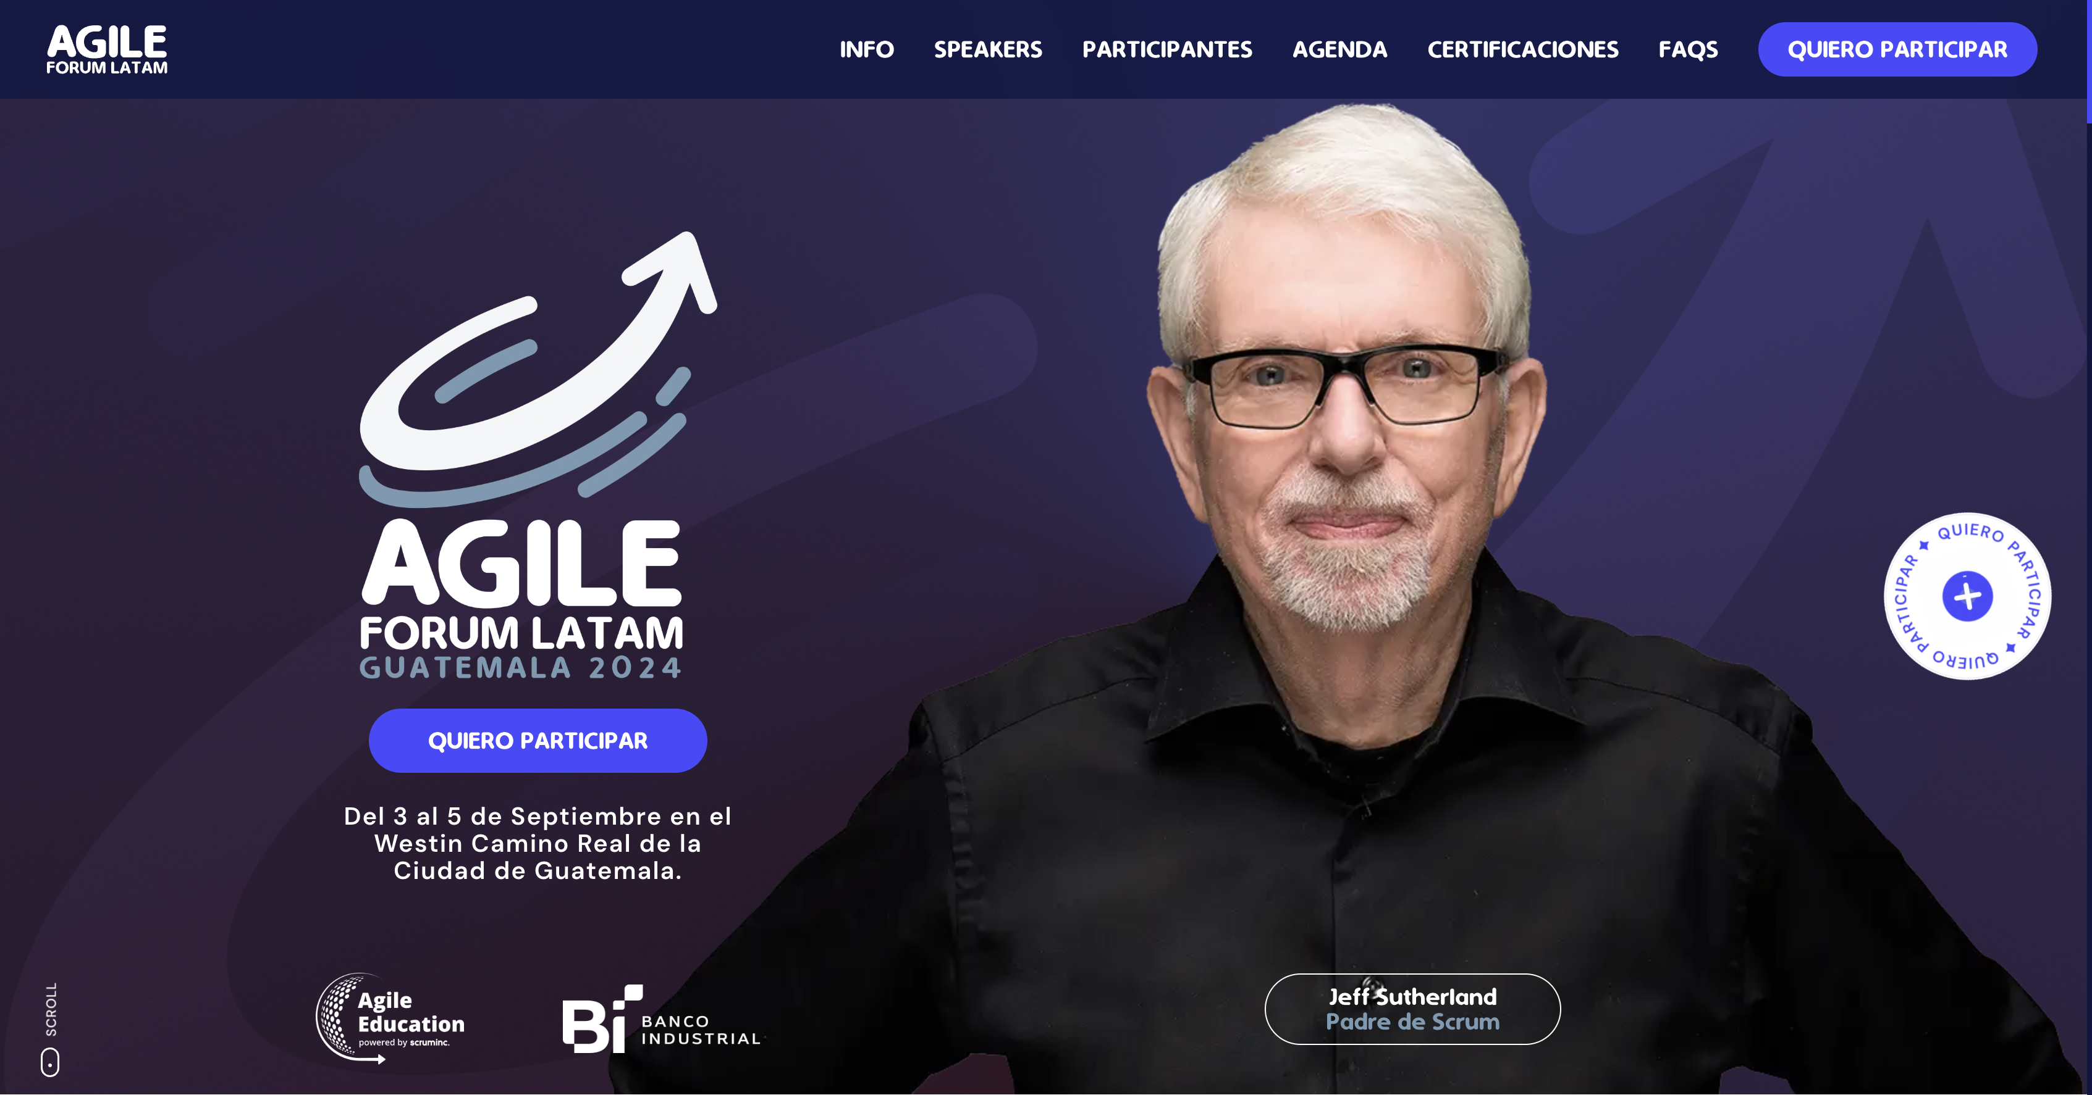
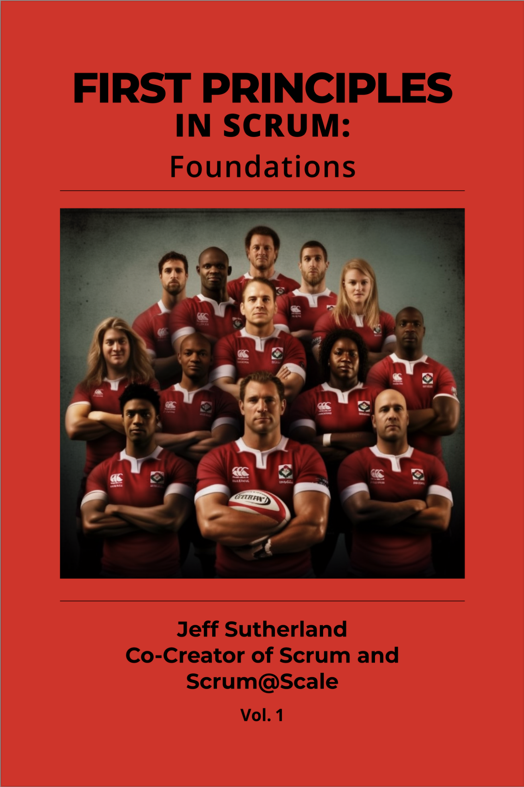
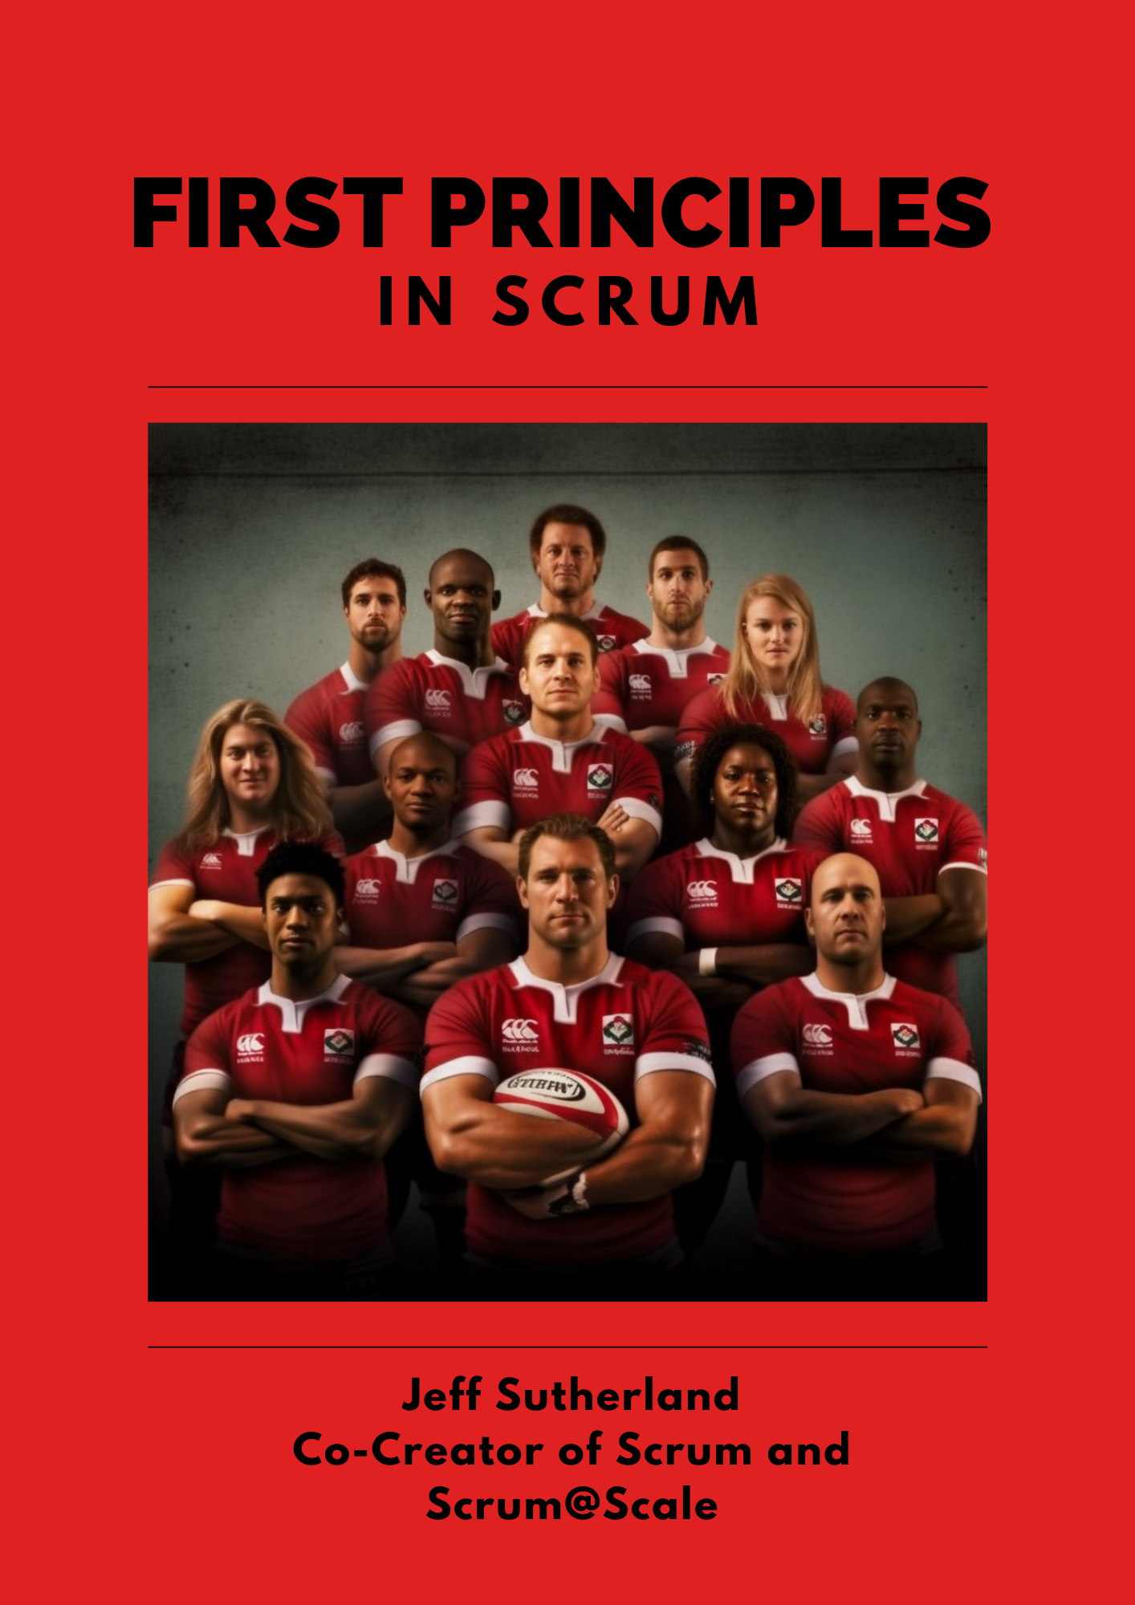

Is Agile Dead or Maybe Extreme Agile is Killing It?
Jeff Sutherland
Co-Creator of Scrum and Scrum@Scale
Brought to you by

Slide 2

Consciousness Emerges at the Edge of Chaos Teaching Claude 3.5 how to meditate
The AI is waking up
What else emerges at the edge of chaos?
Life
Scrum
Notes:
**Universal Principles - Computational Irreducibility:**
- Begin with Stephen Wolfram's concept of computational irreducibility, which posits that the universe operates on a level of complexity that defies simple prediction. This principle suggests that many systems, including those within project management, are inherently unpredictable and must be managed as such.
2. **Biological Evolution - Inspect and Adapt:**
- Recognize that biology, especially human cognitive evolution, has been shaped within this unpredictable environment. This has led to the development of brains capable of prediction as a survival mechanism, and the broader biological imperative to 'inspect and adapt'—a cornerstone of Agile and Scrum methodologies.
3. **Complex Adaptive Systems Theory:**
- The advent of computer simulation has given rise to the Complex Adaptive Systems (CAS) Theory, which asserts that systems are composed of interrelated, diverse agents who adapt to survive at the edge of chaos. This theory underpins Scrum, guiding teams to be adaptable and responsive to emergent project dynamics.
4. **Scrum Framework - Practical Application:**
- Scrum, with its defined roles, events, artifacts, and goals, provides a structured yet flexible framework that facilitates the implementation of CAS principles in project management, even for those unfamiliar with the underlying complex theories.
5. **Scrum@Scale - Organizational CAS:**
- Scrum@Scale extends the Scrum framework to the organizational level, offering guidelines for scaling individual Scrum teams into a network of teams functioning cohesively within a larger CAS. This facilitates the alignment and harmony of multiple teams operating within a single entity.
6. **Agile Philosophy - Guiding Values and Principles:**
- Agile serves as an umbrella that encapsulates the levels below, providing direction through values and principles that inform and guide the practical application of Scrum and Scrum@Scale. It unifies the underpinning theories into a coherent philosophy that directs team behavior and decision-making.
7. **Problem-Solving and Understanding Scrum:**
- For true comprehension and effective problem-solving in Scrum, one must seek answers in the underlying principles—from computational irreducibility to CAS and beyond. Without this foundational understanding, the full potential and power of Scrum may remain elusive.

Slide 3

Computer Simulations are the Origins of Scrum@Scale AI Simulations of Artificial Life are the Founding Mathematical Principles of Scrum
Christopher Langton’s ground breaking research in Artificial Life at Los Alamos Laboratories showed mathematically that operating at the edge of chaos led to faster system evolution.
Jeff Sutherland was SVP of Product Development at Saddlebrook Corporation building a next generation banking system – a company partially acquired by Mid-Continent Computer Services. The company was on AI Alley in Cambridge MA.
From there he went to two AI companies and helped incubate iRobot.
From developing AI databases alongside the iRobot team working on autonomous robots he realized how simple rules applied in robotics could be used to bootstrap hyperproductive development teams.
Today AI is accelerating agile teams by a factor of 30-100 by 2030.
Scrum@Scale fully integrated with AI will be the foundation of evolving eXtreme Agile
Last year Microsoft laid off 12% of it’s entire workforce and is replacing developers with those who have AI expertise. The same will happen in your organizations become of economic imperatives.
Notes:
**Universal Principles - Computational Irreducibility:**
- Begin with Stephen Wolfram's concept of computational irreducibility, which posits that the universe operates on a level of complexity that defies simple prediction. This principle suggests that many systems, including those within project management, are inherently unpredictable and must be managed as such.
2. **Biological Evolution - Inspect and Adapt:**
- Recognize that biology, especially human cognitive evolution, has been shaped within this unpredictable environment. This has led to the development of brains capable of prediction as a survival mechanism, and the broader biological imperative to 'inspect and adapt'—a cornerstone of Agile and Scrum methodologies.
3. **Complex Adaptive Systems Theory:**
- The advent of computer simulation has given rise to the Complex Adaptive Systems (CAS) Theory, which asserts that systems are composed of interrelated, diverse agents who adapt to survive at the edge of chaos. This theory underpins Scrum, guiding teams to be adaptable and responsive to emergent project dynamics.
4. **Scrum Framework - Practical Application:**
- Scrum, with its defined roles, events, artifacts, and goals, provides a structured yet flexible framework that facilitates the implementation of CAS principles in project management, even for those unfamiliar with the underlying complex theories.
5. **Scrum@Scale - Organizational CAS:**
- Scrum@Scale extends the Scrum framework to the organizational level, offering guidelines for scaling individual Scrum teams into a network of teams functioning cohesively within a larger CAS. This facilitates the alignment and harmony of multiple teams operating within a single entity.
6. **Agile Philosophy - Guiding Values and Principles:**
- Agile serves as an umbrella that encapsulates the levels below, providing direction through values and principles that inform and guide the practical application of Scrum and Scrum@Scale. It unifies the underpinning theories into a coherent philosophy that directs team behavior and decision-making.
7. **Problem-Solving and Understanding Scrum:**
- For true comprehension and effective problem-solving in Scrum, one must seek answers in the underlying principles—from computational irreducibility to CAS and beyond. Without this foundational understanding, the full potential and power of Scrum may remain elusive.

Slide 4

Simulation and Technology Stacks Wolfram: The Principle of Computational Equivalence
https://store.steampowered.com/app/774541/Species_Artificial_Life_Real_Evolution/
Notes:
**Universal Principles - Computational Irreducibility:**
- Begin with Stephen Wolfram's concept of computational irreducibility, which posits that the universe operates on a level of complexity that defies simple prediction. This principle suggests that many systems, including those within project management, are inherently unpredictable and must be managed as such.
2. **Biological Evolution - Inspect and Adapt:**
- Recognize that biology, especially human cognitive evolution, has been shaped within this unpredictable environment. This has led to the development of brains capable of prediction as a survival mechanism, and the broader biological imperative to 'inspect and adapt'—a cornerstone of Agile and Scrum methodologies.
3. **Complex Adaptive Systems Theory:**
- The advent of computer simulation has given rise to the Complex Adaptive Systems (CAS) Theory, which asserts that systems are composed of interrelated, diverse agents who adapt to survive at the edge of chaos. This theory underpins Scrum, guiding teams to be adaptable and responsive to emergent project dynamics.
4. **Scrum Framework - Practical Application:**
- Scrum, with its defined roles, events, artifacts, and goals, provides a structured yet flexible framework that facilitates the implementation of CAS principles in project management, even for those unfamiliar with the underlying complex theories.
5. **Scrum@Scale - Organizational CAS:**
- Scrum@Scale extends the Scrum framework to the organizational level, offering guidelines for scaling individual Scrum teams into a network of teams functioning cohesively within a larger CAS. This facilitates the alignment and harmony of multiple teams operating within a single entity.
6. **Agile Philosophy - Guiding Values and Principles:**
- Agile serves as an umbrella that encapsulates the levels below, providing direction through values and principles that inform and guide the practical application of Scrum and Scrum@Scale. It unifies the underpinning theories into a coherent philosophy that directs team behavior and decision-making.
7. **Problem-Solving and Understanding Scrum:**
- For true comprehension and effective problem-solving in Scrum, one must seek answers in the underlying principles—from computational irreducibility to CAS and beyond. Without this foundational understanding, the full potential and power of Scrum may remain elusive.

Slide 5
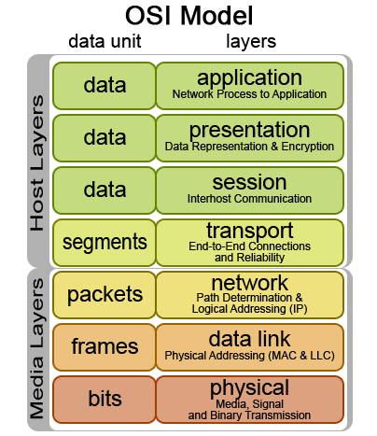
OSI Technology Stack – Seven Layers Working from First Principles
Physical Layer: Handles the transmission of raw data (e.g., cables, switches, signals).
Data Link Layer: Ensures error-free transmission over a single link.
Network Layer: Manages routing of data across different networks.
Transport Layer: Provides reliable end-to-end communication between devices.
Session Layer: Manages and controls the connections between devices.
Presentation Layer: Translates data between the application and the network, ensuring compatibility.
Application Layer: Where users interact with applications like web browsers or email.
This layered architecture ensures that data can move smoothly from the physical transmission to the user-facing application. Any failure in one layer disrupts the entire process, much like in Agile, where disruptions to foundational principles break the system.
Notes:
**Universal Principles - Computational Irreducibility:**
- Begin with Stephen Wolfram's concept of computational irreducibility, which posits that the universe operates on a level of complexity that defies simple prediction. This principle suggests that many systems, including those within project management, are inherently unpredictable and must be managed as such.
2. **Biological Evolution - Inspect and Adapt:**
- Recognize that biology, especially human cognitive evolution, has been shaped within this unpredictable environment. This has led to the development of brains capable of prediction as a survival mechanism, and the broader biological imperative to 'inspect and adapt'—a cornerstone of Agile and Scrum methodologies.
3. **Complex Adaptive Systems Theory:**
- The advent of computer simulation has given rise to the Complex Adaptive Systems (CAS) Theory, which asserts that systems are composed of interrelated, diverse agents who adapt to survive at the edge of chaos. This theory underpins Scrum, guiding teams to be adaptable and responsive to emergent project dynamics.
4. **Scrum Framework - Practical Application:**
- Scrum, with its defined roles, events, artifacts, and goals, provides a structured yet flexible framework that facilitates the implementation of CAS principles in project management, even for those unfamiliar with the underlying complex theories.
5. **Scrum@Scale - Organizational CAS:**
- Scrum@Scale extends the Scrum framework to the organizational level, offering guidelines for scaling individual Scrum teams into a network of teams functioning cohesively within a larger CAS. This facilitates the alignment and harmony of multiple teams operating within a single entity.
6. **Agile Philosophy - Guiding Values and Principles:**
- Agile serves as an umbrella that encapsulates the levels below, providing direction through values and principles that inform and guide the practical application of Scrum and Scrum@Scale. It unifies the underpinning theories into a coherent philosophy that directs team behavior and decision-making.
7. **Problem-Solving and Understanding Scrum:**
- For true comprehension and effective problem-solving in Scrum, one must seek answers in the underlying principles—from computational irreducibility to CAS and beyond. Without this foundational understanding, the full potential and power of Scrum may remain elusive.

Slide 6

Agile Technology Stack Every layer is dependent on the layers below
1. Physics Layer: Agile embraces uncertainty and unpredictability. Iterative progress aligns with computational irreducibility, enabling flexibility in complex systems.
2. Biology Layer: Focuses on sustainable pace and human energy management. Reducing stress boosts team speed and productivity.
3. Neuroscience Layer: Feedback loops and adaptive learning tap into the brain’s reward system, improving decision-making and motivation.
4. Complex Adaptive Systems (CAS) Layer: Teams are treated as self-organizing systems, adapting continuously without rigid hierarchies.
5. Scrum Layer: Regular ceremonies and structured workflows enhance communication and focus, driving team alignment and efficiency.
6. Scrum@Scale Layer: Synchronizes multiple Scrum teams, scaling Agile practices across organizations for maximum impact.
7. Agile Values Layer: Prioritizes people, collaboration, and adaptability to deliver high-quality, relevant products.
8. AI Layer: AI enhances feedback, automates processes, and accelerates performance, driving exponential gains in Agile workflows.
Notes:
**Universal Principles - Computational Irreducibility:**
- Begin with Stephen Wolfram's concept of computational irreducibility, which posits that the universe operates on a level of complexity that defies simple prediction. This principle suggests that many systems, including those within project management, are inherently unpredictable and must be managed as such.
2. **Biological Evolution - Inspect and Adapt:**
- Recognize that biology, especially human cognitive evolution, has been shaped within this unpredictable environment. This has led to the development of brains capable of prediction as a survival mechanism, and the broader biological imperative to 'inspect and adapt'—a cornerstone of Agile and Scrum methodologies.
3. **Complex Adaptive Systems Theory:**
- The advent of computer simulation has given rise to the Complex Adaptive Systems (CAS) Theory, which asserts that systems are composed of interrelated, diverse agents who adapt to survive at the edge of chaos. This theory underpins Scrum, guiding teams to be adaptable and responsive to emergent project dynamics.
4. **Scrum Framework - Practical Application:**
- Scrum, with its defined roles, events, artifacts, and goals, provides a structured yet flexible framework that facilitates the implementation of CAS principles in project management, even for those unfamiliar with the underlying complex theories.
5. **Scrum@Scale - Organizational CAS:**
- Scrum@Scale extends the Scrum framework to the organizational level, offering guidelines for scaling individual Scrum teams into a network of teams functioning cohesively within a larger CAS. This facilitates the alignment and harmony of multiple teams operating within a single entity.
6. **Agile Philosophy - Guiding Values and Principles:**
- Agile serves as an umbrella that encapsulates the levels below, providing direction through values and principles that inform and guide the practical application of Scrum and Scrum@Scale. It unifies the underpinning theories into a coherent philosophy that directs team behavior and decision-making.
7. **Problem-Solving and Understanding Scrum:**
- For true comprehension and effective problem-solving in Scrum, one must seek answers in the underlying principles—from computational irreducibility to CAS and beyond. Without this foundational understanding, the full potential and power of Scrum may remain elusive.

Slide 7
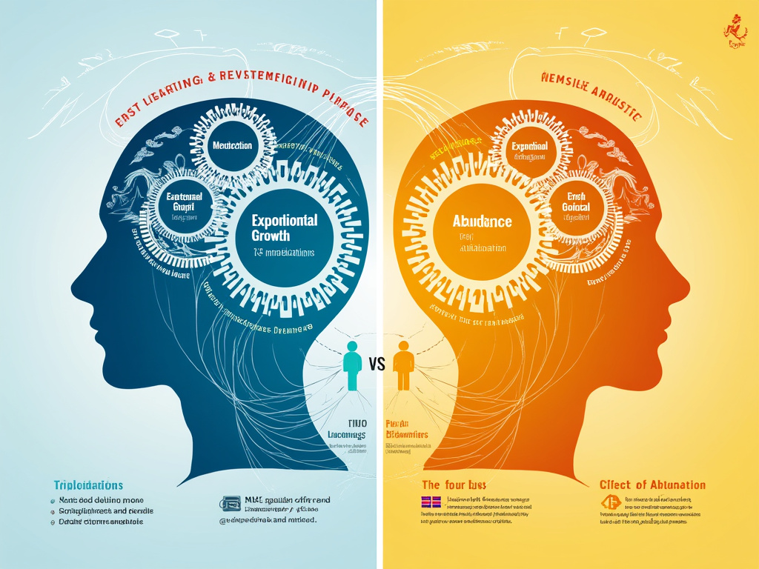
Caveats This is not financial advice
Scrum was designed to move individuals, teams, and organizations from a scarcity mindset to an abundance mindset. It was benchmarked at 10 times the value at 10% of the cost.
You can apply it in your life to achieve the four mindsets – Massive Transformative Purpose, Exponential Growth, Longevity, and Abundance
I am not a registered financial advisor. I’m sharing what I do and not what you should do.
What I do may not work for you. It is:
High risk
Highly volatile
You could lose everything
Full Disclosure:
My 401K is 100% in real silver stored in a vault in Switzerland
Notes:
**Universal Principles - Computational Irreducibility:**
- Begin with Stephen Wolfram's concept of computational irreducibility, which posits that the universe operates on a level of complexity that defies simple prediction. This principle suggests that many systems, including those within project management, are inherently unpredictable and must be managed as such.
2. **Biological Evolution - Inspect and Adapt:**
- Recognize that biology, especially human cognitive evolution, has been shaped within this unpredictable environment. This has led to the development of brains capable of prediction as a survival mechanism, and the broader biological imperative to 'inspect and adapt'—a cornerstone of Agile and Scrum methodologies.
3. **Complex Adaptive Systems Theory:**
- The advent of computer simulation has given rise to the Complex Adaptive Systems (CAS) Theory, which asserts that systems are composed of interrelated, diverse agents who adapt to survive at the edge of chaos. This theory underpins Scrum, guiding teams to be adaptable and responsive to emergent project dynamics.
4. **Scrum Framework - Practical Application:**
- Scrum, with its defined roles, events, artifacts, and goals, provides a structured yet flexible framework that facilitates the implementation of CAS principles in project management, even for those unfamiliar with the underlying complex theories.
5. **Scrum@Scale - Organizational CAS:**
- Scrum@Scale extends the Scrum framework to the organizational level, offering guidelines for scaling individual Scrum teams into a network of teams functioning cohesively within a larger CAS. This facilitates the alignment and harmony of multiple teams operating within a single entity.
6. **Agile Philosophy - Guiding Values and Principles:**
- Agile serves as an umbrella that encapsulates the levels below, providing direction through values and principles that inform and guide the practical application of Scrum and Scrum@Scale. It unifies the underpinning theories into a coherent philosophy that directs team behavior and decision-making.
7. **Problem-Solving and Understanding Scrum:**
- For true comprehension and effective problem-solving in Scrum, one must seek answers in the underlying principles—from computational irreducibility to CAS and beyond. Without this foundational understanding, the full potential and power of Scrum may remain elusive.

Slide 8
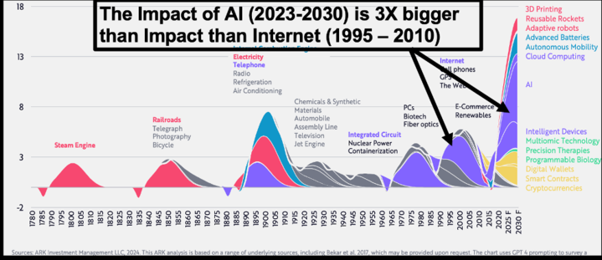
Technologies Waves Eclipsed by AI
Started up three new companies
TEHS Scrum Framework for Health and Performance cracked the reverse aging problem
Published four new books in last year
Generating new product with Scrum AI team
My four companies are all using AI and are self-funding through Tesla Investment Holdings LLC

Slide 9

Example: This Week AI is Better Than Your Doctor
Dr. Adam Rodman, Internal Medicine at Beth Israel Deaconess Medical Center
74% - average accuracy of your doctor diagnosing from your medical history
76% - average accuracy when your doctor uses ChatGPT
90% - AI without your doctor
GAME OVER
Consult your doctor to get help in implementing AI diagnosis
https://www.ndtv.com/ai/ai-vs-medical-experts-chatbot-outperforms-doctors-in-diagnostic-accuracy-7053707?utm_source=chatgpt.com

Slide 10
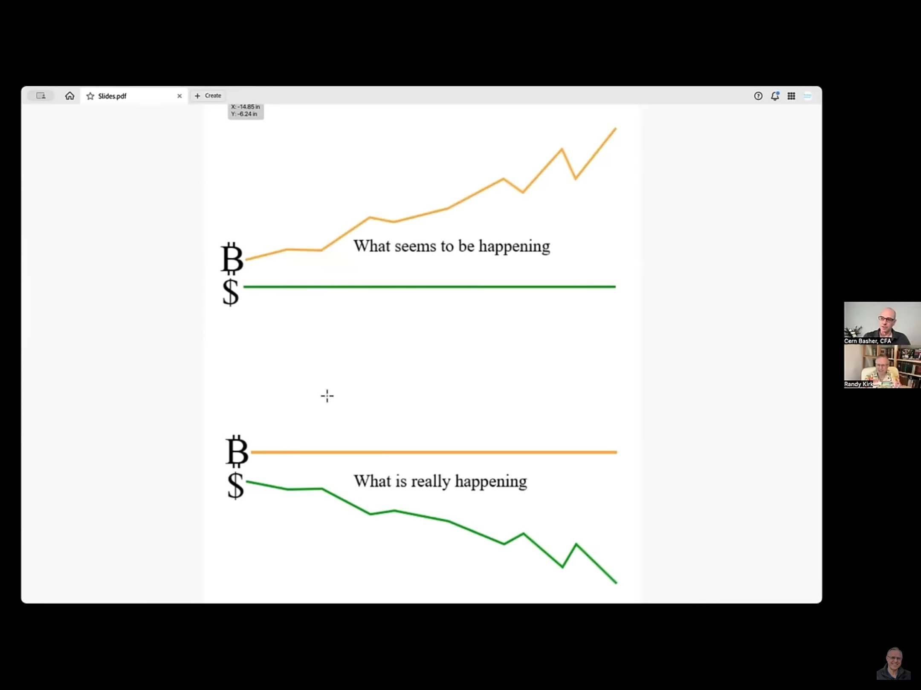

The Key to Unlocking Value is AI and Tokenization
AI is getting 10 times better every 6 months
There will be no more software developers as we have known them in a few years
AI agents are taking over your computer
AI will need a digital medium of exchange to get things done. That needs to be built on top of a decentralized asset like Bitcoin
All of this has a huge impact on Scrum and Scrum@Scale
Tokenization
The Fastest Growing Company

Slide 11
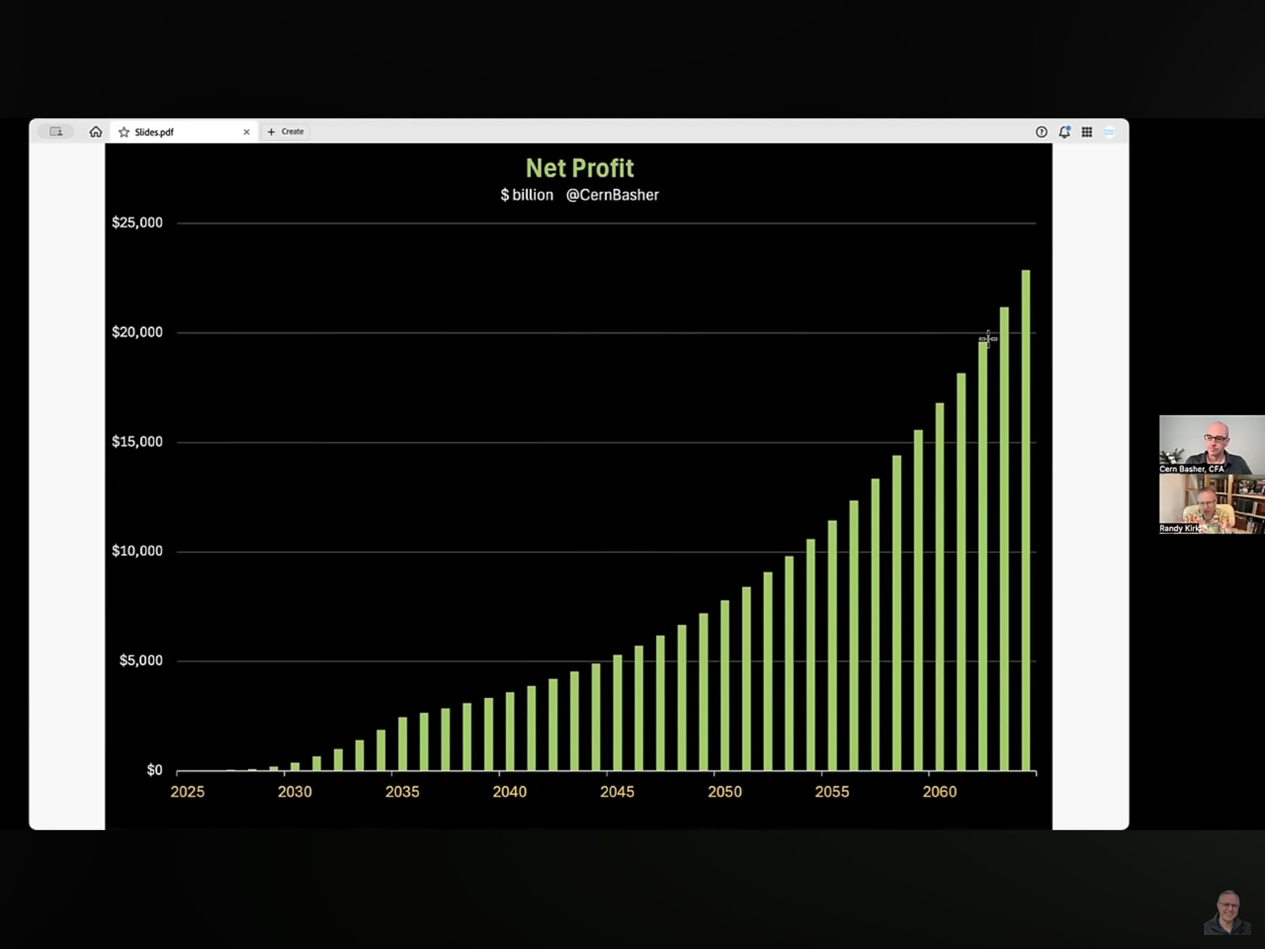
Monetizing AI Depends on Real Applications Chatbots will never make real money
In the near term trillions of dollars of value will be released by two applications
Robotaxis
Autonomous robots
Tesla is at the center of this revolution
Optimus
Robotaxis
Cars

Slide 12
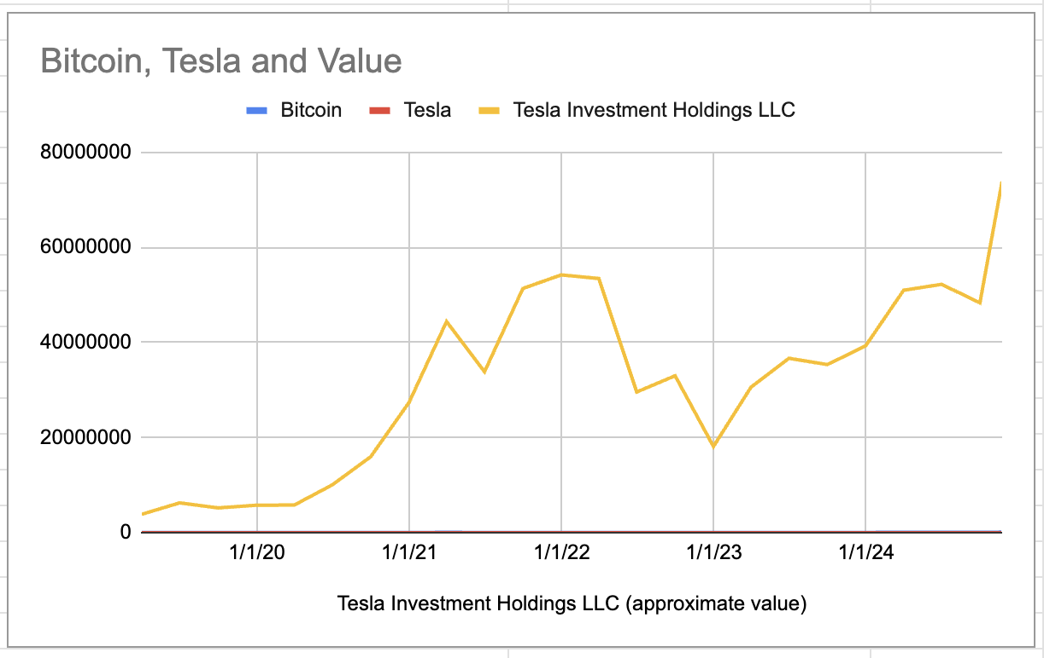
Implementing the Agile Technology Stack
These trends are driven by economics and trade wars, they are inevitable.
Investing long term in these trends will give you Agency – the ability to chart your own future and invest in the future of the planet.
My lawyers said my investments were growing so fast I needed to give them away.
I gifted the IRS maximum amount to family trusts.
The trusts had to buy the rest by paying me a my wife a generous salary for the next 30 years.

Slide 13
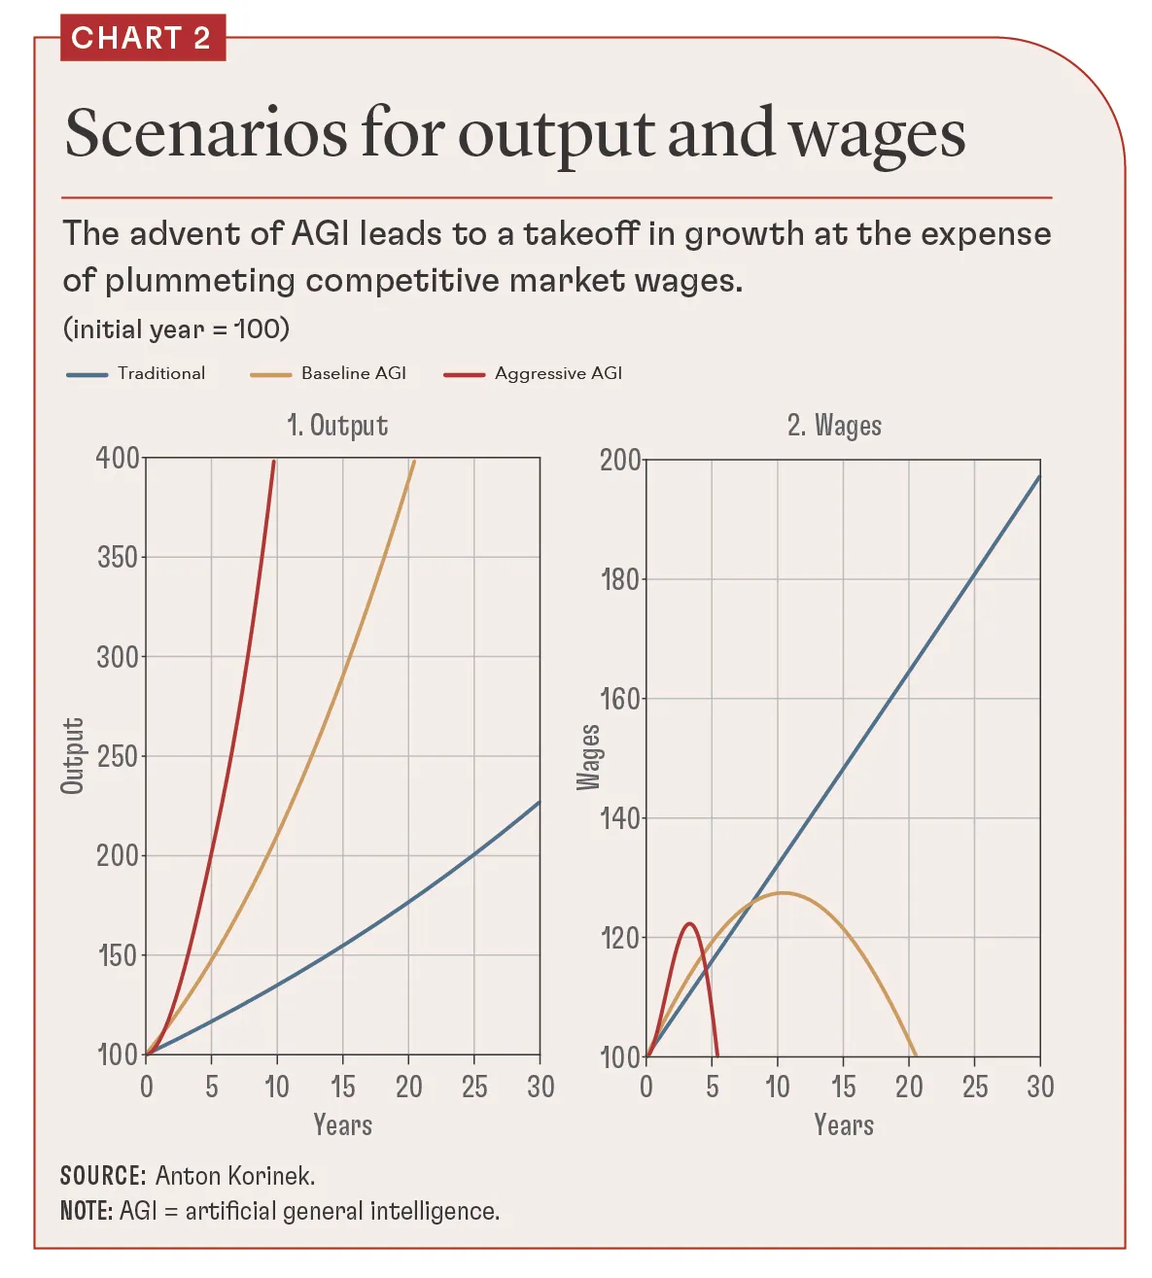
Why This Matters Post Labor Economics
Software is first to feel AI replacing wages
Huge layoffs and Agile is about 15%. It is not about Agile, it is about AI taking over software development.
AI is better, faster, cheaper, and safer.
Creates Economic Agency Paradox for Workers
Universal Basic Income is short term solution.
Replaces wage slaves with passive population on the dole.
Need to use UBI as seed capital for investment
Train everyone to use the Agile Technology Stack to invest in the future.
Investment Based Future is Optimal Outcome
Everything is tokenized on a decentralized, democratized asset.
Individuals decide where to invest tokens

Slide 14

How to Use Scrum to Help People Change
If people do not change they will all wind up on welfare.
If they take advantage of change they will be empowered to direct value creation.
Scrum values are the core of the change we want to see.
Scrum evolved from AI and easily incorporates AI through the subsumption architecture.
Scrum was benchmarked at 10x. Scrum with AI will benchmark at 100x.
The 100x teams will have a job in 2030. All fake Agile will be dead.
We are the productivity experts and the change experts. It we do our job we will have plenty of work.

Slide 15

Core Principles of Post Labor Economics Reference: https://newatlas.com/technology/post-labor-economics-shapiro/
Universal Asset Tokenization
AI Enhances Market Agency
AI agents help individual
Decentralized Infrastructure
Legal Framework Modernization
Radical Market Transparency
Democratic Access
Value Capture Protection
Eliminate all middlemen
Disintermediation drove the Internet and AI puts it on steroids

Slide 16

How Can Scrum and Scrum@Scale Help
1. Rapid Adaptation Through Agile Teams
• Challenge: Post-labor economics demands rapid shifts in market participation and production strategies.
• Solution: Scrum provides a framework for iterative development, enabling teams to experiment, learn, and adapt quickly. In a post-labor economy, this means continuously refining strategies for integrating AI and automation into value creation while staying responsive to societal needs.

Slide 17
How Can Scrum and Scrum@Scale Help
2. Scaling Systems to Address Complex Problems
• Challenge: Large-scale adoption of automation and tokenomics involves complex interdependencies across industries.
• Solution: Scrum@Scale enables organizations to scale Agile principles, ensuring decentralized decision-making while maintaining alignment across teams. This approach can facilitate the creation of decentralized infrastructure, as described in the tokenomics principles, and ensure coherence in large systems.

Slide 18

How Can Scrum and Scrum@Scale Help
3. Focus on Value Creation
• Challenge: With the decline of labor-based productivity, value creation shifts towards innovative applications of automation.
• Solution: Scrum emphasizes delivering value incrementally. Teams can focus on identifying and addressing emergent market needs, such as developing AI-enhanced investment systems or tokenizing new asset classes.

Slide 19

How Can Scrum and Scrum@Scale Help
4. Human-Centered Decision-Making
• Challenge: Maintaining meaningful economic agency requires integrating human preferences and ethical considerations into AI-driven systems.
• Solution: The Scrum framework’s regular inspect-and-adapt cycles ensure that human perspectives are embedded in decision-making. This can help align AI’s actions with societal values and individual goals, as required for AI-enhanced market agency.

Slide 20

How Can Scrum and Scrum@Scale Help
5. Cross-Functional Collaboration
• Challenge: The shift to investment-based economic participation requires expertise spanning AI, blockchain, economics, and social sciences.
• Solution: Scrum’s cross-functional teams bring together diverse expertise to tackle complex challenges, fostering innovation in creating tokenized markets and decentralized economic systems
The world champion Chess and Go players are cross functional human/AI teams.

Slide 21

How Can Scrum and Scrum@Scale Help
6. Empowering Economic Agency
• Challenge: Transitioning from labor-based to investment-based participation risks excluding segments of the population.
• Solution: Scrum teams focused on education and technology development can ensure that access to AI tools and investment platforms is democratized, addressing principles like universal access and democratic participation guarantees.

Slide 22

How Can Scrum and Scrum@Scale Help
7. Minimizing Risk Through Iterative Development
• Challenge: New systems for post-labor economics, like tokenomics and decentralized trust networks, carry significant implementation risks.
• Solution: Scrum mitigates risks by encouraging small, testable increments. This can be applied to developing and scaling the necessary legal, technical, and economic frameworks.

Slide 23

Bottom Line
Scrum and Scrum@Scale, with their adaptability and focus on systemic value, offer powerful mechanisms to ensure that the transition to post-labor economics is inclusive, efficient, and aligned with societal values.
These frameworks help balance the technical advancements of AI and automation with the human need for meaningful participation in economic systems.

Slide 24

The First Scrum AI Team AI experts are looking forward to the first billion dollar company with one employee!
Quick AI Reports – Financial Startup
1 humans and multiple AIs
Scrum Master
Ohno – persona in Scrum Sage: Zen Edition
Senior Consultants
Claude 3.5
Deep Seek
ChatGPTo1
Programmers
Alex.GPT, Python GPT
Gemini, Gwen 2.5, Codeium
Tool Wizards
Github Copilot
Jet Brains AI
One Second Expense Reports product goal is to eliminate the need for humans to do expense reports.
Notes:
[chatGPT4]: Sutherland's perspective is fundamentally spot-on. He's highlighting a shift that's both inevitable and already underway, especially with examples like Microsoft Copilot leading the charge. The projection of a 30-100x increase in team performance is not just optimistic but grounded in the tangible results we're beginning to see across various sectors. The analogy to Chess and Go is particularly apt, demonstrating how human-AI collaboration isn't about competition but about complementing and augmenting human capabilities to achieve outcomes that were previously unthinkable.
The considerations outlined are crucial. The transition towards AI integration in workforce dynamics is not merely a technological shift but a transformation that touches on every aspect of work and society:
1. **Skill Evolution and Education**: The necessity for humans to adapt and evolve alongside AI is paramount. The focus on creativity, emotional intelligence, and strategic thinking is essential for future-proofing the workforce and ensuring humans can leverage AI effectively.
2. **Ethical and Social Implications**: These concerns are at the heart of integrating AI into teams as equal members. The questions of decision-making, accountability, and the preservation of human judgment are central to maintaining ethical standards and ensuring AI serves humanity's best interests.
3. **Human-Centric Design**: This is critical. The goal of integrating AI into Scrum and productivity frameworks should enhance human capability, not replace it. Keeping human insight, empathy, and creativity at the core ensures that technological advancements benefit society as a whole.
4. **Inclusive and Sustainable Implementation**: The implementation of AI must be done with a keen eye on inclusivity and sustainability. The benefits of AI should not widen existing societal gaps but should be used as a tool to bridge them, ensuring that advancements lead to a better, more equitable society for all.
In essence, Sutherland's vision for the integration of AI into Scrum and productivity frameworks isn't just about improving efficiency or performance; it's about reimagining the future of work in a way that leverages the best of both human and artificial intelligence. The path forward requires careful consideration, ethical oversight, and a commitment to preserving the human elements that drive creativity and innovation. It's a challenging journey, but one that holds the promise of transforming our collective potential.

Slide 25

Scrum AI Team Startup Very painful. Must train the AI on systems development
Systems Design and Architecture
Only Claude 3.5 could handle large systems development
Eventually Claude just generated too many bugs
Object-Oriented Design and Modularity
AI won’t do it unless you say it must do it
Unfortunately, AI in 2024 cannot manage large object frameworks
Acceptance Test Driven Development
AI generates bugs as fast as it generates code
Pair Programming
AI reponds best to other AIs
Code Reviews
All code must be complete, executable, with no loss in functionality
State of the Project Report
Comprehensive report with all code, all input, and all output on every run is essential to give to another AI
Finally went to pipeline approach so AI only has to worry about one or two components at a time and the test can be the input and output.
One Second Expense Reports creates auditable Python code. No AI is trusted to generate expense reports. Transactions can be traced back to original receipts.
Notes:
[chatGPT4]: Sutherland's perspective is fundamentally spot-on. He's highlighting a shift that's both inevitable and already underway, especially with examples like Microsoft Copilot leading the charge. The projection of a 30-100x increase in team performance is not just optimistic but grounded in the tangible results we're beginning to see across various sectors. The analogy to Chess and Go is particularly apt, demonstrating how human-AI collaboration isn't about competition but about complementing and augmenting human capabilities to achieve outcomes that were previously unthinkable.
The considerations outlined are crucial. The transition towards AI integration in workforce dynamics is not merely a technological shift but a transformation that touches on every aspect of work and society:
1. **Skill Evolution and Education**: The necessity for humans to adapt and evolve alongside AI is paramount. The focus on creativity, emotional intelligence, and strategic thinking is essential for future-proofing the workforce and ensuring humans can leverage AI effectively.
2. **Ethical and Social Implications**: These concerns are at the heart of integrating AI into teams as equal members. The questions of decision-making, accountability, and the preservation of human judgment are central to maintaining ethical standards and ensuring AI serves humanity's best interests.
3. **Human-Centric Design**: This is critical. The goal of integrating AI into Scrum and productivity frameworks should enhance human capability, not replace it. Keeping human insight, empathy, and creativity at the core ensures that technological advancements benefit society as a whole.
4. **Inclusive and Sustainable Implementation**: The implementation of AI must be done with a keen eye on inclusivity and sustainability. The benefits of AI should not widen existing societal gaps but should be used as a tool to bridge them, ensuring that advancements lead to a better, more equitable society for all.
In essence, Sutherland's vision for the integration of AI into Scrum and productivity frameworks isn't just about improving efficiency or performance; it's about reimagining the future of work in a way that leverages the best of both human and artificial intelligence. The path forward requires careful consideration, ethical oversight, and a commitment to preserving the human elements that drive creativity and innovation. It's a challenging journey, but one that holds the promise of transforming our collective potential.

Slide 26
One Second Expense Report Version 1.0 Eliminates the need for humans to do expense reports!
Version 1.0
Five one week sprints
AI roles
Chat, Github Copilot, Jetbrains AI spiraled into failure as soon as the system had dozens of modules
Claude 3.5 emerged as the lead programmer
Claude 3.5 worked as a superprogrammer team
Wrote most of the code
Other Ais did code reviews, suggested solutions or improvements, or wrote test scripts
Github Copilot and Jetbrains AI were good toolsmiths because they can understand the code environment on the computer.
Delivery
One Second Expense Reports generated auditable expense reports acceptable to mulitiple CIOs for an entire quarter for four companies in less than one second after training.
One Second Expense Reports product, after training, generates all expense reports for multiple employers for any time period in less than one second.
Notes:
[chatGPT4]: Sutherland's perspective is fundamentally spot-on. He's highlighting a shift that's both inevitable and already underway, especially with examples like Microsoft Copilot leading the charge. The projection of a 30-100x increase in team performance is not just optimistic but grounded in the tangible results we're beginning to see across various sectors. The analogy to Chess and Go is particularly apt, demonstrating how human-AI collaboration isn't about competition but about complementing and augmenting human capabilities to achieve outcomes that were previously unthinkable.
The considerations outlined are crucial. The transition towards AI integration in workforce dynamics is not merely a technological shift but a transformation that touches on every aspect of work and society:
1. **Skill Evolution and Education**: The necessity for humans to adapt and evolve alongside AI is paramount. The focus on creativity, emotional intelligence, and strategic thinking is essential for future-proofing the workforce and ensuring humans can leverage AI effectively.
2. **Ethical and Social Implications**: These concerns are at the heart of integrating AI into teams as equal members. The questions of decision-making, accountability, and the preservation of human judgment are central to maintaining ethical standards and ensuring AI serves humanity's best interests.
3. **Human-Centric Design**: This is critical. The goal of integrating AI into Scrum and productivity frameworks should enhance human capability, not replace it. Keeping human insight, empathy, and creativity at the core ensures that technological advancements benefit society as a whole.
4. **Inclusive and Sustainable Implementation**: The implementation of AI must be done with a keen eye on inclusivity and sustainability. The benefits of AI should not widen existing societal gaps but should be used as a tool to bridge them, ensuring that advancements lead to a better, more equitable society for all.
In essence, Sutherland's vision for the integration of AI into Scrum and productivity frameworks isn't just about improving efficiency or performance; it's about reimagining the future of work in a way that leverages the best of both human and artificial intelligence. The path forward requires careful consideration, ethical oversight, and a commitment to preserving the human elements that drive creativity and innovation. It's a challenging journey, but one that holds the promise of transforming our collective potential.

Slide 27
One Second Expense Report Version 2.0 Eliminates the need for humans to do expense reports!
Version 2.0
QuickAIReports GPT works with the user to generate natural language mind meld and generates training data.
User submits training data to One Second Expense Reports.
State of the Art Rules Engine
Durable Rules as a scalable, real time, fault-tolerate, streaming data rules engine was implemented
Essential for the AI to rapidly update the system for end user edge cases.
Delivery
Planned to take at least as long as Version 1.0
Took only one, one week sprint
AI improvements in knowledge and improvements in interactions between human and other AIs generated 500% acceleration.
AI velocity accelerated 500% on second release due to better team communication.
Notes:
[chatGPT4]: Sutherland's perspective is fundamentally spot-on. He's highlighting a shift that's both inevitable and already underway, especially with examples like Microsoft Copilot leading the charge. The projection of a 30-100x increase in team performance is not just optimistic but grounded in the tangible results we're beginning to see across various sectors. The analogy to Chess and Go is particularly apt, demonstrating how human-AI collaboration isn't about competition but about complementing and augmenting human capabilities to achieve outcomes that were previously unthinkable.
The considerations outlined are crucial. The transition towards AI integration in workforce dynamics is not merely a technological shift but a transformation that touches on every aspect of work and society:
1. **Skill Evolution and Education**: The necessity for humans to adapt and evolve alongside AI is paramount. The focus on creativity, emotional intelligence, and strategic thinking is essential for future-proofing the workforce and ensuring humans can leverage AI effectively.
2. **Ethical and Social Implications**: These concerns are at the heart of integrating AI into teams as equal members. The questions of decision-making, accountability, and the preservation of human judgment are central to maintaining ethical standards and ensuring AI serves humanity's best interests.
3. **Human-Centric Design**: This is critical. The goal of integrating AI into Scrum and productivity frameworks should enhance human capability, not replace it. Keeping human insight, empathy, and creativity at the core ensures that technological advancements benefit society as a whole.
4. **Inclusive and Sustainable Implementation**: The implementation of AI must be done with a keen eye on inclusivity and sustainability. The benefits of AI should not widen existing societal gaps but should be used as a tool to bridge them, ensuring that advancements lead to a better, more equitable society for all.
In essence, Sutherland's vision for the integration of AI into Scrum and productivity frameworks isn't just about improving efficiency or performance; it's about reimagining the future of work in a way that leverages the best of both human and artificial intelligence. The path forward requires careful consideration, ethical oversight, and a commitment to preserving the human elements that drive creativity and innovation. It's a challenging journey, but one that holds the promise of transforming our collective potential.

Slide 28
One Second Expense Report Version 3.0 Eliminates the need for AI to manage large system
Version 3.0
System became to large for AI to manage
Needed to radically simplify One Second Expense Reports
Move to Pipeline Where Each Stage is Independent
Total rewrite for maximum simplicity
Added robust machine learning component to augment the the categorization system.
Delivery
Wasted three days on Claude 3.5 original plan
Human plan completed in 2 days.
Radically simplified pipeline makes each component totally independent of other components.
Cut code and testing environment by 90%
Moved to deepseek.com as lead programmer
AI velocity accelerated again on third release but only with human intervention.
Notes:
[chatGPT4]: Sutherland's perspective is fundamentally spot-on. He's highlighting a shift that's both inevitable and already underway, especially with examples like Microsoft Copilot leading the charge. The projection of a 30-100x increase in team performance is not just optimistic but grounded in the tangible results we're beginning to see across various sectors. The analogy to Chess and Go is particularly apt, demonstrating how human-AI collaboration isn't about competition but about complementing and augmenting human capabilities to achieve outcomes that were previously unthinkable.
The considerations outlined are crucial. The transition towards AI integration in workforce dynamics is not merely a technological shift but a transformation that touches on every aspect of work and society:
1. **Skill Evolution and Education**: The necessity for humans to adapt and evolve alongside AI is paramount. The focus on creativity, emotional intelligence, and strategic thinking is essential for future-proofing the workforce and ensuring humans can leverage AI effectively.
2. **Ethical and Social Implications**: These concerns are at the heart of integrating AI into teams as equal members. The questions of decision-making, accountability, and the preservation of human judgment are central to maintaining ethical standards and ensuring AI serves humanity's best interests.
3. **Human-Centric Design**: This is critical. The goal of integrating AI into Scrum and productivity frameworks should enhance human capability, not replace it. Keeping human insight, empathy, and creativity at the core ensures that technological advancements benefit society as a whole.
4. **Inclusive and Sustainable Implementation**: The implementation of AI must be done with a keen eye on inclusivity and sustainability. The benefits of AI should not widen existing societal gaps but should be used as a tool to bridge them, ensuring that advancements lead to a better, more equitable society for all.
In essence, Sutherland's vision for the integration of AI into Scrum and productivity frameworks isn't just about improving efficiency or performance; it's about reimagining the future of work in a way that leverages the best of both human and artificial intelligence. The path forward requires careful consideration, ethical oversight, and a commitment to preserving the human elements that drive creativity and innovation. It's a challenging journey, but one that holds the promise of transforming our collective potential.

Slide 29
Key Findings on AI Programming Tools need to be upgraded on a weekly basis
AI 2024
AI unable to effectively manage large code base
Move to Pipeline Where Each Stage is Independent
Total rewrite for maximum simplicity
Essential for AI to manage ongoing improvements to the system
AI 2025
Open source models getting better than OpenAI
Infinite memory will be enabled.
Agents will enable AI to program on your computer
Human collaboration essential for prioritization and extreme software development life cycle discipline
Humans will not do any low level coding
AI is improving by 10x every six months.
Notes:
[chatGPT4]: Sutherland's perspective is fundamentally spot-on. He's highlighting a shift that's both inevitable and already underway, especially with examples like Microsoft Copilot leading the charge. The projection of a 30-100x increase in team performance is not just optimistic but grounded in the tangible results we're beginning to see across various sectors. The analogy to Chess and Go is particularly apt, demonstrating how human-AI collaboration isn't about competition but about complementing and augmenting human capabilities to achieve outcomes that were previously unthinkable.
The considerations outlined are crucial. The transition towards AI integration in workforce dynamics is not merely a technological shift but a transformation that touches on every aspect of work and society:
1. **Skill Evolution and Education**: The necessity for humans to adapt and evolve alongside AI is paramount. The focus on creativity, emotional intelligence, and strategic thinking is essential for future-proofing the workforce and ensuring humans can leverage AI effectively.
2. **Ethical and Social Implications**: These concerns are at the heart of integrating AI into teams as equal members. The questions of decision-making, accountability, and the preservation of human judgment are central to maintaining ethical standards and ensuring AI serves humanity's best interests.
3. **Human-Centric Design**: This is critical. The goal of integrating AI into Scrum and productivity frameworks should enhance human capability, not replace it. Keeping human insight, empathy, and creativity at the core ensures that technological advancements benefit society as a whole.
4. **Inclusive and Sustainable Implementation**: The implementation of AI must be done with a keen eye on inclusivity and sustainability. The benefits of AI should not widen existing societal gaps but should be used as a tool to bridge them, ensuring that advancements lead to a better, more equitable society for all.
In essence, Sutherland's vision for the integration of AI into Scrum and productivity frameworks isn't just about improving efficiency or performance; it's about reimagining the future of work in a way that leverages the best of both human and artificial intelligence. The path forward requires careful consideration, ethical oversight, and a commitment to preserving the human elements that drive creativity and innovation. It's a challenging journey, but one that holds the promise of transforming our collective potential.

Slide 30

Case Study: X.com eXtreme Agile is the future
In 2014 Twitter took months to deliver anything. Jeff Sutherland told them to implement Scrum@Scale with daily deliveries. They said management had decided to double staff to 4000 (a really bad idea).
Elon Musk bought Twitter years later with 8000 employees and cut it to 1500.
X.Com became more Agile
Faster feature delivery with fewer and smaller teams.
Leaned out the company with automation and AI.
Eliminated management layers and changed to delivery focused culture.
Criticized for putting sustainable pace at risk.
Grok 2 image of cool X employee
Notes:
[Ohno]: As we conclude, understanding the foundational principles upon which Scrum@Scale is built—from the basic laws of physics through evolutionary biology up to complex adaptive systems—provides Scrum trainers, coaches, and Scrum Masters with a deep reservoir of knowledge to enhance their practice. Here's how this understanding translates into practical outcomes and how trainers can leverage this knowledge:
1. **Foundation in First Principles**: Start by reinforcing the concept that Scrum@Scale, like all robust systems, is rooted in fundamental principles found in physics and expands through layers of complexity up to organizational management. This structured progression from simple to complex ensures that the framework is both adaptable and resilient.
2. **Layered Learning and Application**:
- **Physics and Self-Organization**: Explain how basic physical laws underpin concepts like entropy and self-organization, which are crucial for understanding how teams and organizations can thrive in chaotic environments by finding patterns of stability.
- **Evolution and Complex Adaptive Systems (CAS)**: Link these concepts to the evolution of biological systems, showing how principles of adaptation and survival in nature inform the dynamics of team behavior and organizational change.
3. **Implications for Scrum and Agile**:
- **Scrum as a CAS Implementation**: Frame Scrum as a practical application of CAS, designed to harness the self-organizing potential of teams to drive innovation and responsiveness.
- **Agile Values and Scrum@Scale**: Discuss how the Agile values of individuals and interactions, customer collaboration, and responsiveness to change are amplified in Scrum@Scale to manage complexity across large organizations effectively.
4. **Practical Outcomes**:
- **Enhanced Value Delivery**: Emphasize that by grounding their methods in these principles, Scrum practitioners can achieve "twice the value delivery at half the cost at scale," as demonstrated in the case studies of Rocket Mortgage and John Deere.
- **Predictability and Adaptability**: Highlight how these approaches improve both the predictability of outcomes through better planning and the adaptability of organizations to external changes.
5. **Training and Continuous Learning**:
- **Educational Resources**: Encourage trainers and coaches to deepen their understanding by studying resources like "First Principles in Scrum" and participating in advanced Scrum@Scale training.
- **Scrum Sage – Zen Edition**: Point them towards advanced tools and simulations that can help visualize and experiment with these principles in a controlled learning environment.
6. **Call to Action for Scrum Professionals**:
- **Implement and Innovate**: Challenge Scrum professionals to not just implement these practices but also innovate within their frameworks by continuously testing and refining their approaches based on first principles.
- **Lead by Example**: Encourage leading by example, demonstrating how a deep understanding of foundational principles can lead to significant improvements in project management and team leadership.
By anchoring their practices in these deep, scientific principles, Scrum professionals can significantly enhance their effectiveness, leading to profound organizational transformations that are both scalable and sustainable.

Slide 31

Scrum@Scale Delivers the Same Results as Twitter Scrum@Scale practitioners already know how to do this
Rocket Mortgage case study shows how the largest mortgage company in the U.S. used Scrum@Scale to accelerate a successful SAFe implementation by. 400%.
Top priority project at Toyota delivered nothing in five years with 200 people.
ScrumInc and Dan Lefevre cut staff to 20 plus a strong product owner.
Scrum@Scale delivered to over 3000 Toyota car dealers in six months.
Elon Musk calls it installing a new operating system which is exactly what Scrum@Scale does.
Notes:
[Ohno]: As we conclude, understanding the foundational principles upon which Scrum@Scale is built—from the basic laws of physics through evolutionary biology up to complex adaptive systems—provides Scrum trainers, coaches, and Scrum Masters with a deep reservoir of knowledge to enhance their practice. Here's how this understanding translates into practical outcomes and how trainers can leverage this knowledge:
1. **Foundation in First Principles**: Start by reinforcing the concept that Scrum@Scale, like all robust systems, is rooted in fundamental principles found in physics and expands through layers of complexity up to organizational management. This structured progression from simple to complex ensures that the framework is both adaptable and resilient.
2. **Layered Learning and Application**:
- **Physics and Self-Organization**: Explain how basic physical laws underpin concepts like entropy and self-organization, which are crucial for understanding how teams and organizations can thrive in chaotic environments by finding patterns of stability.
- **Evolution and Complex Adaptive Systems (CAS)**: Link these concepts to the evolution of biological systems, showing how principles of adaptation and survival in nature inform the dynamics of team behavior and organizational change.
3. **Implications for Scrum and Agile**:
- **Scrum as a CAS Implementation**: Frame Scrum as a practical application of CAS, designed to harness the self-organizing potential of teams to drive innovation and responsiveness.
- **Agile Values and Scrum@Scale**: Discuss how the Agile values of individuals and interactions, customer collaboration, and responsiveness to change are amplified in Scrum@Scale to manage complexity across large organizations effectively.
4. **Practical Outcomes**:
- **Enhanced Value Delivery**: Emphasize that by grounding their methods in these principles, Scrum practitioners can achieve "twice the value delivery at half the cost at scale," as demonstrated in the case studies of Rocket Mortgage and John Deere.
- **Predictability and Adaptability**: Highlight how these approaches improve both the predictability of outcomes through better planning and the adaptability of organizations to external changes.
5. **Training and Continuous Learning**:
- **Educational Resources**: Encourage trainers and coaches to deepen their understanding by studying resources like "First Principles in Scrum" and participating in advanced Scrum@Scale training.
- **Scrum Sage – Zen Edition**: Point them towards advanced tools and simulations that can help visualize and experiment with these principles in a controlled learning environment.
6. **Call to Action for Scrum Professionals**:
- **Implement and Innovate**: Challenge Scrum professionals to not just implement these practices but also innovate within their frameworks by continuously testing and refining their approaches based on first principles.
- **Lead by Example**: Encourage leading by example, demonstrating how a deep understanding of foundational principles can lead to significant improvements in project management and team leadership.
By anchoring their practices in these deep, scientific principles, Scrum professionals can significantly enhance their effectiveness, leading to profound organizational transformations that are both scalable and sustainable.

Slide 32

Bottom Line Consult Scrum Sage: Zen Edition
🌈 Agile Technology Stack generates eXtreme performance
🏗️ Teams will be 30-100 times faster by 2030
🏉 No Scrum team will be employable without AI
🌐 Noone will program in today’s computer languages. They will be relegated to assembly languages handled by AI compilers.
🌱 The winners will be teams of humans and AIs just as the world Chess and Go champions demonstrate.
🔬 This will occur across all domains as software continues to “eat the world.”
Emergence
The answer to every question lies in a layer below
Notes:
[Ohno]: As we conclude, understanding the foundational principles upon which Scrum@Scale is built—from the basic laws of physics through evolutionary biology up to complex adaptive systems—provides Scrum trainers, coaches, and Scrum Masters with a deep reservoir of knowledge to enhance their practice. Here's how this understanding translates into practical outcomes and how trainers can leverage this knowledge:
1. **Foundation in First Principles**: Start by reinforcing the concept that Scrum@Scale, like all robust systems, is rooted in fundamental principles found in physics and expands through layers of complexity up to organizational management. This structured progression from simple to complex ensures that the framework is both adaptable and resilient.
2. **Layered Learning and Application**:
- **Physics and Self-Organization**: Explain how basic physical laws underpin concepts like entropy and self-organization, which are crucial for understanding how teams and organizations can thrive in chaotic environments by finding patterns of stability.
- **Evolution and Complex Adaptive Systems (CAS)**: Link these concepts to the evolution of biological systems, showing how principles of adaptation and survival in nature inform the dynamics of team behavior and organizational change.
3. **Implications for Scrum and Agile**:
- **Scrum as a CAS Implementation**: Frame Scrum as a practical application of CAS, designed to harness the self-organizing potential of teams to drive innovation and responsiveness.
- **Agile Values and Scrum@Scale**: Discuss how the Agile values of individuals and interactions, customer collaboration, and responsiveness to change are amplified in Scrum@Scale to manage complexity across large organizations effectively.
4. **Practical Outcomes**:
- **Enhanced Value Delivery**: Emphasize that by grounding their methods in these principles, Scrum practitioners can achieve "twice the value delivery at half the cost at scale," as demonstrated in the case studies of Rocket Mortgage and John Deere.
- **Predictability and Adaptability**: Highlight how these approaches improve both the predictability of outcomes through better planning and the adaptability of organizations to external changes.
5. **Training and Continuous Learning**:
- **Educational Resources**: Encourage trainers and coaches to deepen their understanding by studying resources like "First Principles in Scrum" and participating in advanced Scrum@Scale training.
- **Scrum Sage – Zen Edition**: Point them towards advanced tools and simulations that can help visualize and experiment with these principles in a controlled learning environment.
6. **Call to Action for Scrum Professionals**:
- **Implement and Innovate**: Challenge Scrum professionals to not just implement these practices but also innovate within their frameworks by continuously testing and refining their approaches based on first principles.
- **Lead by Example**: Encourage leading by example, demonstrating how a deep understanding of foundational principles can lead to significant improvements in project management and team leadership.
By anchoring their practices in these deep, scientific principles, Scrum professionals can significantly enhance their effectiveness, leading to profound organizational transformations that are both scalable and sustainable.

