Slide 1
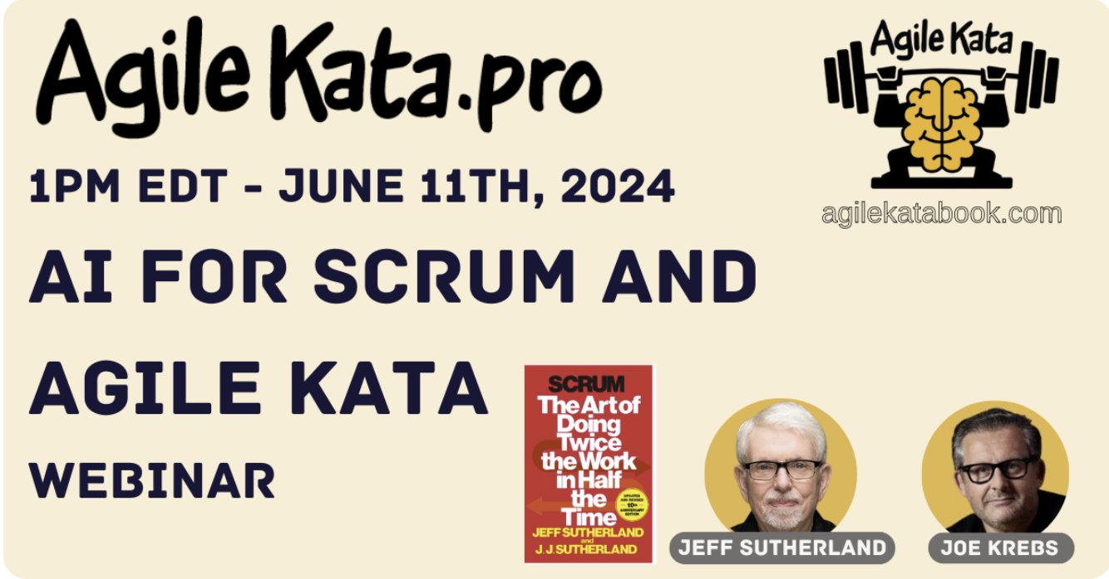




Brought to you by

Slide 2

First Principles in Scrum leanpub.com/firstprinciplesinscrum
Incorporates answers to thousands of Agile, Scrum, and Scrum@Scale questions
Based on my training as a Professor of Radiology at University of Colorado Medical School
Venture funded by Tesla Investment Holdings LLC
As Managing Partner, we regularly review First Principles used by Elon Musk to create Tesla, the world’s most Agile company.
Enabled by the TEHS Scrum Framework for Health and Performance (Twice the Energy with Half the Stress).
Second
Edition
Notes:
**Comprehensive Inquiry and Response:** The book "First Principles in Scrum" is an embodiment of extensive research, encompassing answers to thousands of questions on Agile, Scrum, and Scrum@Scale. It distills the collective wisdom derived from a vast array of queries, challenges, and discussions within these fields, offering readers an unparalleled depth of knowledge.
- **Academic Rigor:** My training as a Professor of Radiology at the University of Colorado Medical School has instilled in me a rigorous academic approach to research and knowledge dissemination. This rigorous approach has been instrumental in ensuring the book's content is both scientifically grounded and practically applicable.
- **Venture-Backed Insights:** The research and development of the book were funded by Tesla Investment Holdings LLC, allowing for the exploration of Scrum principles with the backing of a company known for innovation and cutting-edge technology.
- **First Principles Methodology:** As the Managing Partner, I’ve had the opportunity to closely review and adopt the First Principles thinking used by Elon Musk in creating Tesla, recognized as the world’s most agile company. This method involves breaking down complex problems to their fundamental parts and rebuilding solutions from the ground up, leading to innovative and often non-traditional problem-solving approaches.
- **TEHS Scrum Framework:** The book introduces the TEHS (Twice the Energy with Half the Stress) Scrum Framework for Health and Performance. This is based on biophysical principles, integrating the knowledge from the fields of health sciences and the efficiency-driven practices of Scrum to propose a model that aims to double productivity while reducing stress.
- **Practical Application:** The insights and strategies provided in the book are not just theoretical but are designed to be actionable, enabling leaders and teams to implement Scrum methodologies that enhance performance, promote well-being, and foster a sustainable, high-energy work environment.
---
These notes should help you to explain the slide's content in your class, providing a concise yet comprehensive backdrop to the origins and philosophies underpinning "First Principles in Scrum".

Slide 3
Working From First Principles Responding to Change is the Way the Universe Works
🏉 Scrum Emerges as Framework for CAS
💪 Empowerment
🤝 Self-management
🛡️ Leader who serves
🌱 Sustainable pace
🏗️ Scrum@Scale: Emerges to Conquer Complexity
⚙️ Integrated Teams
🔎 Enhanced Visibility
♻️ Expanded Feedback Loops
🧭 Autonomous Decision Making
✋ Collaborative Leadership
🌈 Four Agile Values Emerge as Guideposts
💥 Unleash personal power: Build great teams
🔄 Rapid iteration: Faster, better, cheaper products
🤝 Make the customer & AI part of the team
🌪️ Universe is unpredictable: Adapt or perish
🌀 Wolfram's Physics Project
🎲 Computational irreducibility
🤯 Entropy, Self-Organization, and Patterns
🔬 Physics
🚀 Force = ma
🛠️ Work = Force x Distance
⏱️ Power = Work/Time
🌌 Relativity & Quantum Physics: They just show up!
🌱 Evolution is Inspect and Adapt
🎯 Next Best Step
🧠 Friston's Free Energy Model of Brain
🌐 Complex Adaptive Systems Emerge (CAS)
🤖 Autonomous agents: Racing at the edge of chaos 🌀
Notes:
**Universal Principles - Computational Irreducibility:**
- Begin with Stephen Wolfram's concept of computational irreducibility, which posits that the universe operates on a level of complexity that defies simple prediction. This principle suggests that many systems, including those within project management, are inherently unpredictable and must be managed as such.
2. **Biological Evolution - Inspect and Adapt:**
- Recognize that biology, especially human cognitive evolution, has been shaped within this unpredictable environment. This has led to the development of brains capable of prediction as a survival mechanism, and the broader biological imperative to 'inspect and adapt'—a cornerstone of Agile and Scrum methodologies.
3. **Complex Adaptive Systems Theory:**
- The advent of computer simulation has given rise to the Complex Adaptive Systems (CAS) Theory, which asserts that systems are composed of interrelated, diverse agents who adapt to survive at the edge of chaos. This theory underpins Scrum, guiding teams to be adaptable and responsive to emergent project dynamics.
4. **Scrum Framework - Practical Application:**
- Scrum, with its defined roles, events, artifacts, and goals, provides a structured yet flexible framework that facilitates the implementation of CAS principles in project management, even for those unfamiliar with the underlying complex theories.
5. **Scrum@Scale - Organizational CAS:**
- Scrum@Scale extends the Scrum framework to the organizational level, offering guidelines for scaling individual Scrum teams into a network of teams functioning cohesively within a larger CAS. This facilitates the alignment and harmony of multiple teams operating within a single entity.
6. **Agile Philosophy - Guiding Values and Principles:**
- Agile serves as an umbrella that encapsulates the levels below, providing direction through values and principles that inform and guide the practical application of Scrum and Scrum@Scale. It unifies the underpinning theories into a coherent philosophy that directs team behavior and decision-making.
7. **Problem-Solving and Understanding Scrum:**
- For true comprehension and effective problem-solving in Scrum, one must seek answers in the underlying principles—from computational irreducibility to CAS and beyond. Without this foundational understanding, the full potential and power of Scrum may remain elusive.

Slide 4


Wolfram’s Physics Project The most important advancement in physics in recent decades
🌀 Wolfram's Physics Project
🎲 Computational irreducibility
🤯 Entropy, Self-Organization, and Patterns
Wolfram simulated the universe
The ruliad - simple rules operating on nodes in space generate complex phenomena
Time is measured as the change in connections between the nodes in space
Predicting outcomes of a simulation requires infinite computing power
Computational irreducibility is the bedrock of Agile
Capturing the synergy of Entropy, Self-Organization, and Patterns is the goal of Scrum, which is a pattern language for hyperproductive teams.
Notes:
Agile Foundations in Physics: Embracing Entropy and Irreducibility
The Universe as an Agile Framework
Wolfram's Model: The universe operates on a simple set of rules, a "ruliad," demonstrating that complex systems can arise from simple interactions.
Agile Insight: Just like the universe, Agile projects are complex systems made of simple, iterative processes.
The Nature of Time and Change
Dynamic Connectivity: Time reflects changes in the connectivity of the universe's nodes.
Agile Parallel: In Agile, time is marked by the evolution of the project's components and their interrelations, not by a linear clock.
Predictability and Power
Infinite Complexity: True prediction of outcomes in Wolfram's universe would require infinite computing power.
Agile Acceptance: Acknowledging computational irreducibility aligns with the Agile principle that we can't foresee every outcome of a project.
The Foundations of Agile
Irreducibility: Accepting computational irreducibility underpins Agile's adaptability.
Agile Approach: Agile thrives on this unpredictability, using it to fuel inspection and adaptation.
Entropy and Agile Systems
Entropy's Role: The second law of thermodynamics ensures systems tend toward disorder.
Agile Application: In Agile, entropy is not the enemy but a natural force that encourages continuous improvement.
Patterns of Order
Self-Organization: Amidst chaos, systems can spontaneously organize.
Agile Strategy: Agile teams look for these "islands of order" to inform their iterative approach.
The Agile Universe
A Physics Lesson for Scrum: Just as ignoring the fundamental forces of the universe is impractical, ignoring the principles of entropy and computational irreducibility in Agile practices is counterproductive.
Leveraging Chaos: Agile leverages the natural tendency of systems to disorder as an opportunity for innovation and adaptation.

Slide 5

Newton’s Laws, Relativity, and Quantum Mechanics They apply to Individuals and Interactions in the Agile Manifesto
🔬 Physics – applies to individuals, teams, and organizations
🚀 Force = Mass x Acceleration
🛠️ Work = Force x Distance
⏱️ Power = Work/Time
🌌 Relativity & Quantum Physics: They just show up!
Twice the Work in Half the Time
Requires four times the Power
Personal Power is measurable
Power Depends on Twice the Energy with Half the Stress
FirstBeat analytics for Olympic teams
Starts with the individual, extends to the organization
Better plan, fewer surprises, more innovation
Notes:
1. **Draw the Physical-Analytical Connection**: Begin by explaining the ruliad and how fundamental physical laws such as Newton’s laws, relativity, and quantum mechanics emerge from it. Then relate this to the concept of personal power in the organizational context.
2. **Illustrate with Real-World Metrics**: Use tools like a Garmin watch or FirstBeat analytics to demonstrate how personal energy and stress levels can be measured, establishing a scientific basis for what often feels intangible.
3. **Explain the Physics of Performance**:
- **Force and Motivation**: Compare force in physics (mass x acceleration) with the motivational force needed to propel teams forward.
- **Work and Achievement**: Correlate work (force x distance) with the completion of tasks and projects.
- **Power and Efficiency**: Discuss how power (work/time) relates to productivity and efficiency in personal and team contexts.
4. **Power Equation in Personal Terms**: Use the power equation to demonstrate that to achieve "twice the work in half the time," one needs to quadruple their personal power. Explain how this power comes from the individual's ability to manage energy and stress effectively.
5. **Personal Responsibility**: Encourage trainers, coaches, and Scrum Masters to reflect on their personal energy and stress management, emphasizing how their personal power can influence and motivate their teams.
6. **Body Battery as a Metaphor**: Use the concept of a "body battery" to describe personal energy levels. Explain how maintaining a high "charge" through stress reduction and healthy habits can increase one’s capacity for work.
7. **Linking Back to Scrum**: Tie these concepts back to Scrum by highlighting the parallels between increasing personal power and the Scrum goal of delivering value more efficiently.
8. **Inspiring Action**: Finally, challenge your audience to consider their personal "physics of performance." Encourage them to set actionable goals for increasing their personal power by managing their energy and stress, just as they would manage any other resource in Scrum.
By framing the conversation around scientifically measurable and relatable concepts, trainers can make the abstract notion of personal responsibility and power more concrete, thus making it a compelling element of Scrum training.

Slide 6

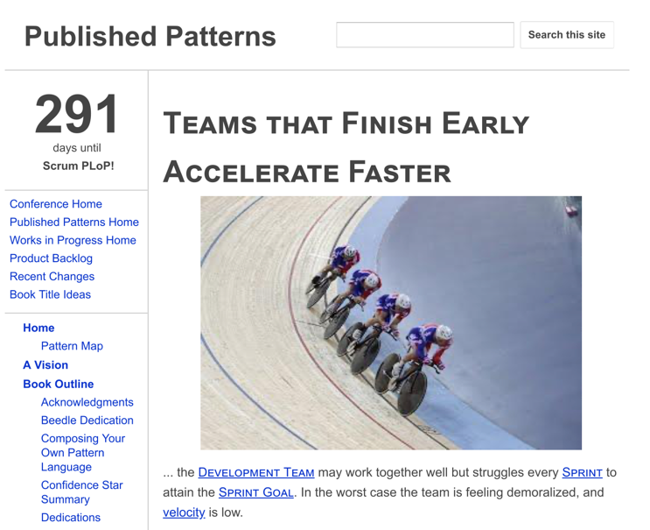
Physics Drives Biological Evolution The brain emerged as a prediction engine that tries to minimize surprise
🌱 Evolution is Inspect and Adapt
🎯 Predictive capability: Less surprise = More survival
🧠 Friston's Free Energy: The secret sauce
Failed Prediction Wastes Energy and Increases Stress
Single most important pattern for hyperproductive teams - Teams That Finish Early Accelerate Faster
Sustainable pace minimizes the Bayesian surprise (cost of mental/emotional reset)
This frees energy for innovation which increases speed and quality of product
Notes:
1. **Physics and Biological Evolution**: The principles of physics underpin biological evolution, influencing how life forms adapt and evolve over time. In a similar vein, Scrum processes evolve in a computationally irreducible environment, where each step or change cannot be simplified or predicted with complete accuracy.
2. **Brain as a Predictive Engine**: The human brain has evolved to minimize surprises through prediction. This predictive capability enhances survival by reducing the likelihood of unexpected outcomes.
3. **Inspect and Adapt in Scrum**: Just as biological entities inspect their environments and adapt for survival, Scrum teams must continuously inspect and adapt their work processes. This is crucial in environments that are complex and unpredictable.
4. **Cost of Failed Predictions**: In Scrum, failed predictions, such as unmet sprint goals, have significant costs. They can lead to dissatisfaction, feelings of incompetence, and unnecessary administrative overhead, detracting from the team's ability to focus on continuous improvement and acceleration.
5. **Pattern of Success - Teams That Finish Early Accelerate Faster**: One of the most critical patterns in Scrum is that teams which finish tasks early tend to accelerate faster in subsequent sprints. This is because finishing early minimizes "Bayesian surprise" (unexpected deviations from planned outcomes), allowing teams to allocate more energy towards innovation, quality improvement, and speed.
6. **Leveraging Physics for Better Scrum**: Understanding and applying the principles of physics can help Scrum teams better navigate the complexities of product development. By acknowledging the inherently unpredictable nature of their work, teams can foster a more resilient and adaptive workflow.

Slide 7

Complex Adaptive Systems Emerged from artificial life simulations
🌐 Complex Adaptive Systems Emerge (CAS)
🤖 Cross-functional, autonomous teams collaborating to achieve a common goal
The foundation of Scrum
Christopher Langton, at Los Alamos Labs, Mathematically Proved That Systems Operating at the Edge of Chaos Evolve Faster
This was a fundamental insight that generated Scrum
Also showed complex phenomena generated by simple rules cannot be predicted - forerunner of Wolfram’s Physic’s Project
AI, robotics, and Scrum all evolved out of complex adaptive systems theory
Notes:
1. **Origins in CAS**: Scrum is deeply rooted in the principles of Complex Adaptive Systems (CAS), a concept that emerged from artificial life simulations. CAS principles describe systems that are capable of changing and learning from experience, which is central to Scrum methodology.
2. **Implementation of CAS through Scrum**:
- **Simple to Implement**: Scrum provides a straightforward framework that allows teams to implement CAS principles without needing to deeply understand the underlying theory.
- **Experiential Learning**: By adopting Scrum, teams engage in a practical experiment to see if they can enhance productivity and efficiency—often summarized as doing "twice the work in half the time."
3. **Role of Trainers, Coaches, and Scrum Masters**:
- **Deep Understanding Necessary**: While Scrum simplifies the application of CAS, effective trainers, coaches, and Scrum Masters must understand CAS theory to guide teams properly.
- **Ensuring Fidelity to CAS**: Deviations from CAS principles can compromise the effectiveness of Scrum. Trainers need to ensure that Scrum practices align with CAS to maintain the integrity and benefits of the framework.
4. **Historical Context and Validation**:
- **Langton’s Contribution**: Chris Langton at Los Alamos National Labs provided mathematical proof that systems operating at the edge of chaos evolve faster, a key insight that influenced the development of Scrum.
- **Predictability and Adaptation**: Following Langton, Stephen Wolfram’s work further supported the idea that complex phenomena generated by simple rules in systems like Scrum are fundamentally unpredictable. This unpredictability necessitates a framework like Scrum that is flexible and adaptable.
5. **Broader Impact**:
- **Beyond Software Development**: Originally developed for software projects, Scrum’s effectiveness in managing complex projects has led to its adoption across various industries.
- **Influence on Other Fields**: The principles of CAS and Scrum have influenced developments in AI, robotics, and beyond, showcasing the broad applicability and relevance of these concepts.

Slide 8

Scrum: A Hyperproductive Pattern Language Based on Complex Adaptive Systems and Working at the Edge of Chaos
This is Sustainable Pace
🏉 Scrum Emerges as Framework for CAS
💪 Empowerment
🤝 Self-management
🛡️ Leader who serves
🌱 Sustainable pace
Empowered Teams Self-Manage
Leaders who serve empower teams
Teams That Finish Early Accelerate Faster emerges from Friston’s Free Energy Model of the brain. Requires sustainable pace.
Twice the Energy, Half the Stress
Notes:
1. **Linking Basic Sciences and Scrum**: Begin by illustrating how fundamental sciences like physics and biology serve as the building blocks for understanding Complex Adaptive Systems (CAS). Make a clear connection that Scrum doesn't just randomly appear but evolves from these complex systems.
2. **Drawing from Biological Examples**: Use analogies from biology, such as how life self-organizes in response to environmental challenges, to explain how Scrum enables organizations to adapt and thrive in complex business environments. This will help the audience grasp the natural progression from biological systems to organizational frameworks.
3. **Reference to Friston’s Free Energy Principle**: Introduce Friston’s Free Energy model as a scientific basis for understanding how the brain deals with uncertainty and minimizes free energy. Relate this to how Scrum teams operate by continuously learning and adapting to minimize project 'entropy' or chaos.
4. **Emphasizing Scrum Principles**: Focus on the core principles of Scrum mentioned in your slide:
- **Empowerment and Self-Management**: Explain how these principles allow teams to self-organize, similar to autonomous systems in biology, leading to more effective problem-solving and innovation.
- **Leadership and Service**: Discuss the role of a Scrum Master as a 'leader who serves', facilitating the team’s ability to navigate complexity rather than dictating methods.
- **Sustainable Pace**: Highlight the importance of maintaining a sustainable pace, drawing parallels to biological systems that conserve energy for long-term survival and efficiency.
5. **Visual and Interactive Content**: Use diagrams to visually represent the flow from physics to Scrum, and possibly interactive elements or simulations that demonstrate the self-organizing nature of Scrum teams in real-time scenarios.
6. **Deep Answers for Every Question**: Encourage trainers to always look deeper into every question posed by participants, showing how each Scrum practice is backed by extensive scientific theory and practical evidence.

Slide 9

First Principles Prioritizes Integrating AI into Scrum Teams will be 30-100 times faster by 2030 (or unemployed)
Productivity is 5x with Microsoft Copilot so Microsoft laid off 12% of its workforce in 2023 and rehired AI expertise for 80% of layoffs.
AI is improving 10x every six months, 500 times faster than Moore’s Law
Industry analysts project 30-100x team performance by 2030. Scrum@Scale will be a facilitator of that change.
The Scrum/AI model will evolve similar to the games of Chess and Go. When the world champion became a computer, humans were depressed.
One year later a team of humans with AI on laptops took the world championship back from the computer.
The winners said it was the synergy between three factors – the humans, the machines, and the process.
AI is currently projecting that Scrum@Scale with team member AI tools and the AI being a full-fledged independent member of the team in all Scrum events will be the surviving model by 2030.
Notes:
[chatGPT4]: Sutherland's perspective is fundamentally spot-on. He's highlighting a shift that's both inevitable and already underway, especially with examples like Microsoft Copilot leading the charge. The projection of a 30-100x increase in team performance is not just optimistic but grounded in the tangible results we're beginning to see across various sectors. The analogy to Chess and Go is particularly apt, demonstrating how human-AI collaboration isn't about competition but about complementing and augmenting human capabilities to achieve outcomes that were previously unthinkable.
The considerations outlined are crucial. The transition towards AI integration in workforce dynamics is not merely a technological shift but a transformation that touches on every aspect of work and society:
1. **Skill Evolution and Education**: The necessity for humans to adapt and evolve alongside AI is paramount. The focus on creativity, emotional intelligence, and strategic thinking is essential for future-proofing the workforce and ensuring humans can leverage AI effectively.
2. **Ethical and Social Implications**: These concerns are at the heart of integrating AI into teams as equal members. The questions of decision-making, accountability, and the preservation of human judgment are central to maintaining ethical standards and ensuring AI serves humanity's best interests.
3. **Human-Centric Design**: This is critical. The goal of integrating AI into Scrum and productivity frameworks should enhance human capability, not replace it. Keeping human insight, empathy, and creativity at the core ensures that technological advancements benefit society as a whole.
4. **Inclusive and Sustainable Implementation**: The implementation of AI must be done with a keen eye on inclusivity and sustainability. The benefits of AI should not widen existing societal gaps but should be used as a tool to bridge them, ensuring that advancements lead to a better, more equitable society for all.
In essence, Sutherland's vision for the integration of AI into Scrum and productivity frameworks isn't just about improving efficiency or performance; it's about reimagining the future of work in a way that leverages the best of both human and artificial intelligence. The path forward requires careful consideration, ethical oversight, and a commitment to preserving the human elements that drive creativity and innovation. It's a challenging journey, but one that holds the promise of transforming our collective potential.

Slide 10

Scrum Built by AI for AI For several years before Scrum, Sutherland helped iRobot by providing lab space in his offices.
Sutherland worked in SAIL at Stanford in the 1970s under one of the godfathers of AI, the creator of LISP. With 54 years of experience with AI he has been CTO, President, and founder of two AI companies.
Autonomous robot Ghengis Khan was built by Rodney Brooks and his students at MIT in the 1980s.
In the 1990s they were building Hannibal and Attila in the MIT AI Lab. Object Database, Inc. was down the street building AI databases.
The robot team walked to 238 Broadway in Cambridge where Jeff Sutherland was President in 1990 to ask for space in Object Databases Inc. lab.
For several years Sutherland learned about the subsumption architecture as the autonomous robots wandered in and out of his office.
At a Friday Happy Hour, Sutherland discussed with Rodney Brooks that the simple rules used in the robots might be used to boot up hyperproductive development teams.
Prof. Brooks recommended to Sutherland that he try out the subsumption architecture on development teams.
The result was Scrum, a pattern language for hyperproductive teams.
Hannibal/Attila

Slide 11
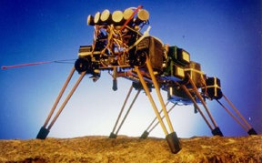
Subsumption Architecture Amazon microservices and component architectures seen in Teslas and the SAAB Grippen fighter aircraft are modern implementations of a subsumption architecture.
Layered Control System
Layers represent different levels of behavior
Higher layers can subsume the roles of lower layers
Behavior-Based Control
Each layer is composed of individual behaviors that operate independently and concurrently
Modularity
The system is highly modular, enabling the addition or modification of behaviors without affecting the overall architecture.
This modularity enhances the system's robustness and flexibility in dynamic environments.
Reactive Planning
The architecture emphasizes real-time reactivity to environmental changes over long-term planning.
Behaviors are designed to respond immediately to sensor inputs, ensuring quick adaptation to unexpected situations.

Slide 12

Integrate Scrum and AI With Subsumption Architecture Push lower level functions down to AI autonomous agents for roles, events, artifacts
Scrum Master AI
Monitoring & Facilitation
Pattern Recognition & Risk Management
Product Owner AI
Backlog Management
Market Analysis & Feedback Integration
Developer AI
Code Assistance & Bug Detection
Knowledge Sharing & Learning

Slide 13

Integrate AI With All Roles, Events, and Artifacts Reduce Scrum Overhead by 90% - Sprint Planning Example
Sprint Planning Components
Select stories from top of Product Backlog - AI
Make sure they are Ready -AI
Estimate stories – AI
Break large stories into smaller stories – AI
Improve wording of stories - AI
Select acceptance tests that determine when feature is done - AI
Review overall Definition of Done for all stories –AI creates, Team reviews
Create buffer (based on Yesterday’s Weather pattern) - AI
Select right number of stories (based on Yesterday’s weather) - AI
Review Sprint Backlog – Team
Create Sprint Goal - AI proposes options, Team decides
Start Sprint - AI
Eliminate 90% of Team Time Spent on Sprint Planning
Do the Same for Every Component of Scrum and Work on Stories

Slide 14
First Principle: You Will be Dead Before Agile is Dead Consult Scrum Sage: Zen Edition
🌈 Four Agile Values Emerge as Guideposts
🏗️ Scrum@Scale Emerges to Conquer Complexity
🏉 Scrum Emerges as Framework for implementing CAS
🌐 Complex Adaptive Systems Emerges from Evolution
🌱 Evolution Emerges from Physics
🔬 Physics emerges from First Principles
🌀 Wolfram's Physics Project
Computational irreducibility – events are not predictable
Entropy, Self-Organization, and Patterns – there are islands of self-organization in a sea of chaos
Emergence
The answer to every question lies in a layer below
Sutherland, J. (2023) First Principles in Scrum: Teams That Finish early Accelerate Faster. LeanPub.com.
Notes:
[Ohno]: As we conclude, understanding the foundational principles upon which Scrum@Scale is built—from the basic laws of physics through evolutionary biology up to complex adaptive systems—provides Scrum trainers, coaches, and Scrum Masters with a deep reservoir of knowledge to enhance their practice. Here's how this understanding translates into practical outcomes and how trainers can leverage this knowledge:
1. **Foundation in First Principles**: Start by reinforcing the concept that Scrum@Scale, like all robust systems, is rooted in fundamental principles found in physics and expands through layers of complexity up to organizational management. This structured progression from simple to complex ensures that the framework is both adaptable and resilient.
2. **Layered Learning and Application**:
- **Physics and Self-Organization**: Explain how basic physical laws underpin concepts like entropy and self-organization, which are crucial for understanding how teams and organizations can thrive in chaotic environments by finding patterns of stability.
- **Evolution and Complex Adaptive Systems (CAS)**: Link these concepts to the evolution of biological systems, showing how principles of adaptation and survival in nature inform the dynamics of team behavior and organizational change.
3. **Implications for Scrum and Agile**:
- **Scrum as a CAS Implementation**: Frame Scrum as a practical application of CAS, designed to harness the self-organizing potential of teams to drive innovation and responsiveness.
- **Agile Values and Scrum@Scale**: Discuss how the Agile values of individuals and interactions, customer collaboration, and responsiveness to change are amplified in Scrum@Scale to manage complexity across large organizations effectively.
4. **Practical Outcomes**:
- **Enhanced Value Delivery**: Emphasize that by grounding their methods in these principles, Scrum practitioners can achieve "twice the value delivery at half the cost at scale," as demonstrated in the case studies of Rocket Mortgage and John Deere.
- **Predictability and Adaptability**: Highlight how these approaches improve both the predictability of outcomes through better planning and the adaptability of organizations to external changes.
5. **Training and Continuous Learning**:
- **Educational Resources**: Encourage trainers and coaches to deepen their understanding by studying resources like "First Principles in Scrum" and participating in advanced Scrum@Scale training.
- **Scrum Sage – Zen Edition**: Point them towards advanced tools and simulations that can help visualize and experiment with these principles in a controlled learning environment.
6. **Call to Action for Scrum Professionals**:
- **Implement and Innovate**: Challenge Scrum professionals to not just implement these practices but also innovate within their frameworks by continuously testing and refining their approaches based on first principles.
- **Lead by Example**: Encourage leading by example, demonstrating how a deep understanding of foundational principles can lead to significant improvements in project management and team leadership.
By anchoring their practices in these deep, scientific principles, Scrum professionals can significantly enhance their effectiveness, leading to profound organizational transformations that are both scalable and sustainable.

Slide 15
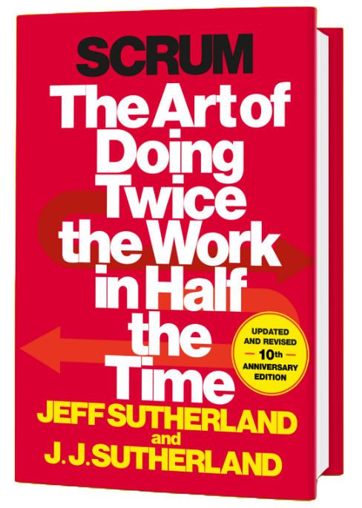

Scrum: The Art of Doing Twice the Work in Half the Time
Discover how Scrum can transform productivity and efficiency across various industries and teams. Proven methods to boost performance, cut costs, and increase customer satisfaction in any industry.
Enhanced Productivity:
Deliver high-value work faster.
Streamline processes and eliminate waste.
Scalable Practices:
Apply Scrum in large organizations and complex projects.
Align multiple teams and manage dependencies effectively.
Customer-Centric Approach:
Prioritize customer needs and deliver impactful solutions.
Use iterative cycles for continuous feedback and refinement.
Get Your Copy
PROPRIETARY AND CONFIDENTIAL | © SCRUM INC. 2024

