Slide 1

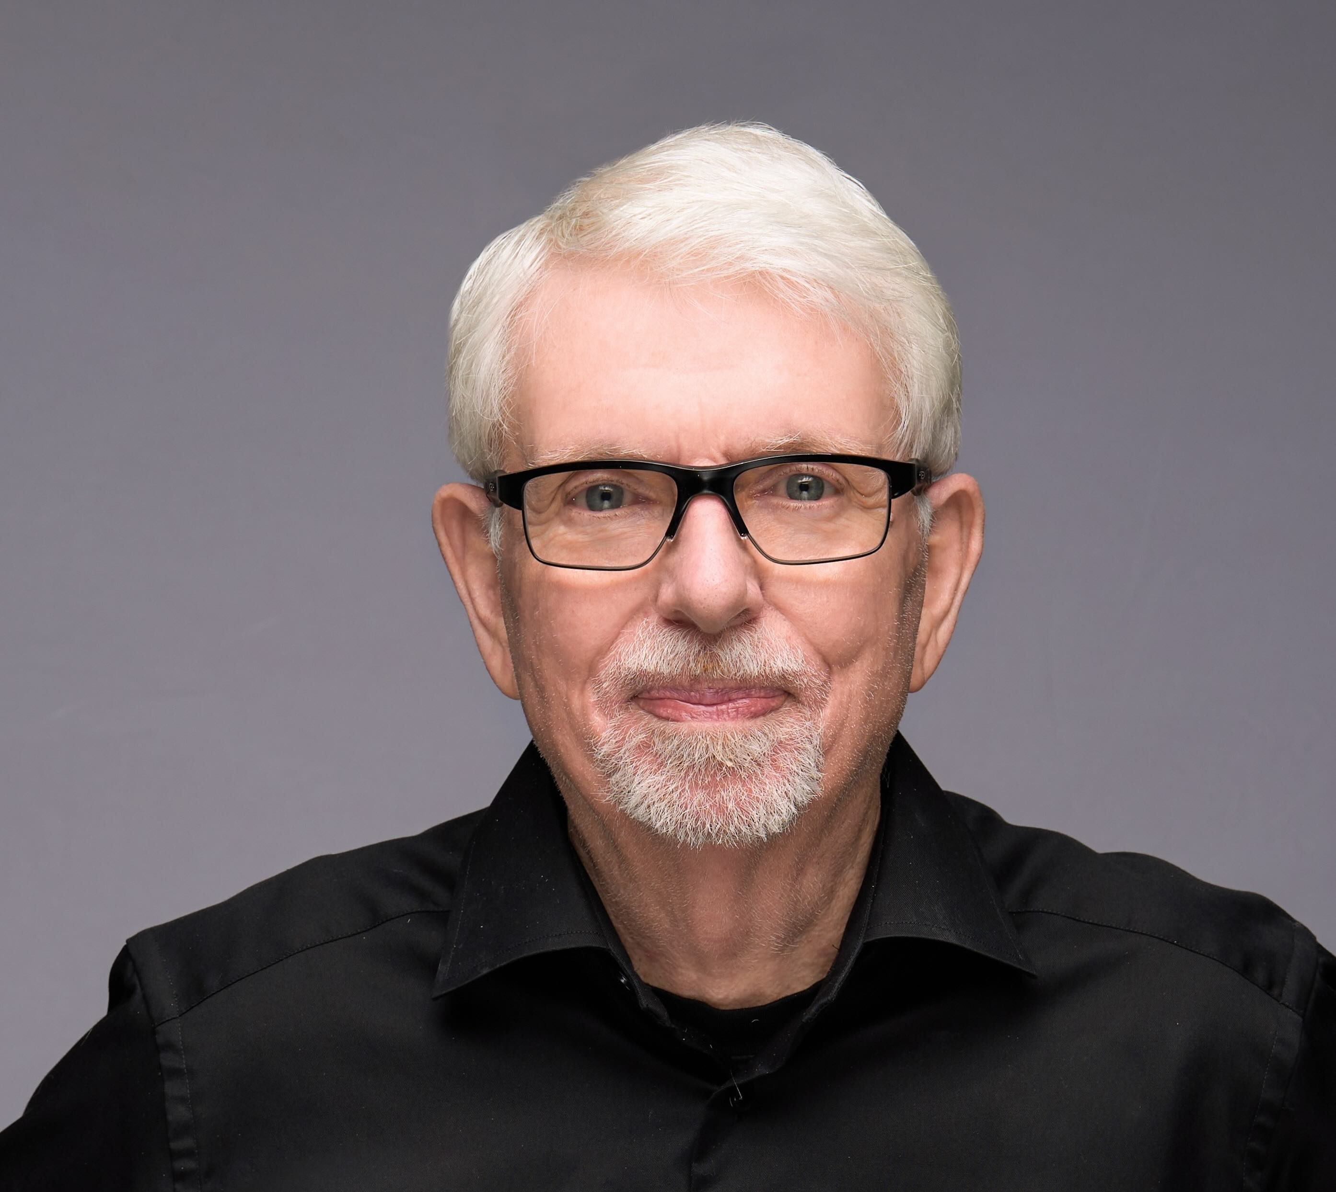
Agile Evolution: The Neuro-Scientific Roots and AI-Enhanced Future of Scrum
Dr. Jeff Sutherland
Co-Creator of Scrum and Scrum@Scale
Signatory of the Agile Manifesto
Notes:
Join us for an enlightening meetup featuring Dr. Jeff Sutherland, the co-creator of Scrum and a signatory of the Agile Manifesto, as he explores the fascinating intersection of agile, neuroscience, and artificial intelligence. In this session, Dr. Sutherland will dive deep into the origins of agile and scrum, explaining how these practices are not just rooted in product development but are underpinned by fundamental principles of physics and biology that govern our universe.
Through a compelling narrative, Dr. Sutherland will reveal how Scrum emerges as a natural framework for managing complex adaptive systems, drawing parallels between the empirical processes of Scrum and the evolutionary dynamics of the natural world. He will discuss ground-breaking insights from Wolfram's Physics Project and Friston's Free Energy Principle, illustrating how these concepts from computational irreducibility to predictive coding influence agile practices and team dynamics.
Furthermore, Dr. Sutherland will explore the role of AI in today's agile environment, challenging common misconceptions and highlighting how AI, when leveraged appropriately, can enhance human collaboration, creativity, and productivity rather than replace it. Participants will learn how the principles of physics and neuroscience can be applied to foster empowered, self-managing teams that are poised for innovation and hyper-productivity.
Whether you are a seasoned agile practitioner, a team leader looking to enhance your team's performance, or simply curious about the scientific foundations of agile methodologies, this meetup will provide you with a unique perspective on agility, backed by science and practical experience. Prepare to be inspired and gain actionable insights into creating more adaptive, resilient, and high-performing teams in the unpredictable world of today.

Slide 2

First Principles in Scrum leanpub.com/firstprinciplesinscrum
Incorporates answers to thousands of Agile, Scrum, and Scrum@Scale questions
Based on my training as a Professor of Radiology at University of Colorado Medical School
Venture funded by Tesla Investment Holdings LLC
  As Managing Partner, we regularly review First Principles used by Elon Musk to create Tesla, the world’s most Agile company.
Enabled by the TEHS Scrum Framework for Health and Performance based on biophysics (Twice the Energy with Half the Stress).
Second
Edition

Slide 3
Working From First Principles – Six Layers
Responding to Change is the Way the Universe Works
🌀 Wolfram's Physics Project
  🎲 Computational irreducibility
  🤯 Entropy and Self-Organization
🔬 Physics
  🚀 Force = ma
  🛠️ Work = Force x Distance
  ⏱️ Power = Work/Time
  🌌 Relativity & Quantum Physics: They just show up!
🌱 Evolution is Inspect and Adapt
    🎯 Next Best Step
    🧠 Friston's Free Energy Model of Brain
  🌐 Complex Adaptive Systems Emerge (CAS)
    🤖 Autonomous agents: Racing at the edge of chaos 🌀
🏉 Scrum Emerges as Framework for CAS
  💪 Empowerment
  🤝 Self-management
  🛡️ Leader who serves
  🌱 Sustainable pace
🌈 Four Agile Values Emerge as Guideposts
  💥 Unleash personal power: Build great teams
  🔄 Rapid iteration: Faster, better, cheaper products
  🤝 Make the customer & AI part of the team
  🌪️ Universe is unpredictable: Adapt or perish

Slide 4

Wolfram’s Physics Project
The most important advancement in physics in recent decades
🌀 Wolfram's Physics Project
  🎲 Computational irreducibility
  🤯 Entropy and Self-Organization
Wolfram simulated the universe
  The ruliad - simple rules operating on nodes in space generate complex phenomena
  Time measured as the change in connections between the nodes in space
Predicting outcomes of a simulation requires infinite computing power
  Empirical process control is essential
  GANTT charts are always wrong and Agile is the solution

Slide 5
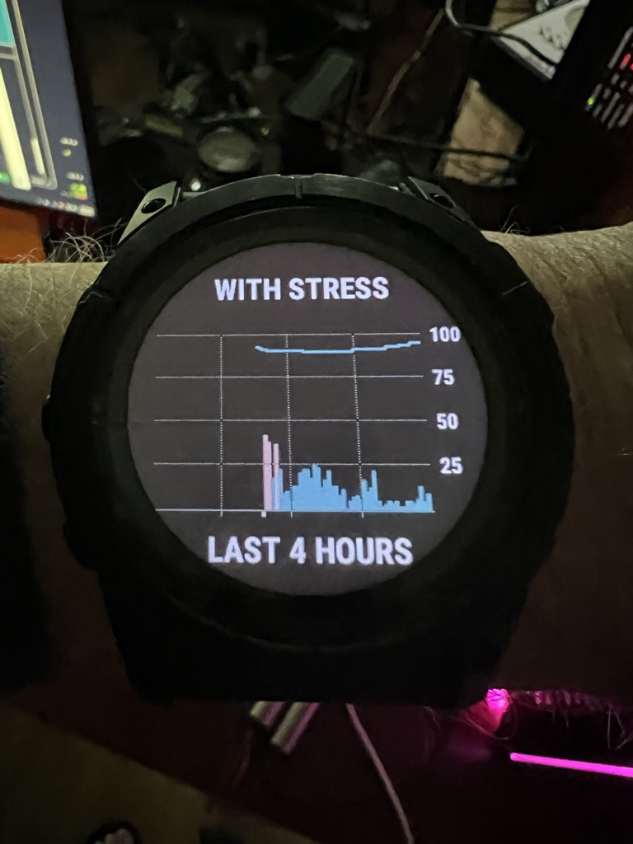
Newton’s Laws, Relativity, and Quantum Mechanics
They all emerge from the ruliad
🔬 Physics – applies to individuals, teams, and organizations
  🚀 Force = Mass x Acceleration
  🛠️ Work = Force x Distance
  ⏱️ Power = Work/Time
  🌌 Relativity & Quantum Physics: They just show up!
Twice the Work in Half the Time
  Requires four times the Power
  Personal Power is measurable
Power Depends on Twice the Energy with Half the Stress
  FirstBeat analytics for Olympic teams
  Incorporated into the Garmin watch
Better plan, fewer surprises, more innovation

Slide 6

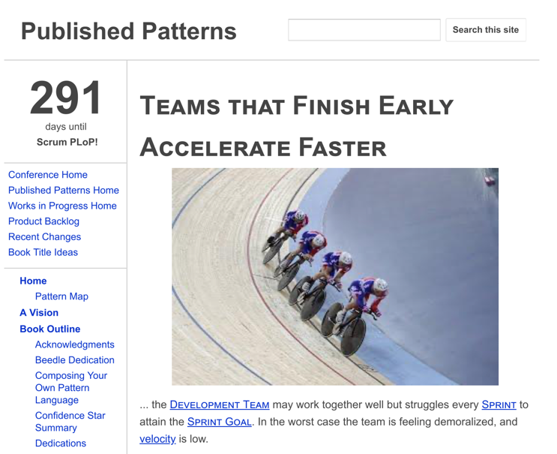
Physics Drives Biological Evolution
The brain emerged as a prediction engine that tries to minimize surprise
🌱 Evolution is Inspect and Adapt
  🎯 Predictive capability: Less surprise = More survival
🧠 Friston's Free Energy: The secret sauce
  Failed Prediction Wastes Energy and Increases Stress
  Single most important pattern for hyperproductive teams - Teams That Finish Early Accelerate Faster
  Other patterns support finishing early with sustainable pace
  Sustainable pace minimizes the Bayesian surprise (cost of mental/emotional reset)
  This frees energy for innovation which increases speed and quality of product

Slide 7

Complex Adaptive Systems
Emerged from artificial life simulations
🌐 Complex Adaptive Systems Emerge (CAS)
  🤖 Cross-functional, autonomous teams collaborating to achieve a goal 🌀
Langton, at Los Alamos Labs, Mathematically Proved That Systems Operating at the Edge of Chaos Evolve Faster
  This was a fundamental insight that generated Scrum
  Also showed complex phenomena generated by simple rules cannot be predicted - forerunner of Wolfram’s Physic’s Project
  AI, robotics, and Scrum all evolved out of complex adaptive systems theory

Slide 8
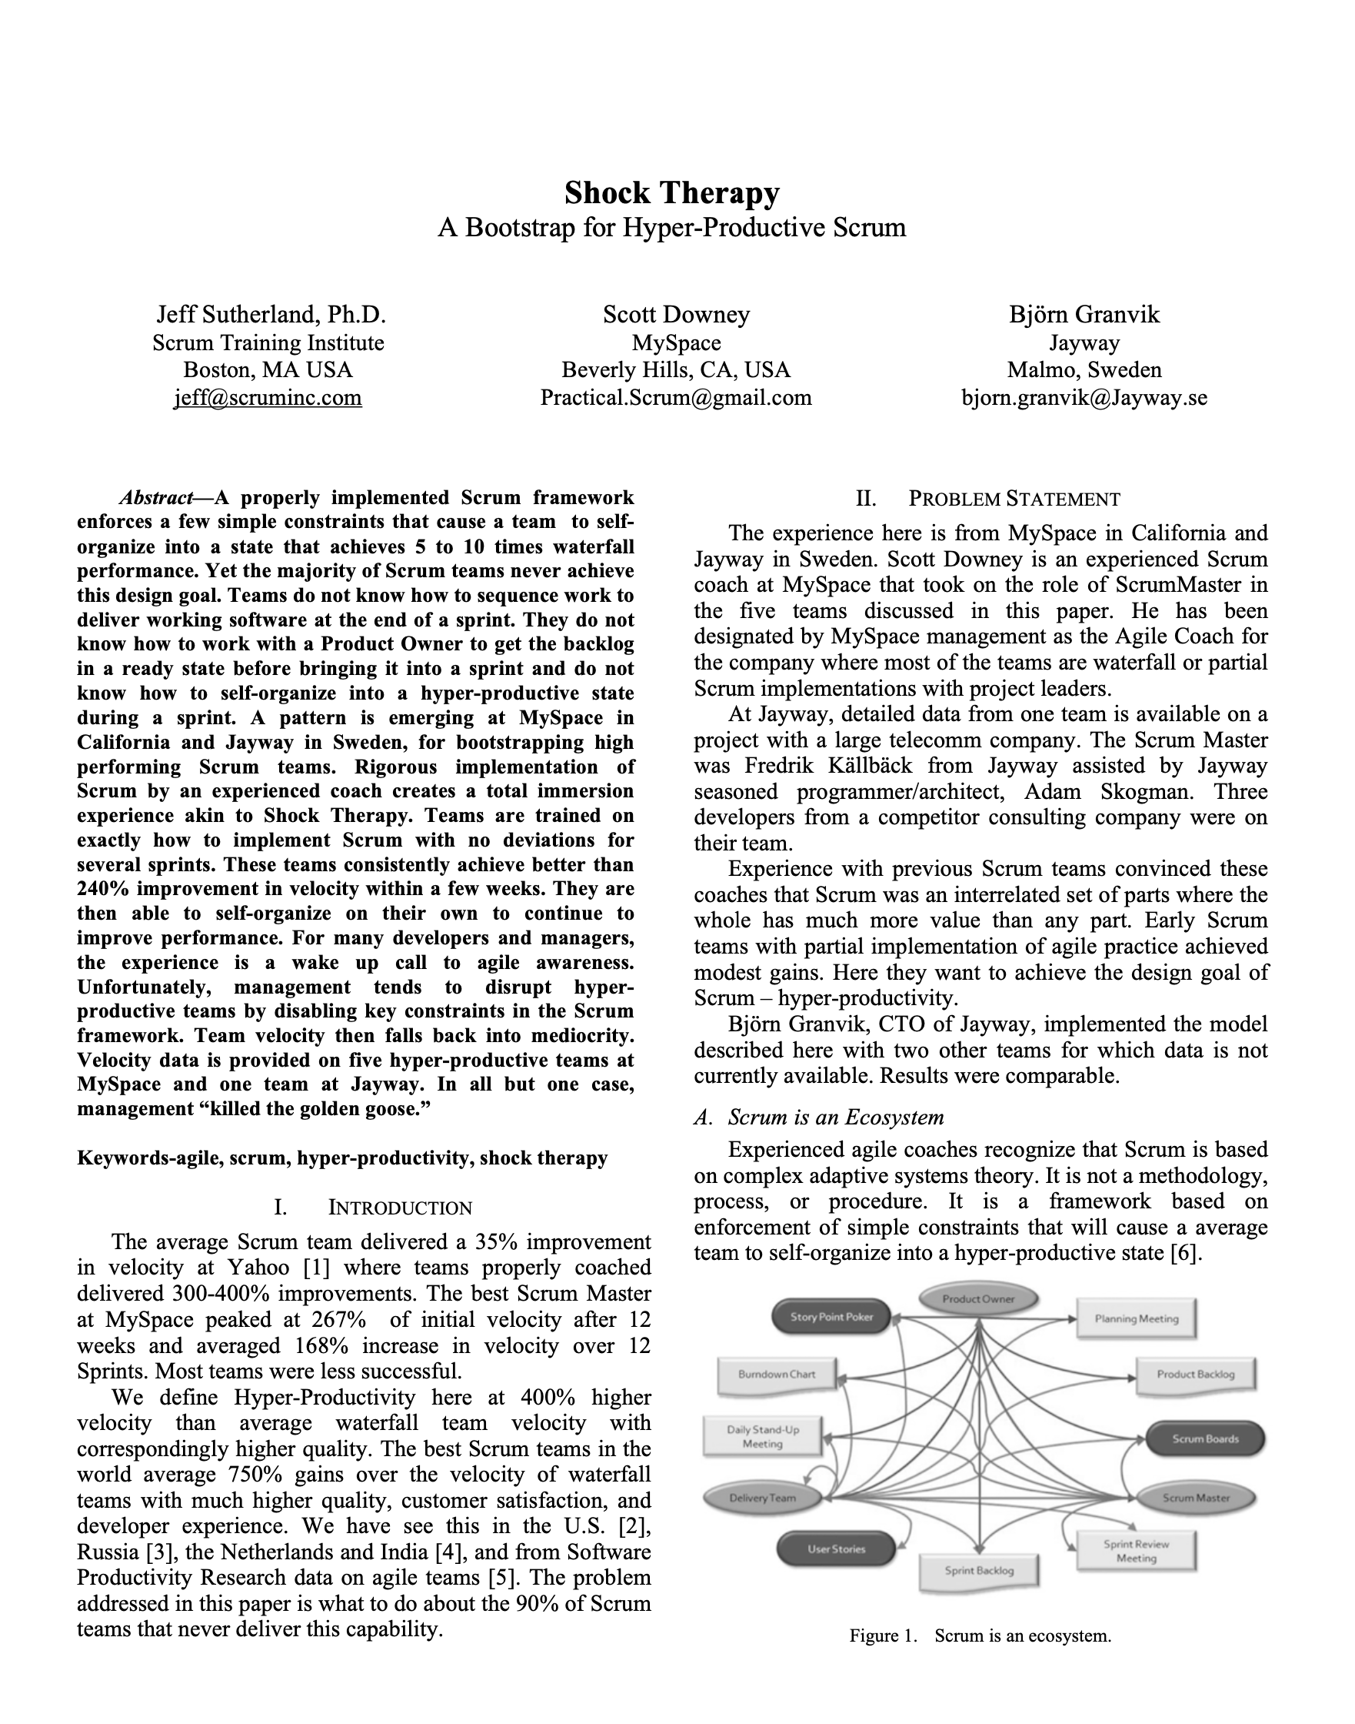
Autonomous Teams Emerge From Being Empowered
Empowerment is done systematically by Agile Leaders
The Ladder of Empowerment
  Phase 1: Command and Control
    Here is how we do it.
  Phase 2: Guided Discovery
    What do you see?
  Phase 3: Shared Analysis
    What do you think?
  Phase 4: Delegated Decision Making
    What should we do?
  Phase 5: Autonomous Operation
    How is it going?
See Shock Therapy Paper
This can be done in 1-2 one week sprints

Slide 9
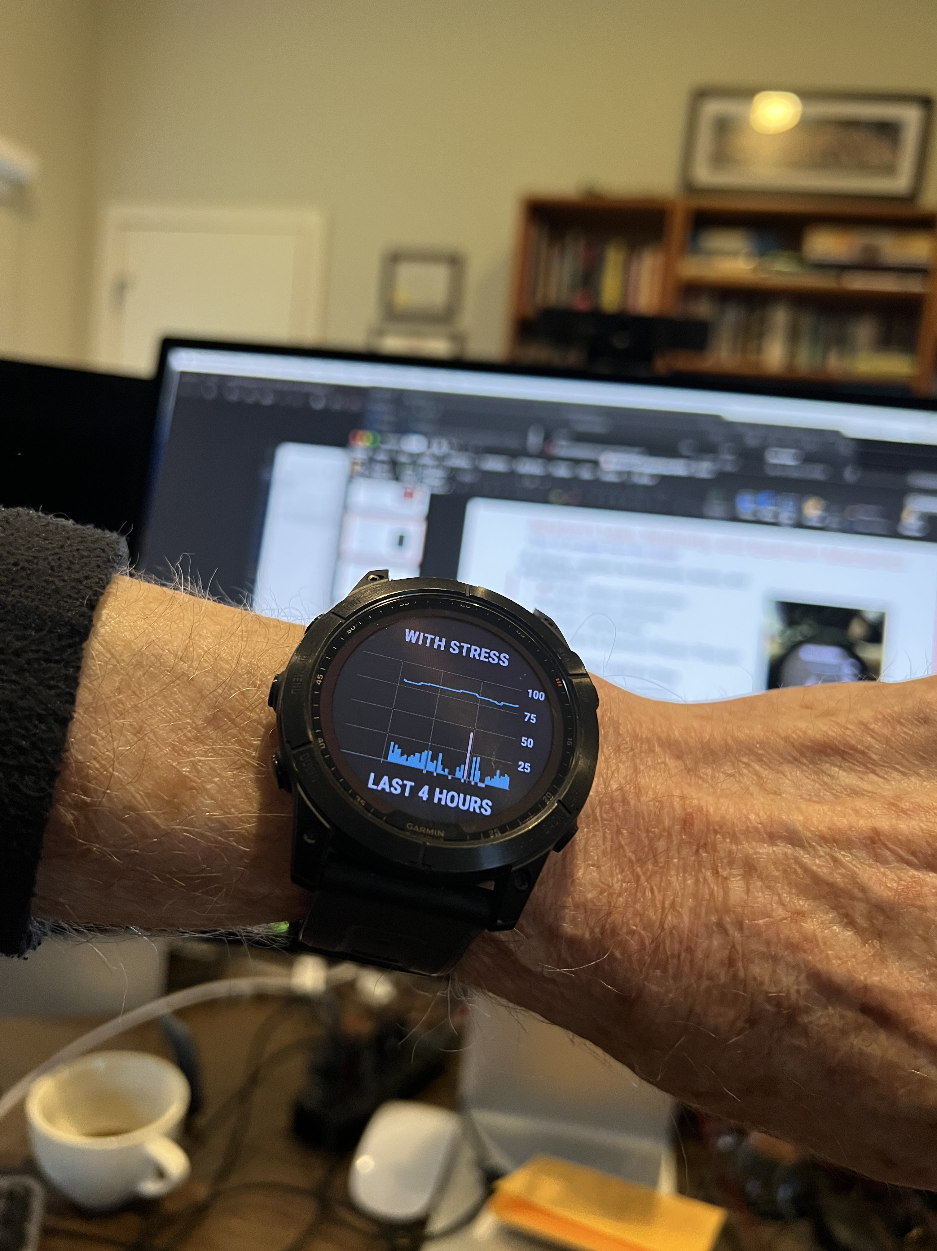
Scrum: A Hyperproductive Pattern Language
Based on Complex Adaptive Systems and Working at the Edge of Chaos
This is Sustainable Pace
🏉 Scrum Emerges as Framework for CAS
  💪 Empowerment
  🤝 Self-management
  🛡️ Leader who serves
  🌱 Sustainable pace
Empowered Teams Self-Manage
Leaders who serve empower teams
Teams That Finish Early Accelerate Faster emerges from Friston’s Free Energy Model of the brain. Requires sustainable pace.
Twice the Energy, Half the Stress

Slide 10

Agile Emerged Out of Scrum and XP
It is a generalized set of values and principles
🌈 Four Agile Values Emerge as Guideposts
  💥 Unleash personal power: Build great teams
  🔄 Rapid iteration: Faster, better, cheaper products
  🤝 Make the customer & AI part of the team
  🌪️ Universe is unpredictable: Adapt or perish
Individuals and Interactions Over Processes and Tools
  A team is set of individuals with interactions that self-manage towards a common goal
  Adherence to First Principles determine success or failure
Individual Self-Managing Sustainable Pace

Slide 11

58% of Agile Teams Fail, 88% are Scrum Teams
They are late, over budget, with unhappy customers
🏉 Agile in Name Only
  💪 Lack of empowerment
  🤝 Lack of Self-management
  🛡️ Lack of Leader who serves
  🌱 Lack of Sustainable pace
Weaponization of Terms to Justify Failure
  Team members sometimes claim they can do anything they want because that is self-organization. Removed this term from the Scrum Guide in 2020.
  Scrum Masters claim they are servant leaders by being a secretary and taking notes. Removed this term from the Scrum Guide in 2020.

Slide 12
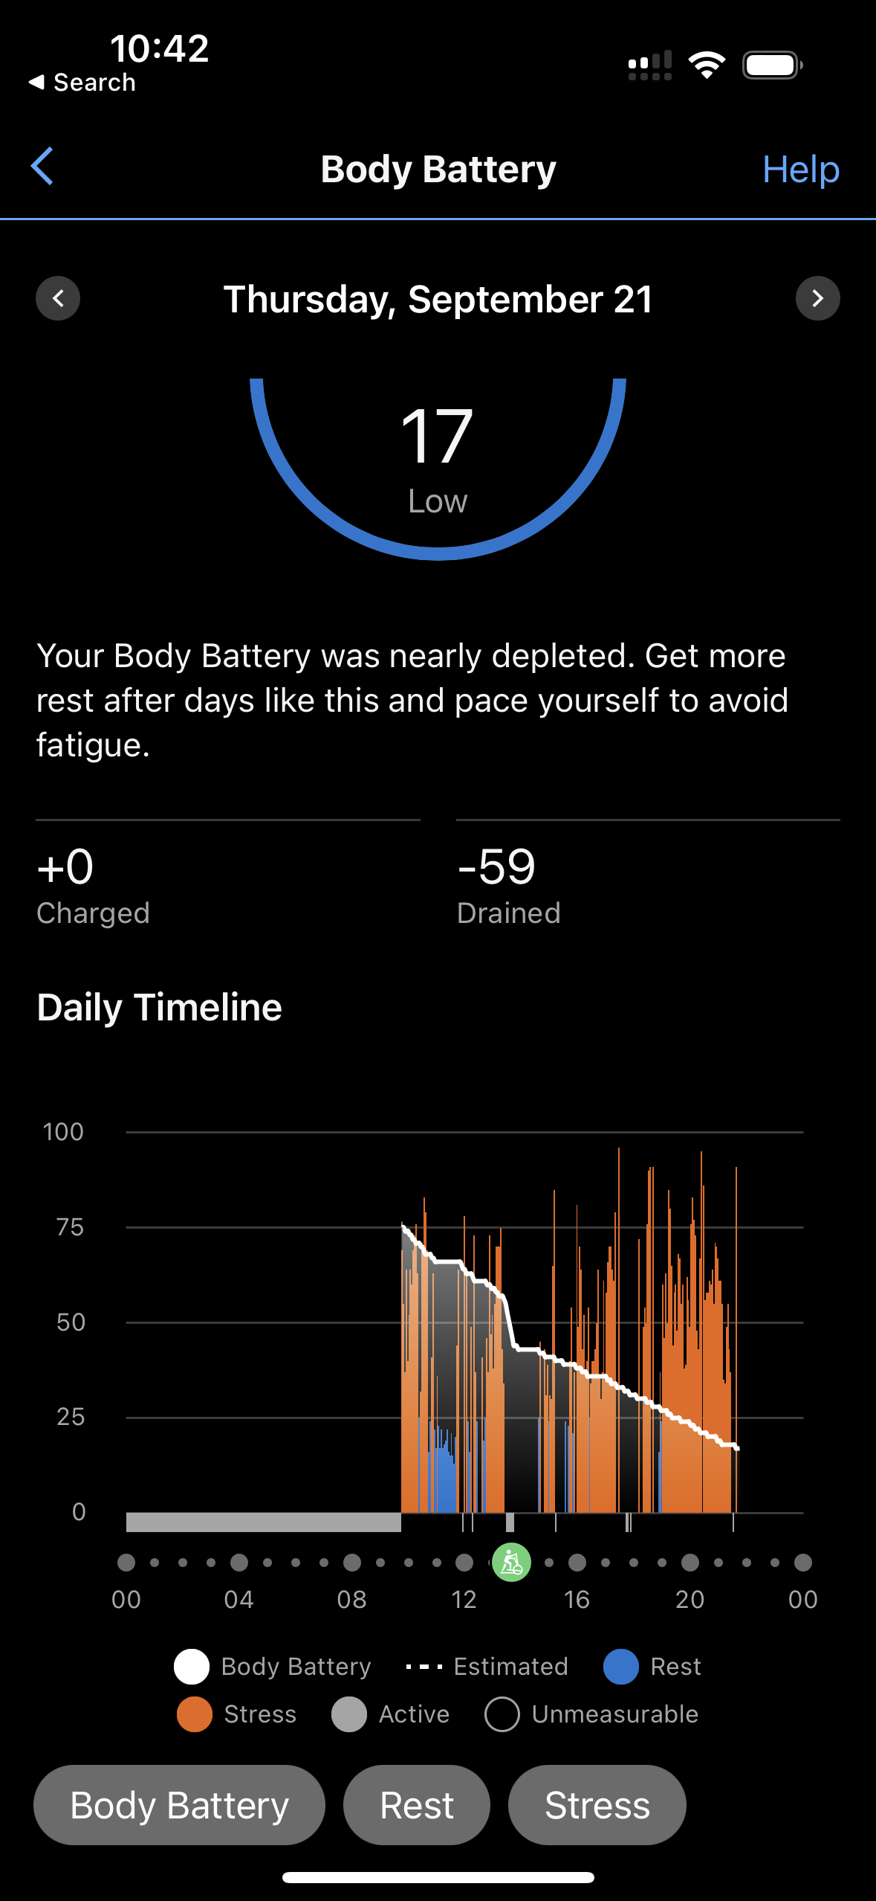
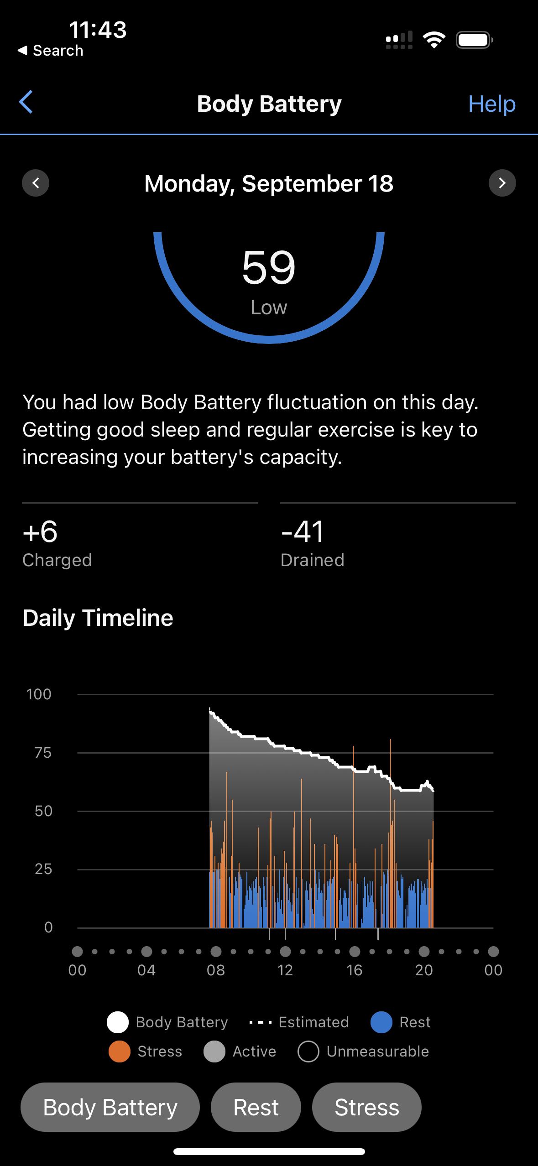
Weaponizing Sustainable Pace – A Cautionary Tale
How the misinterpretation of “Sustainable Pace” is sabotaging Agile teams
The Misuse:
Justifying Poor Performance
Misaligned Understanding
Lack of Accountability for Scrum and for Individual Performance
The Original Intent:
Sustaining High Performance
Adaptability within Complex Systems
Team-Level Self-Management
Course Correction:
From "Servant Leadership" to "Leader Who Serves"
From "Self-Organizing" to "Self-Managing"
From "Sustainable Pace" to "Sustained High Performance"
Ohno says: You need to understand the essence of terms to prevent misuse, Implement checks and balances, and realign with Agile and Scrum principles

Slide 13
The Intent of Agile Manifesto Sustainable Pace
Principle 8: Agile processes promote sustainable development. The sponsors, developers, and users should be able to maintain a constant pace indefinitely.
Setting Up for Success:
Hyperproductive Patterns: Yesterday's Weather, Buffer Pattern
Master Pattern: Teams that Finish Early Accelerate Faster
The Individual Factor:
Aligning with the first value of the Agile Manifesto
Personal Responsibility & Team Support
Life-Work Balance for Sustained Performance
Measurable Metrics:
Olympic Team Training Analytics – FirstBeat.com
Ohno says: The true meaning of "sustainable pace" is about sustaining high performance, both at the team and individual level. Measurement and adaptability are key.
Better plan, fewer surprises, more innovation

Slide 14

Daily Scrum: Unleashing Hyperproductivity
Agile leaders need to understand the seven neuroscience accelerators
Historical Context: Daily Scrum in 1993; influence of the Borland Quattro project.
First Scrum Team: Adoption of the "Next Best Step" strategy, based on punctuated equilibrium.
Neuroscience in Scrum: Alignment of Daily Scrum with the seven neuroscience accelerators.
Cultural Integration: Incorporation of the Adidas All Black Haka video to enhance focus, unity, and team spirit.
Breakthrough in March 1994: Completion of a month's work in less than a week, demonstrating a a new standard of productivity.
Conclusion: Merging Scrum with neuroscience and cultural elements led to a new paradigm in development efficiency.

Slide 15

Neuroscience Accelerators Regulate Happiness and Productivity
Agile leaders need to stimulate these effects to get free energy from the team
Collaborative Environment stimulates Social Neuroscience
Mirror Neuron Effect builds empathy
Zeigarnik Effect accelerates team
Feedback Loops fuels Dopamine Reward System
Adaptive Change improves Neuroplasticity
Empirical Process Control enabled by Predictive Coding System of the Brain
Vagus Nerve Stimulation supports Emotional Regulation and fearlessness
Haka stimulates vagus nerve
Aligns the team and make them fearless

Slide 16
Scrum@Scale Emerged From First Principles
Based on Patterns
    Scrum team (small and cross-functional)
    Mitosis (split team at 7 people)
    Scrum of Scrums (multiple patterns support SofS)
    Product Owner Team
    Metascrum
    Enterprise Action Team
  Scrum@Scale Works Because:
  Implements the True Scrum
    Twice the Value at Half the Cost
  Focuses on the Next Best Step
    Operating System for entire enterprise
    Prioritizes interventions for maximum impact and speed of change
  Implements Minimum Viable Bureaucracy to enable Linear Scalability
    By enabling six patterns of performance at scale in “Scrum: The Spirit of the Game”

Slide 17
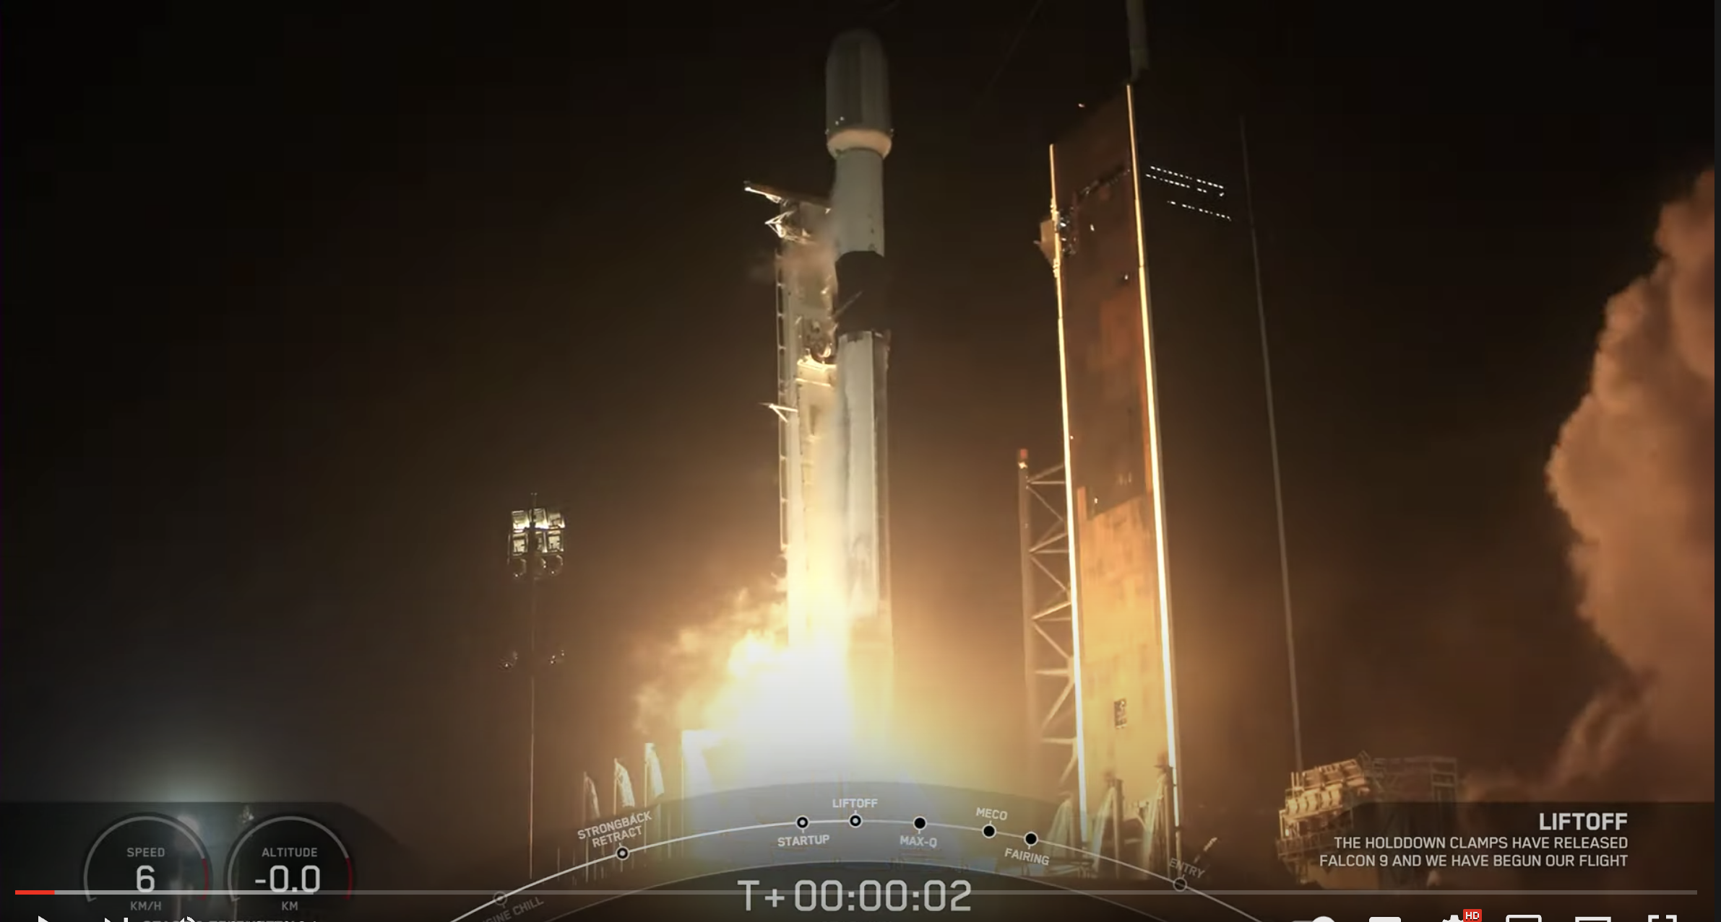
Rocket Mortgage Moves from a SAFe Culture to a Delivery Culture
Implement True Scrum
Streamline organization and meetings
Total focus on delivery
Strong DevOps implementation
Went from delivering every quarter to delivering multiple times a day
Used new capabilities to bring up COVID testing system for city of Detroit in one week.
Now rolling Scrum@Scale model across the enterprise, upgrading all SAFe implementations
400% more value delivery than their 10 year old successful SAFe implementation
Rocket Companies’ record-breaking fourth quarter and full year results demonstrate the sheer power of the technology platform we have built and refined for more than two decades.” Jay Farner, Rocket Companies’ vice chairman and CEO
Juan, D, Negron, D., Simmons, M. and Sutherland J. (2022) Rocket Mortgage Delivers Twice the Value at Half the Cost at Scale. Proceedings of the 55th Hawaii International Conference on System Sciences, IEEE.

Slide 18
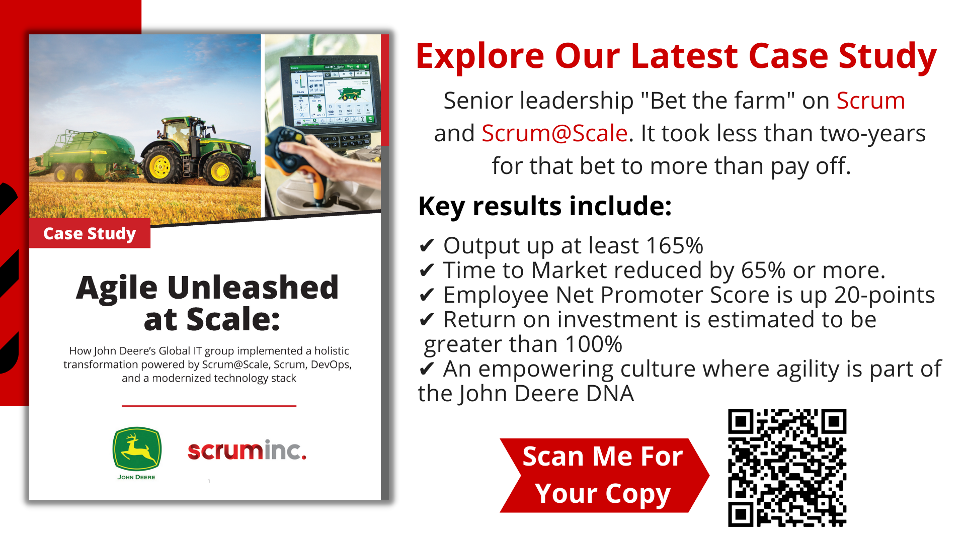
Enterprise Agility Drives Performance

Slide 19
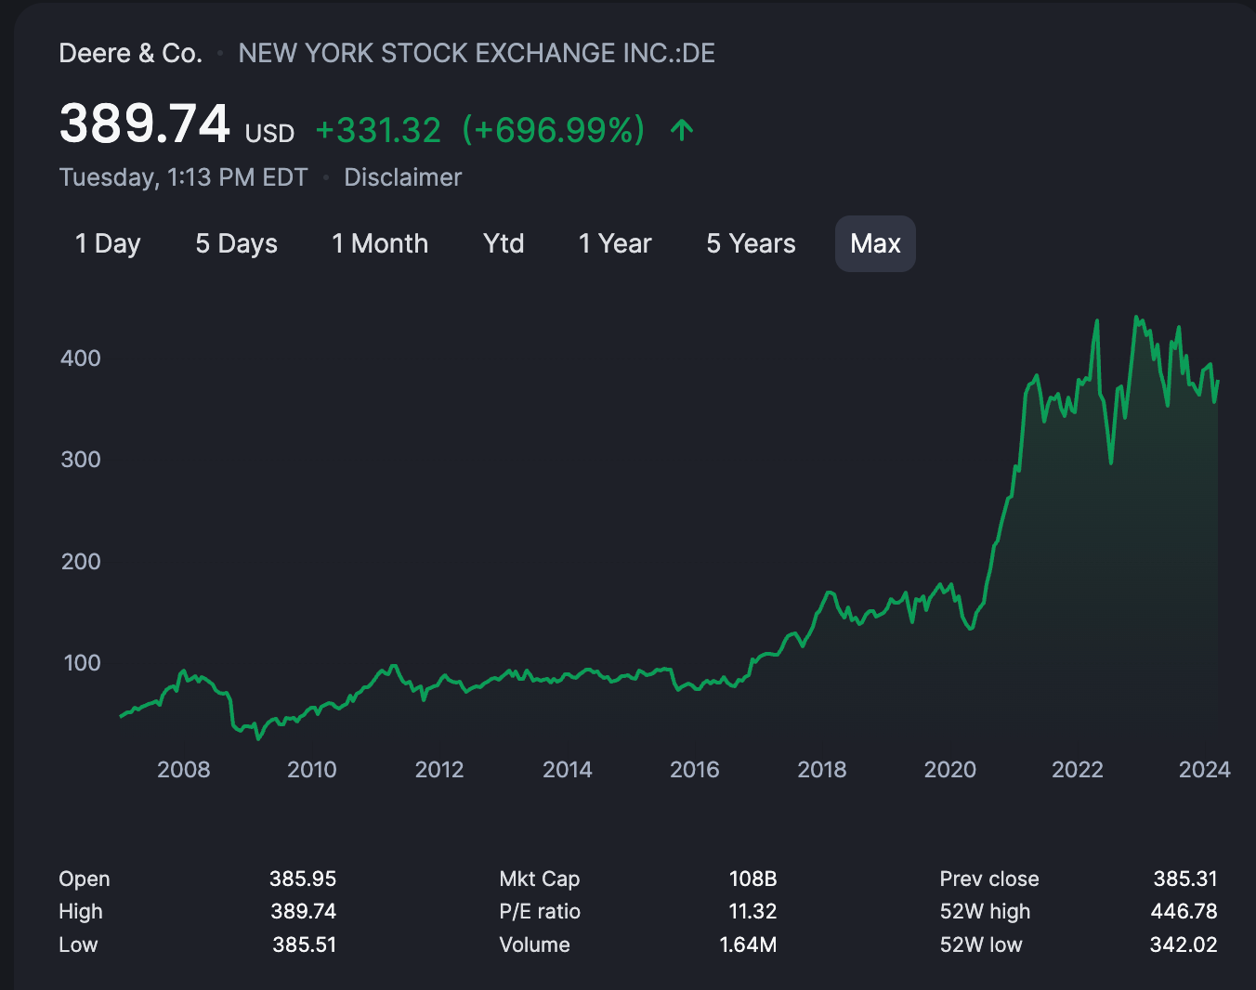
John Deere Delivers 400% More Value to Stakeholders
Successful SAFe implementation with 20-30% improvement
Transitioned to Scrum@Scale in 2019
Created Minimum Viable Bureaucracy
Focused on Next Best Step
  Supply chain velocity up 15x
  Production delivery up 10x
Stock price showed phase change
  John Deere is a different company
  Better alignment with first principles
Scrum@Scale
SAFe

Slide 20
Work Bottom Up From First Principles https://chat.openai.com/g/g-pajO1fBss-scrum-sage-zen-edition
🌈 Four Agile Values Emerge as Guideposts
🏉 Scrum Emerges as Framework for implementing CAS
🌐 Complex Adaptive Systems Emerge from Evolution
🌱 Evolution Emerges from Physics
🔬 Physics emerges from First Principles
🌀 Wolfram's Physics Project
  Computational irreducibility – events are not predictable
  Entropy and Self-Organization – there are islands of self-organization in a sea of chaos
Emergence
The answer to every question lies in a layer below
leanpub.org/firstprinciplesinscrum

