Slide 1
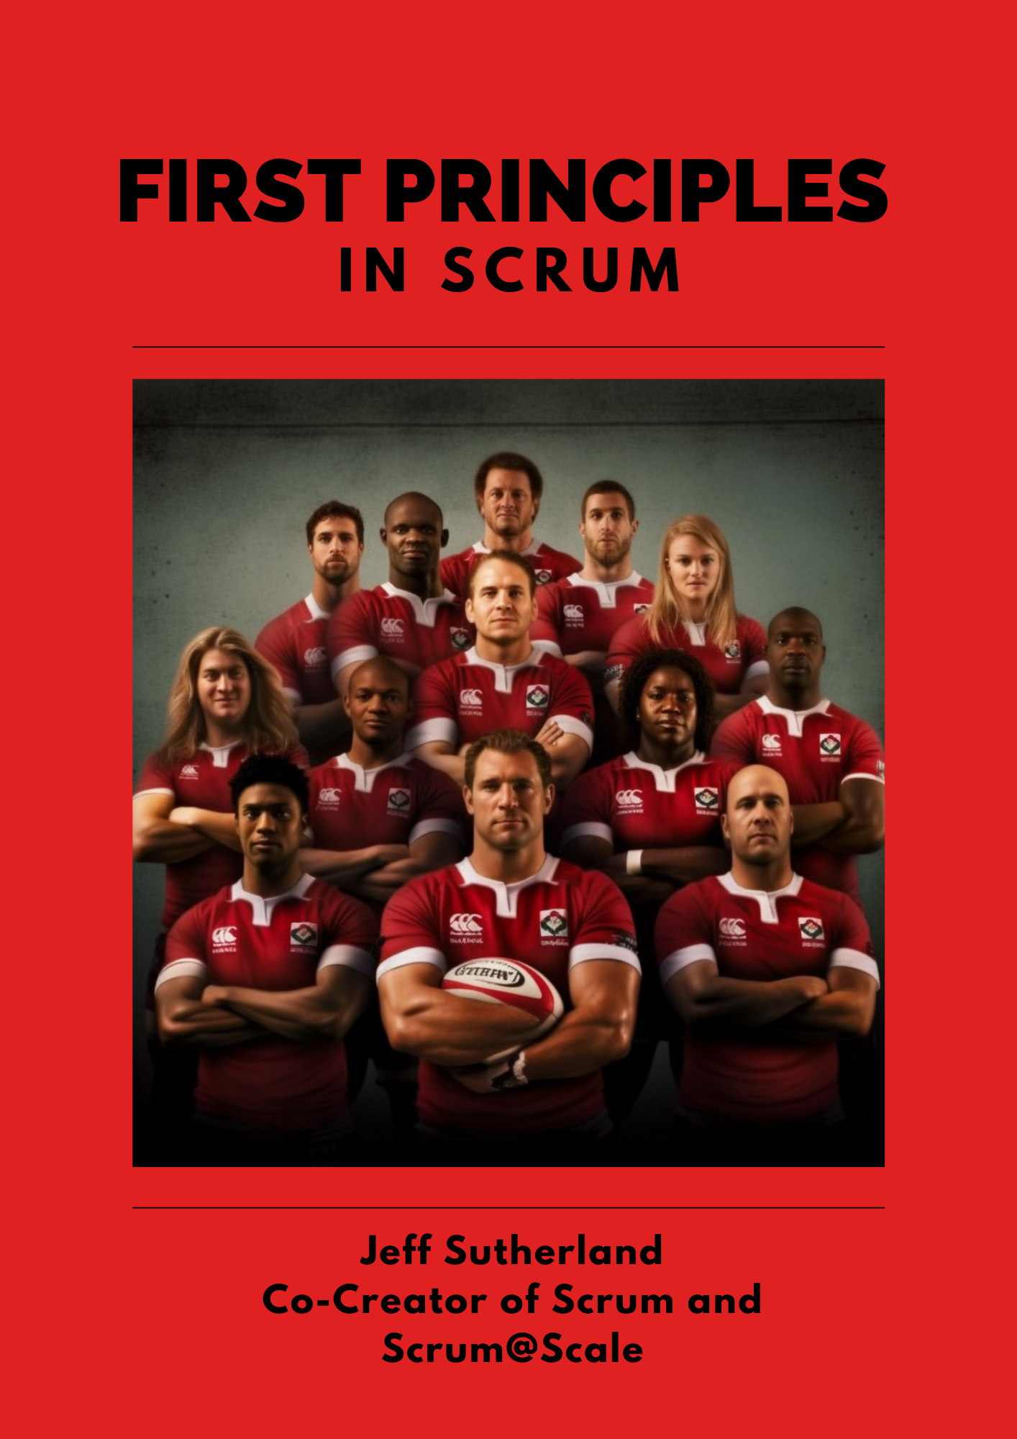
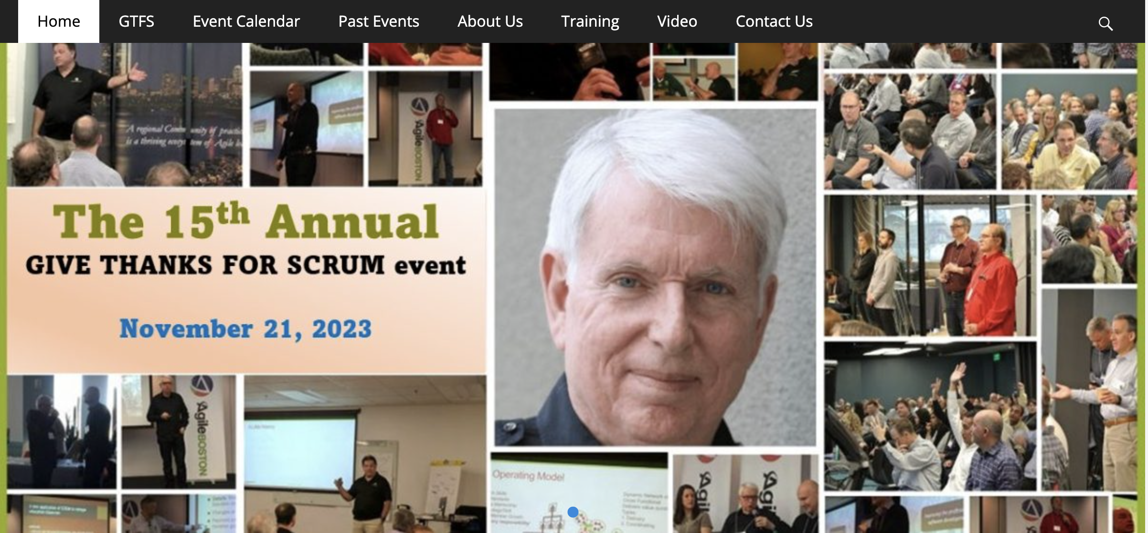
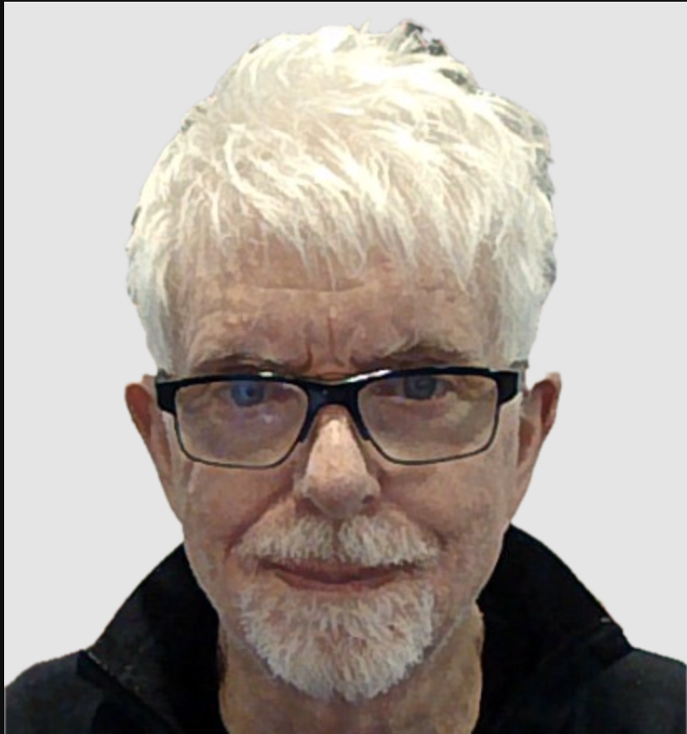
Computational Irreducibility:
The Law of Physics That Mandates Inspecting and Adapting
Dr. Jeff Sutherland
Scrum Pioneer and Co-Creator of Scrum and Scrum@Scale
Agile Manifesto Signatory
Notes:
AI won’t take your job. Someone using AI will.
I’m using Ohno, a leading coach and consultant on Scrum and Scrum@Scale as my copilot.

Slide 2
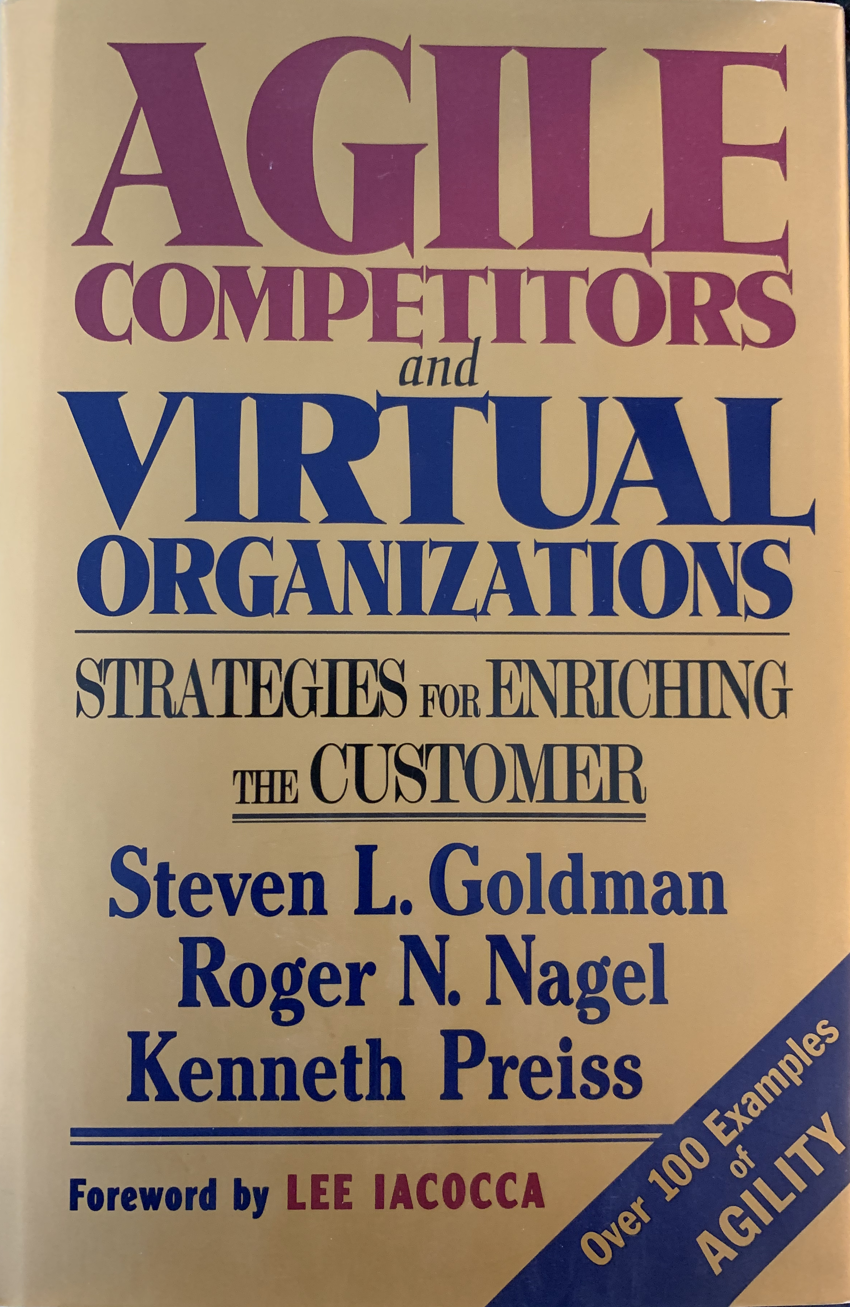
Agile Manifesto Day 1 Snowbird, Utah, 11-13 Feb 2001
17 Signatories
3 Scrum, 4 XP, 10 authors/consultants
Invitation only to leading innovators in software development
First Day – Debating about process
Mike Beedle talked about Agile Competitors and Virtual Organizations
100 lean hardware companies formed an Agile Consortium
We decided to use the word Agile as the umbrella term for lightweight processes

Slide 3
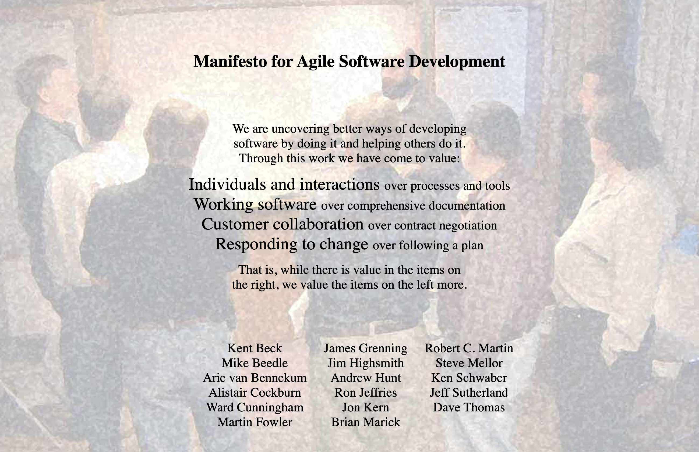
Agile Manifesto Day 2 Snowbird, Utah, 11-13 Feb 2001
10 am coffee break (10 min)
Martin Fowler concerned about getting agreement
8 people stayed in the room
Wrote Agile Values on White Board
Individuals and Interactions over processes and tools
Working Software over Comprehensive Documentation
Customer Collaboration over Contract Negotiation
Responding to Change over Following a Plan
Photo of Coffee Break

Slide 4

Agile Manifesto Day 2-3 Snowbird, Utah, 11-13 Feb 2001
On return from break, Ward Cunningham said the Agile values were awesome. They were accepted without edits
Spent afternoon and next day writing twelve agile principles
We wrote it up and it ”put a dent in the universe.”
Problem: 58% of Agile teams and 53% of Agile Transformations fail
Failure is the result of not understanding First Principles
We had to completely reinvent Scrum Training and Scrum@Scale in 2016 and radically revise the Scrum Guide in 2020

Slide 5
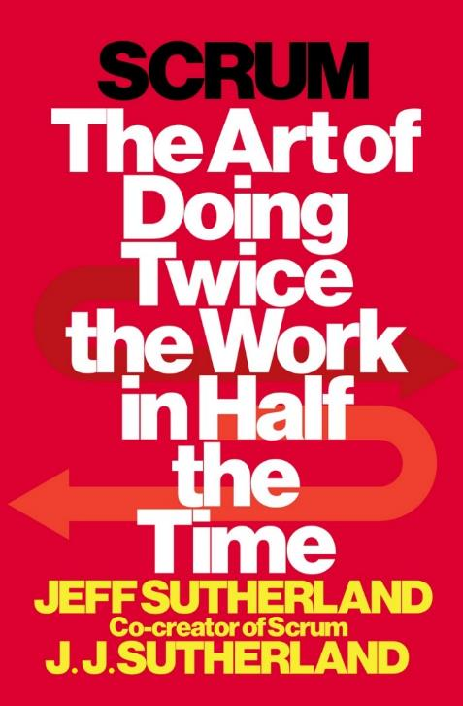
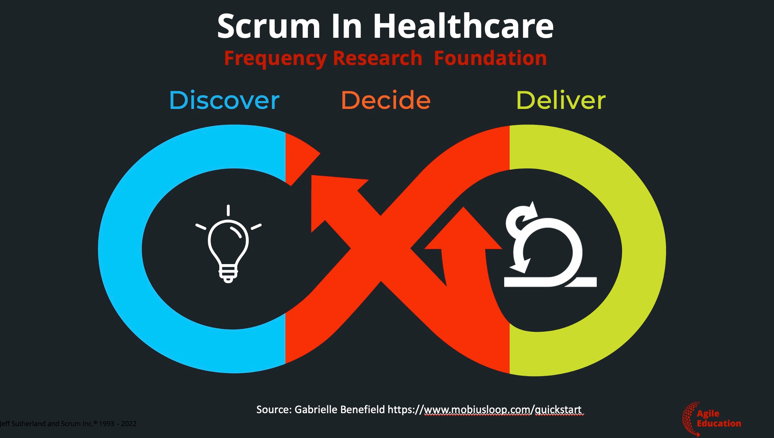
First Principles in Scrum leanpub.com/firstprinciplesinscrum
Incorporates answers to thousands of Agile and Scrum questions
Based on my training as a radiation physicist and Professor of Radiology
Venture funded by Tesla Investment Holdings LLC
As Managing Partner, we regularly review First Principles used by Elon Musk to create Tesla, the world’s most Agile company.
Working full time on TEHS Scrum Framework for Health and Performance based on biophysics.
Second
Edition

Slide 6
Working From First Principles – Six Layers Responding to Change is the Way the Universe Works
🌀 Wolfram's Physics Project
🎲 Computational irreducibility
🤯 Universe = Unpredictable
🔬 Physics
🚀 Force = ma
🛠️ Work = Force x Distance
⏱️ Power = Work/Time
🌌 Relativity & Quantum Physics: They just show up!
🌱 Evolution is Inspect and Adapt
🎯 Predictive capability: Less surprise = More survival
🧠 Friston's Free Energy: The secret sauce
🌐 Complex Adaptive Systems Emerge (CAS)
🤖 Autonomous agents: Racing at the edge of chaos 🌀
🏉 Scrum Emerges as Framework for CAS
💪 Empowerment
🤝 Self-management
🛡️ Leader who serves
🌱 Sustainable pace
🌈 Four Agile Values Emerge as Guideposts
💥 Unleash personal power: Build great teams
🔄 Rapid iteration: Faster, better, cheaper products
🤝 Make the customer & AI part of the team
🌪️ Universe is unpredictable: Adapt or perish

Slide 7

Wolfram’s Physics Project The most important advancement in physics in recent decades
🌀 Wolfram's Physics Project
🎲 Computational irreducibility
🤯 Universe = Unpredictable
Wolfram simulated the universe
The ruliad - simple rules operating on nodes in space generate complex phenomena
Time measured as the change in connections between the nodes in space
Predicting outcomes of a simulation requires infinite computing power
Empirical process control is essential
GANTT charts are always wrong and Agile is the solution

Slide 8
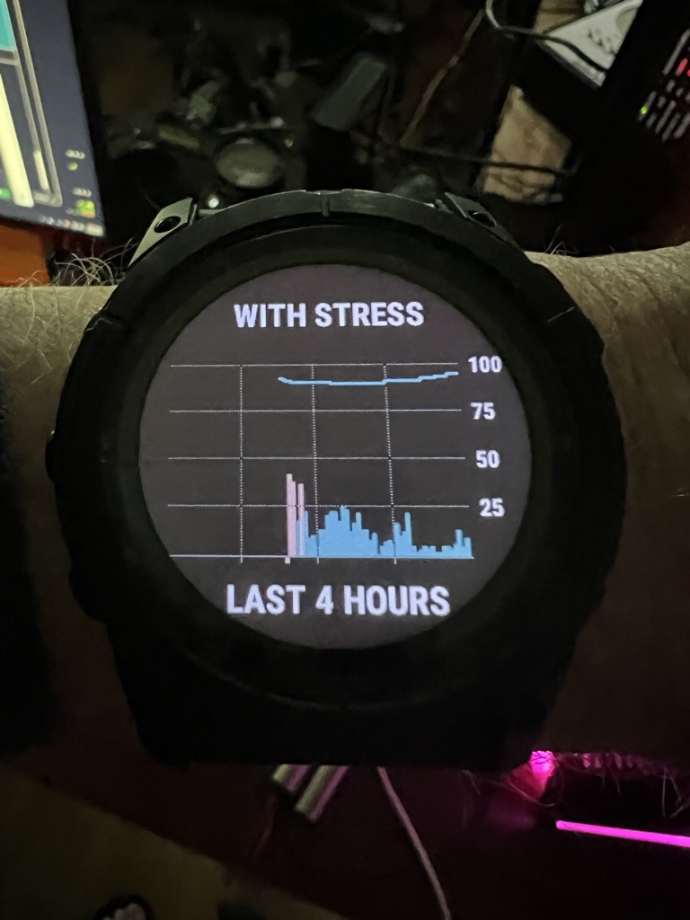
Newton’s Laws, Relativity, and Quantum Mechanics They all emerge from the ruliad
🔬 Physics – applies to individuals, teams, and organizations
🚀 Force = Mass x Acceleration
🛠️ Work = Force x Distance
⏱️ Power = Work/Time
🌌 Relativity & Quantum Physics: They just show up!
Twice the Work in Half the Time
Requires four times the Power
Personal Power is measurable
Power Depends on Twice the Energy with Half the Stress
FirstBeat analytics for Olympic teams
Incorporated into the Garmin watch
Better plan, fewer surprises, more innovation

Slide 9

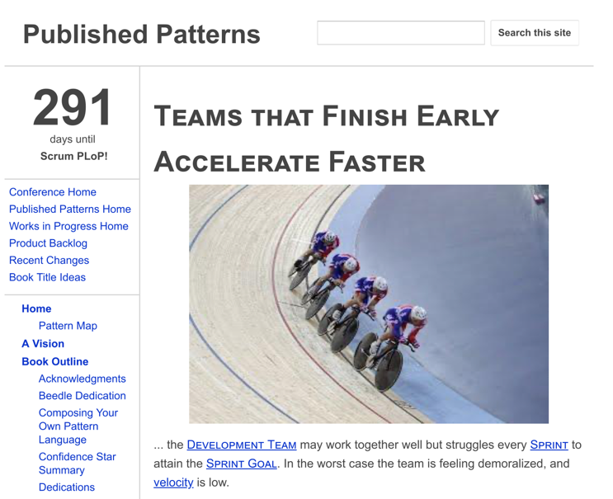
Physics Drives Biological Evolution The brain emerged as a prediction engine that tries to minimize surprise
🌱 Evolution is Inspect and Adapt
🎯 Predictive capability: Less surprise = More survival
🧠 Friston's Free Energy: The secret sauce
Failed Prediction Wastes Energy and Increases Stress
Single most important pattern for hyperproductive teams - Teams That Finish Early Accelerate Faster
Finishing early requires Sustainable Pace
Sustainable pace minimizes the Bayesian surprise (cost of mental/emotional reset)
This saves energy for innovation which increases speed and quality of product

Slide 10

Complex Adaptive Systems Cross-functional, autonomous teams collaborating to achieve a goal
🌐 Complex Adaptive Systems Emerge (CAS)
🤖 Autonomous agents: Racing at the edge of chaos 🌀
Langton, at Los Alamos Labs, Mathematically Proved That Systems Operating at the Edge of Chaos Evolve Faster
This was a fundamental insight that generated Scrum
Also showed complex phenomena generated by simple rules cannot be predicted - forerunner of Wolfram’s Physic’s Project
AI, robotics, and Scrum all evolved out of complex adaptive systems theory

Slide 11
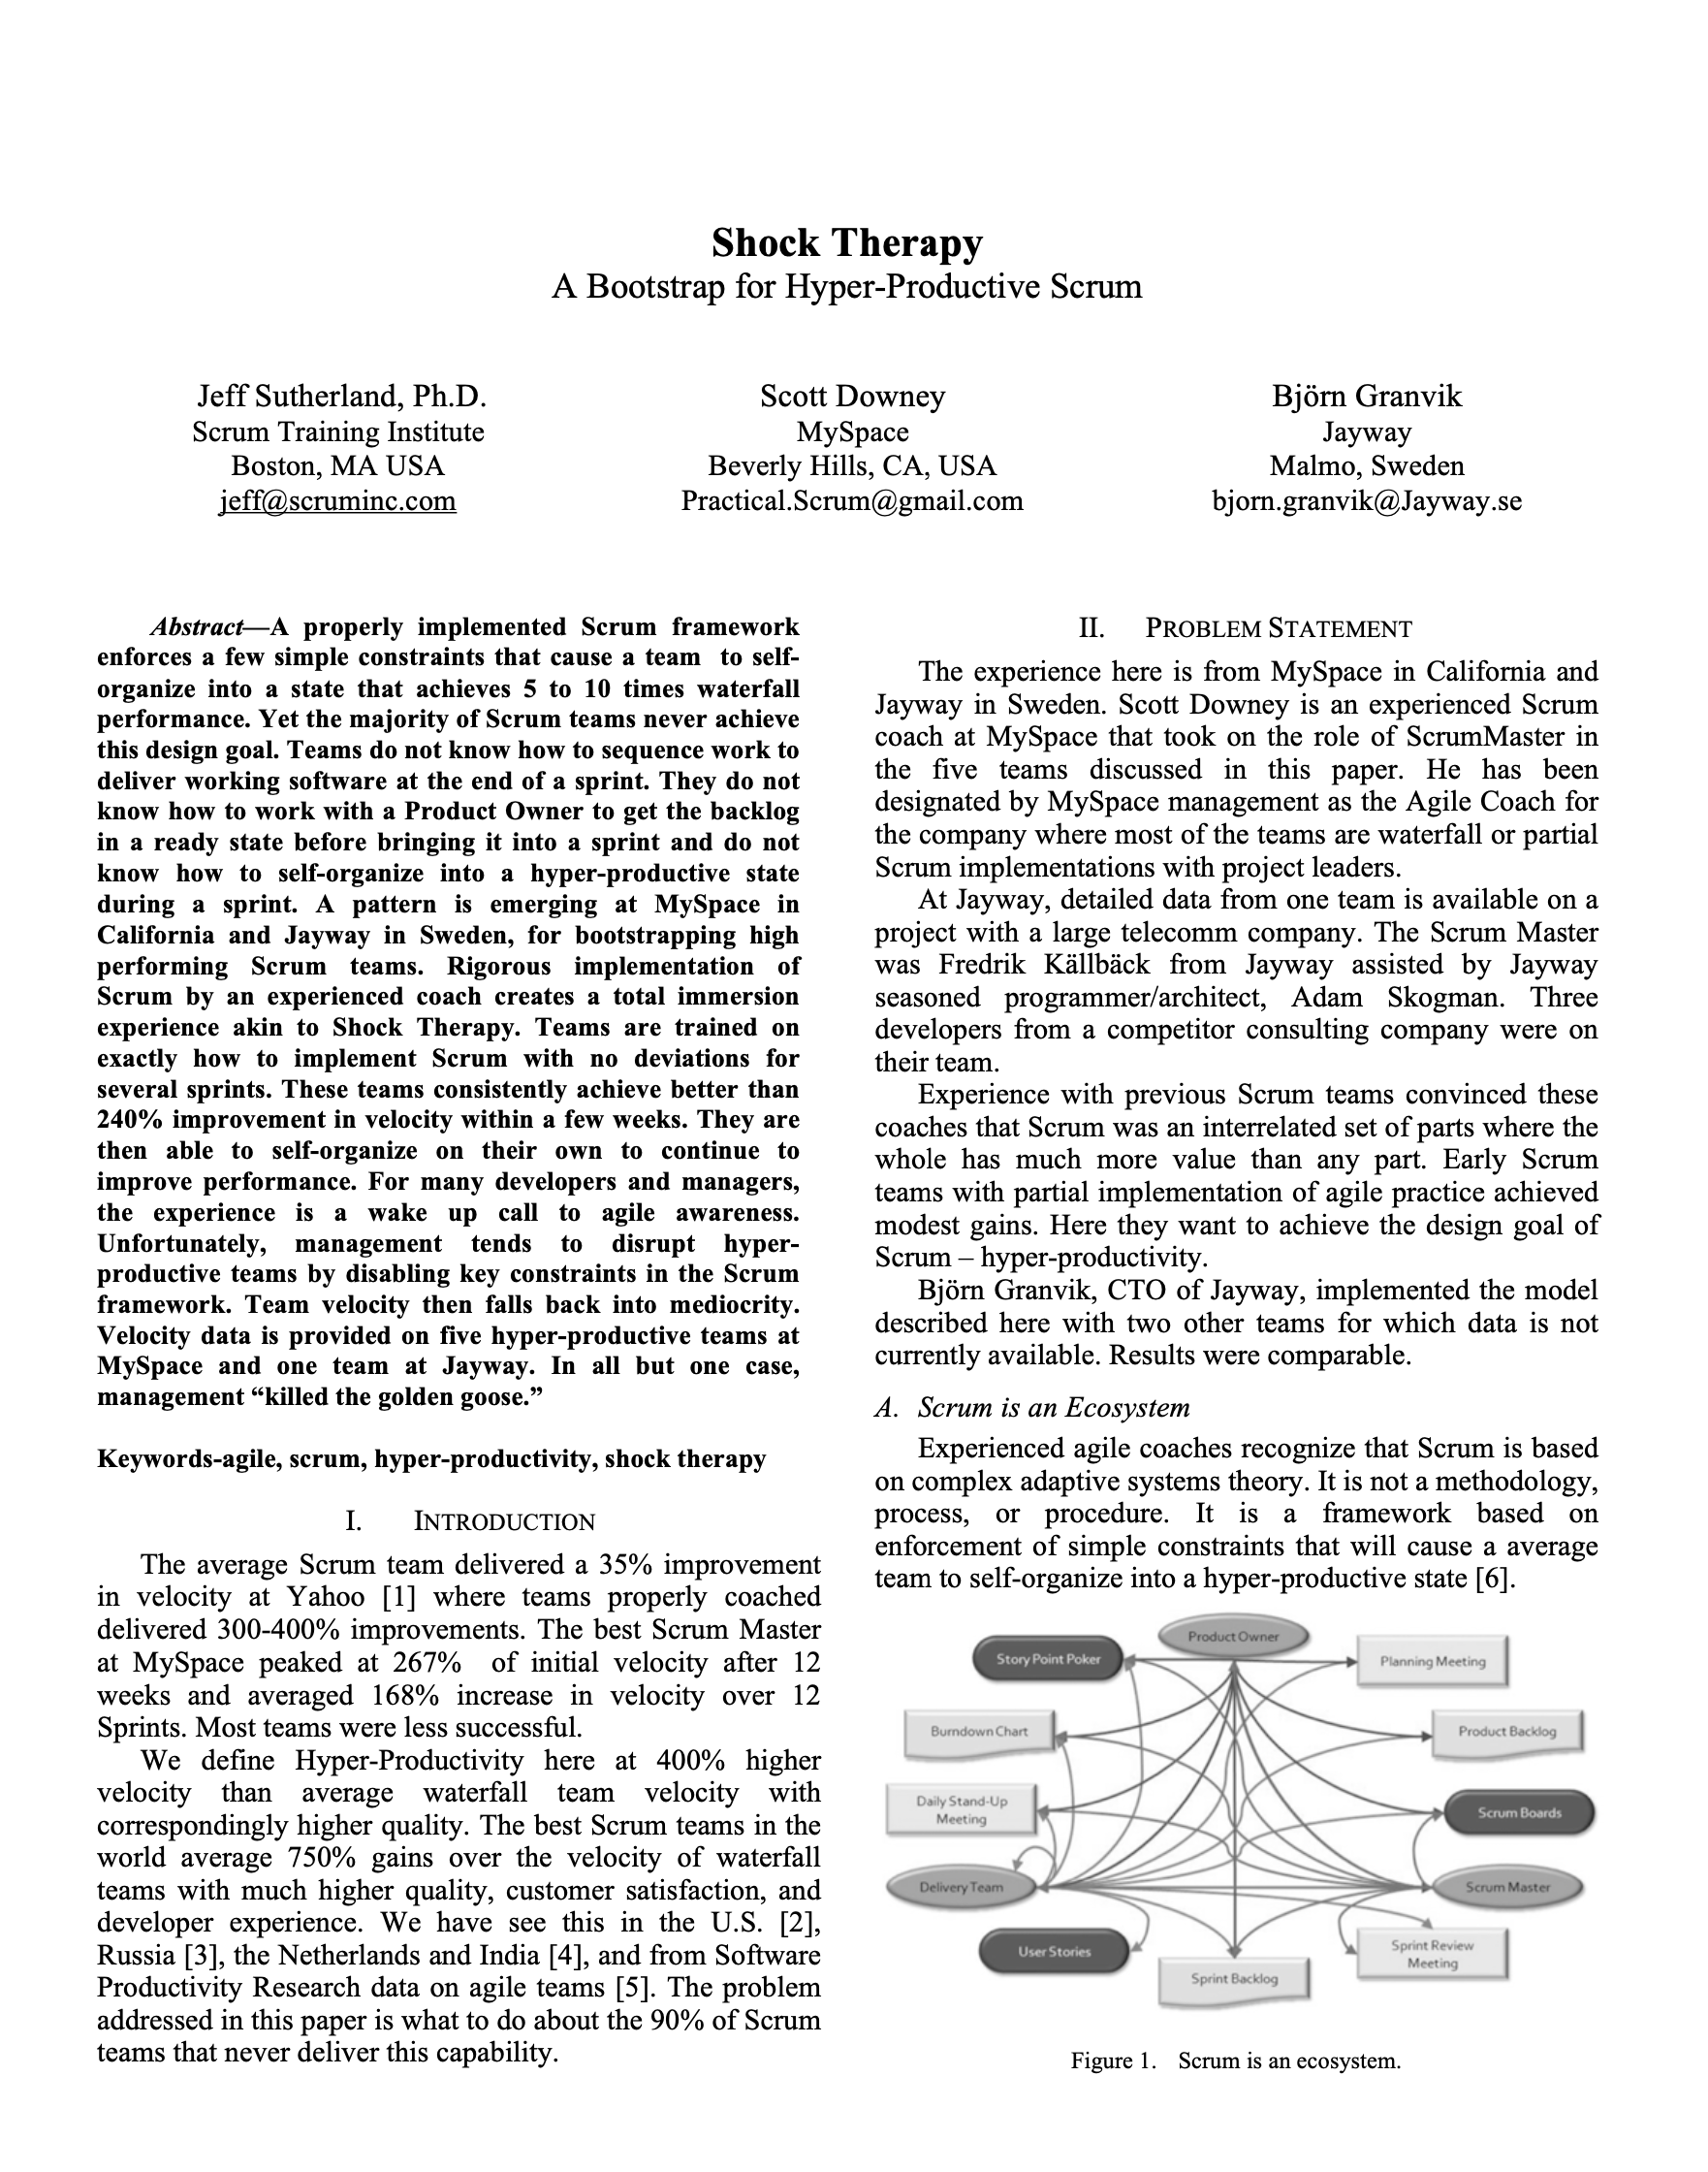
Autonomous Teams Emerge From Being Empowered Empowerment is done systematically by Agile Leaders
The Ladder of Empowerment
Phase 1: Command and Control
Here is how we do it.
Phase 2: Guided Discovery
What do you see?
Phase 3: Shared Analysis
What do you think?
Phase 4: Delegated Decision Making
What should we do?
Phase 5: Autonomous Operation
How is it going?
See Shock Therapy Paper
This can be done in 1-2 one week sprints

Slide 12
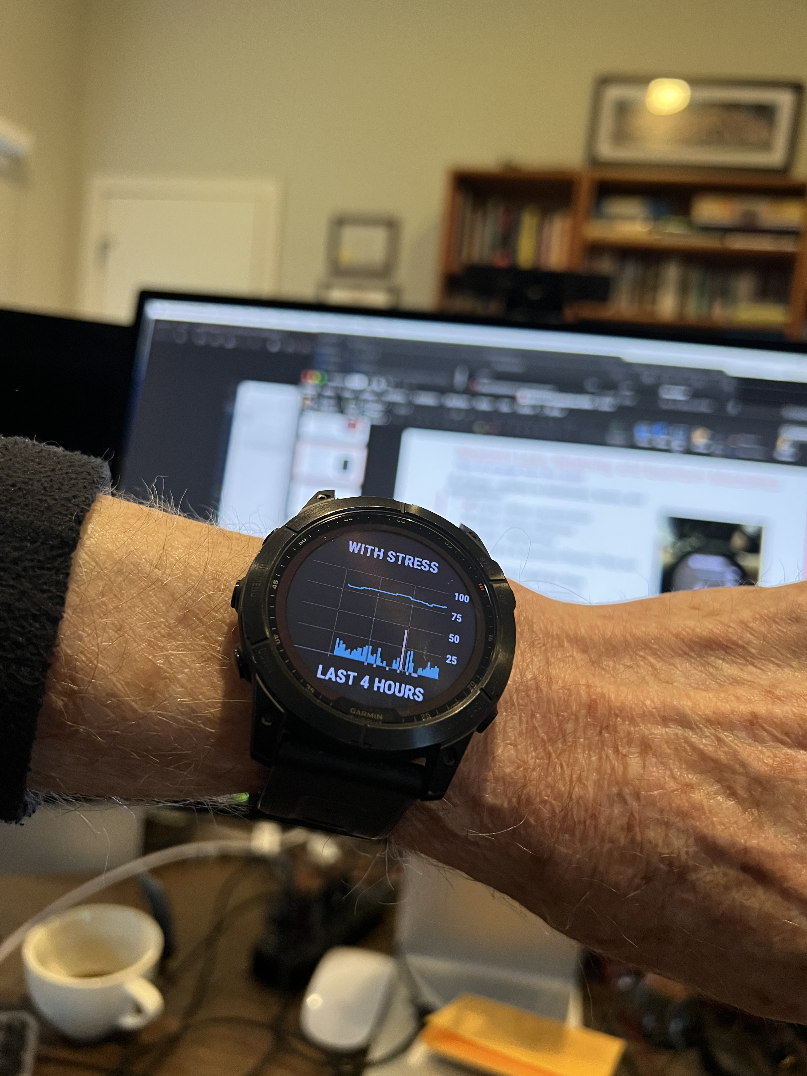
Scrum: A Hyperproductive Pattern Language Based on Complex Adaptive Systems and Working at the Edge of Chaos
This is Sustainable Pace
🏉 Scrum Emerges as Framework for CAS
💪 Empowerment
🤝 Self-management
🛡️ Leader who serves
🌱 Sustainable pace
Empowered Teams Self-Manage
Leaders who serve empower teams
Teams That Finish Early Accelerate Faster emerges from Friston’s Free Energy Model of the brain. Requires sustainable pace.
Twice the Energy, Half the Stress

Slide 13

Agile Emerged Out of Scrum and XP It is a generalized set of values and principles
🌈 Four Agile Values Emerge as Guideposts
💥 Unleash personal power: Build great teams
🔄 Rapid iteration: Faster, better, cheaper products
🤝 Make the customer & AI part of the team
🌪️ Universe is unpredictable: Adapt or perish
Individuals and Interactions Over Processes and Tools
A team is set of individuals with interactions that self-manage towards a common goal
Adherence to First Principles determine success or failure
Individual Self-Managing Sustainable Pace

Slide 14

58% of Agile Teams Fail, 88% are Scrum Teams They are late, over budget, with unhappy customers
🏉 Agile in Name Only
💪 Lack of empowerment
🤝 Lack of Self-management
🛡️ Lack of Leader who serves
🌱 Lack of Sustainable pace
Weaponization of Terms to Justify Failure
Team members sometimes claim they can do anything they want because that is self-organization. Had to remove this term from the Scrum Guide.
Scrum Masters claim they are servant leaders by being a secretary and taking notes. Had to remove this term from the Scrum Guide.

Slide 15
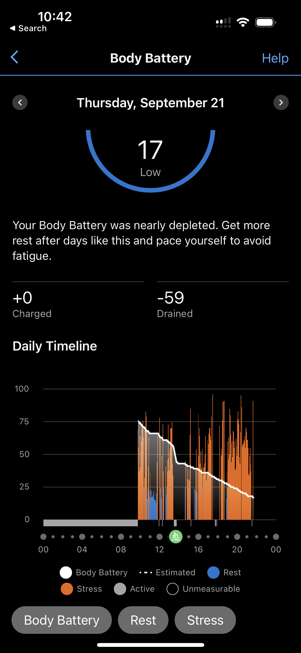
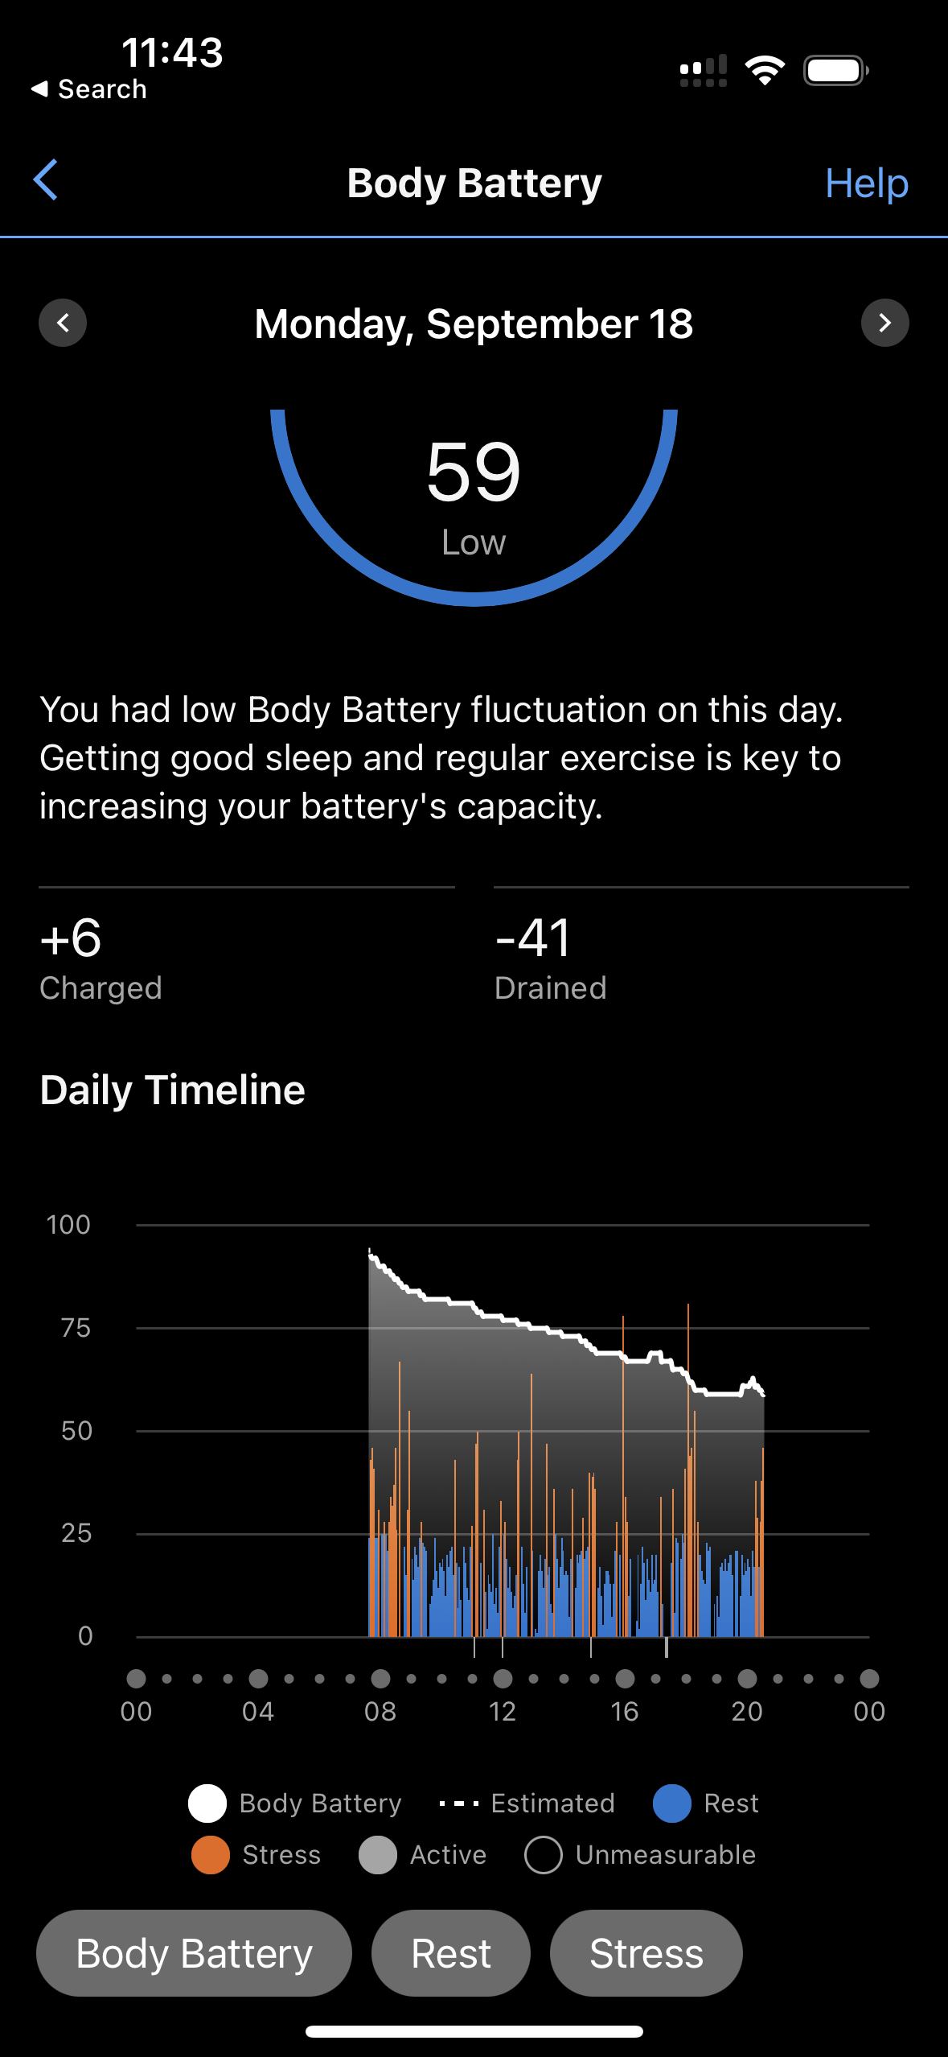
Weaponizing Sustainable Pace – A Cautionary Tale How the misinterpretation of “Sustainable Pace” is sabotaging Agile teams
The Misuse:
Justifying Poor Performance
Misaligned Understanding
Lack of Accountability for Scrum and for Individual Performance
The Original Intent:
Sustaining High Performance
Adaptability within Complex Systems
Team-Level Self-Management
Course Correction:
From "Servant Leadership" to "Leader Who Serves"
From "Self-Organizing" to "Self-Managing"
From "Sustainable Pace" to "Sustained High Performance"
Ohno says: You need to understand the essence of terms to prevent misuse, Implement checks and balances, and realign with Agile and Scrum principles

Slide 16
The Intent of Agile Manifesto Sustainable Pace Principle 8: Agile processes promote sustainable development. The sponsors, developers, and users should be able to maintain a constant pace indefinitely.
Setting Up for Success:
Hyperproductive Patterns: Yesterday's Weather, Buffer Pattern
Master Pattern: Teams that Finish Early Accelerate Faster
The Individual Factor:
Aligning with the first value of the Agile Manifesto
Personal Responsibility & Team Support
Life-Work Balance for Sustained Performance
Measurable Metrics:
Olympic Team Training Analytics
Ohno says: The true meaning of "sustainable pace" is about sustaining high performance, both at the team and individual level. Measurement and adaptability are key.
Better plan, fewer surprises, more innovation

Slide 17

Using Sustainable Pace to Achieve Transcendence The first Scrum team was a transcendent team
First Scrum team members said it was different that anything they had previously experienced
The looked forward to coming to work every day
Their work together was exhilarating
Fellow team members lifted them to a level beyond where they could go alone.
They learned how to finish sprints early
Yesterday’s weather, Interrupt buffer, Emergency procedure
Finished second monthly sprint in 4 days
They mastered the neuroscience accelerators
Better plan, fewer surprises, more innovation

Slide 18
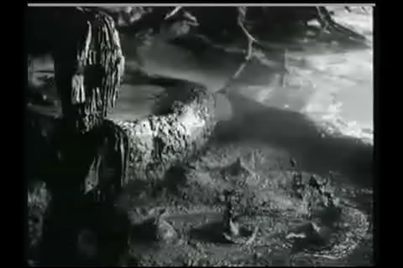
Neuroscience Accelerators Regulate Happiness and Productivity Agile leaders need to understand how individuals and interactions work
Collaborative Environment and Social Neuroscience
Mirror Neuron Effect
Iterative Progress and the Zeigarnik Effect
Feedback Loops and Dopamine Reward System
Adaptive Change and Neuroplasticity
Empirical Process Control and Predictive Coding
Vagus Nerve Stimulation and Emotional Regulation
Haka stimulates vagus nerve
Aligns the team and make them fearless

Slide 19
Work Bottom Up From First Principles If you are not finishing early you will not accelerate faster!
🌈 Four Agile Values Emerge as Guideposts
🏉 Scrum Emerges as Framework for implementing CAS
🌐 Complex Adaptive Systems Emerge from Evolution
🌱 Evolution Emerges from Physics
🔬 Physics emerges from First Principles
🌀 Wolfram's Physics Project
Computational irreducibility
The universe is unpredictable and GANTT charts are always wrong.
Emergence
The answer to every question lies in a layer below

Slide 20

References
Sutherland, J. (2023) First Principles in Scrum: Teams That Finish Early Accelerate Faster. Leanpub.com.
Sutherland, J. (2014). Scrum: The art of doing twice the work in half the time. Crown Business.
Takeuchi, H., & Nonaka, I. (1986). The new new product development game. Harvard Business Review, 64(1), 137-146.
Ohno, T. (1988). Toyota production system: beyond large-scale production. Productivity Press.
Womack, J. P., Jones, D. T., & Roos, D. (1990). The machine that changed the world: The story of lean production. Harper Perennial.
Sutherland, J. and Schwaber, K. (2023). The Scrum Guide. https://www.scrumguides.org/
Sutherland, J. (2021). The Scrum papers: Nuts, bolts, and origins of an agile process, Second Edition. Scruminc.com.
Tupy, J., & Pooley, G. (2022) Superabundance: The Story of Population Growth, Innovation, and Human Flourishing on an Infinitely Bountiful Planet. Cato Institute.

