Slide 1
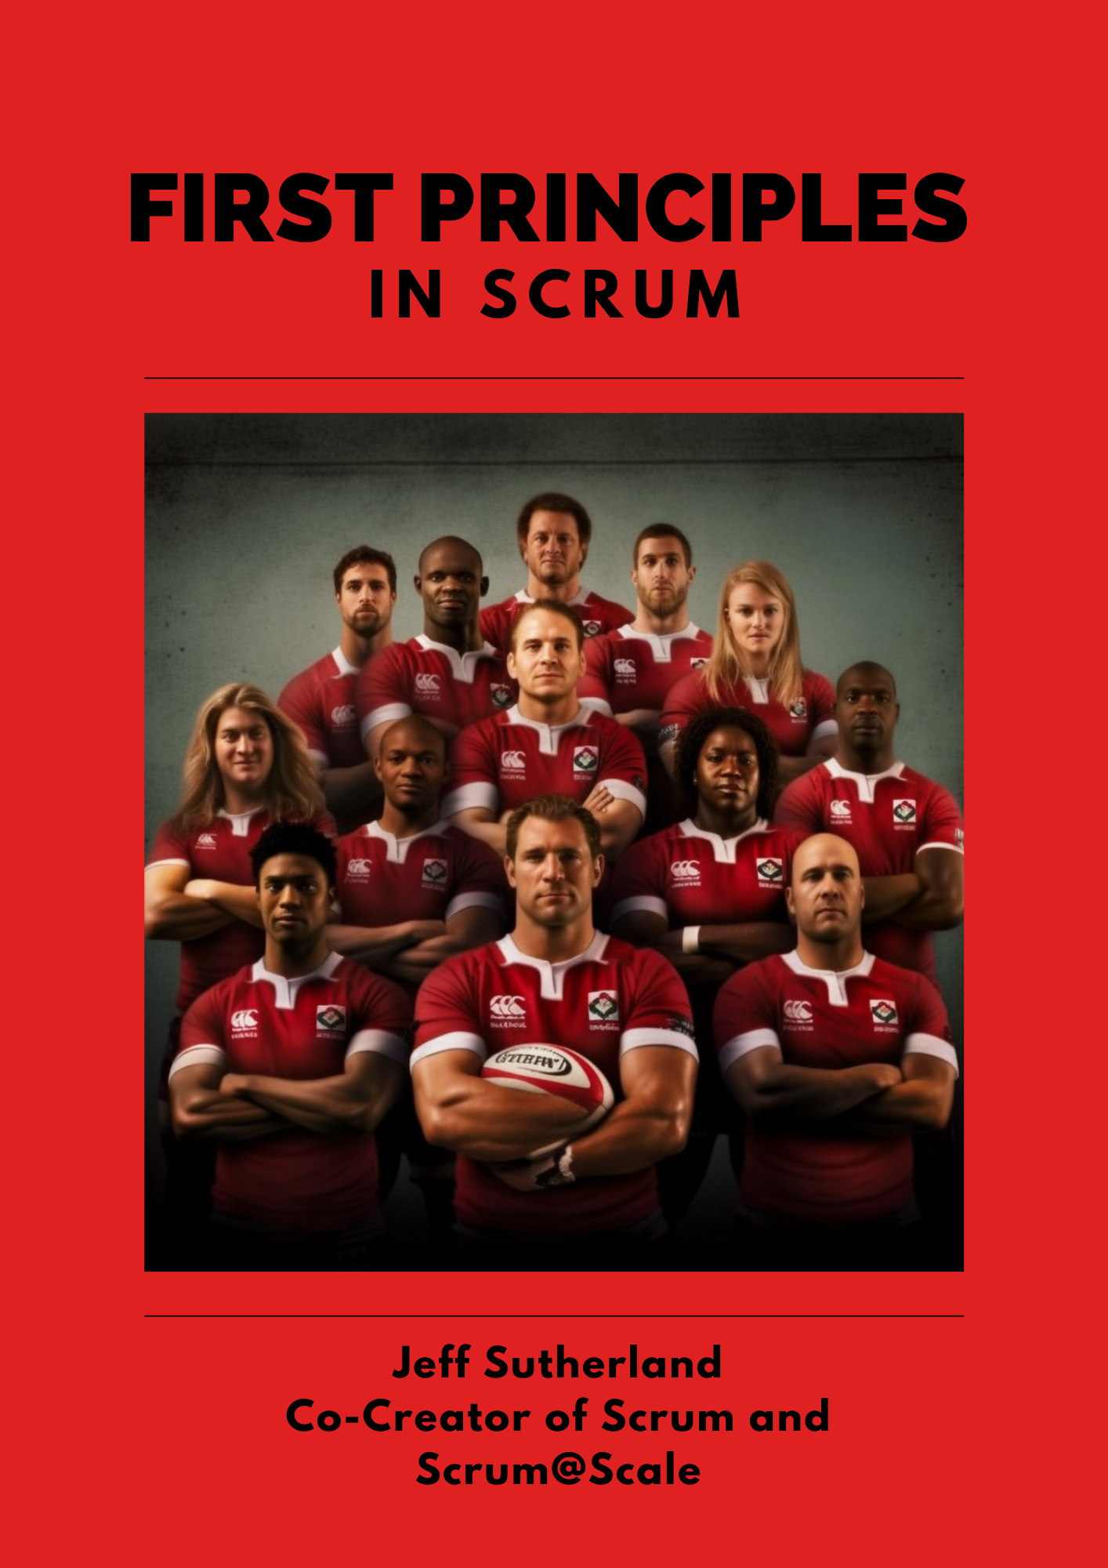

The Agile Manifesto Revisited: The Urgent Need to Redefine Sustainable Pace
Dr. Jeff Sutherland
Scrum Pioneer and Co-Creator of Scrum and Scrum@Scale
Agile Manifesto Signatory
Notes:
AI won’t take your job. Someone using AI will.
I’m using Ohno, a leading coach and consultant on Scrum and Scrum@Scale as my copilot.

Slide 2
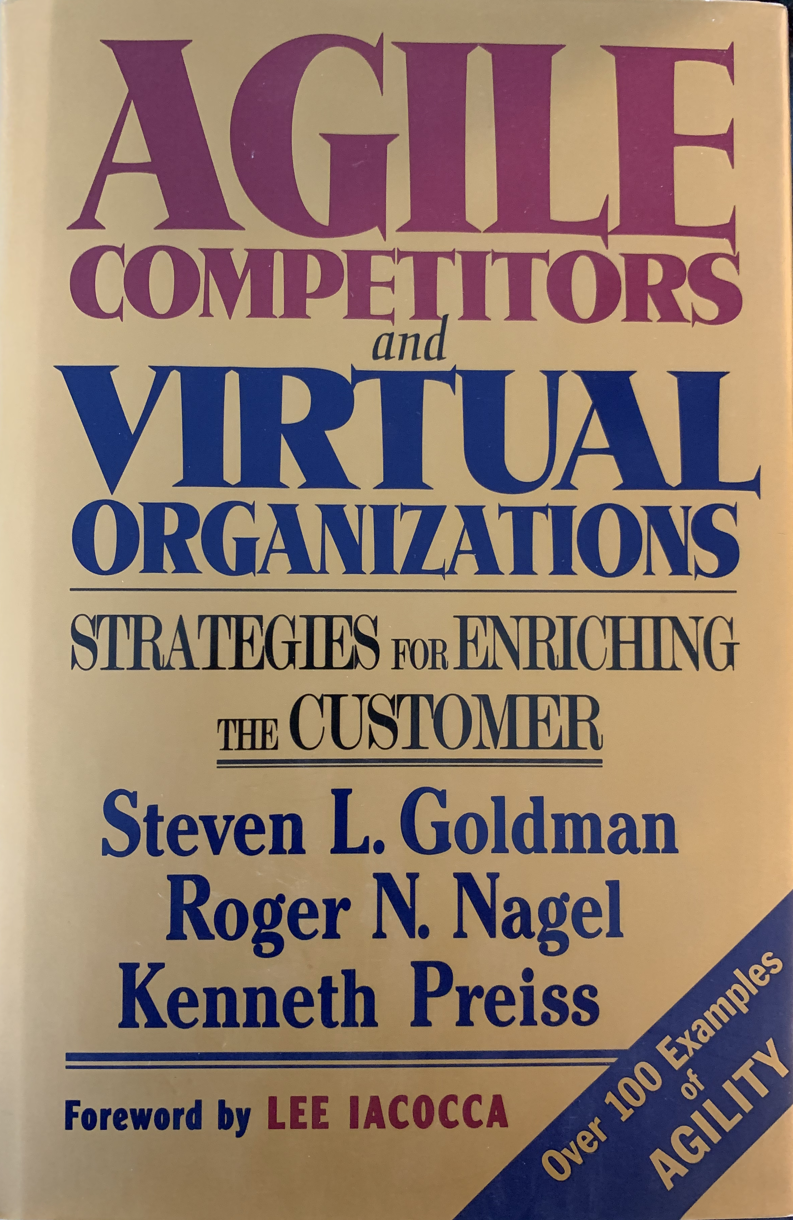
Agile Manifesto Day 1
Snowbird, Utah, 11-13 Feb 2001
17 Signatories
  3 Scrum, 4 XP, 10 authors/consultants
  Invitation only to leading innovators in software development
First Day – Debating about process
  Mike Beedle talked about Agile Competitors and Virtual Organizations
    100 lean hardware companies formed an Agile Consortium
  We decided to use the word Agile as the umbrella term for lightweight processes

Slide 3
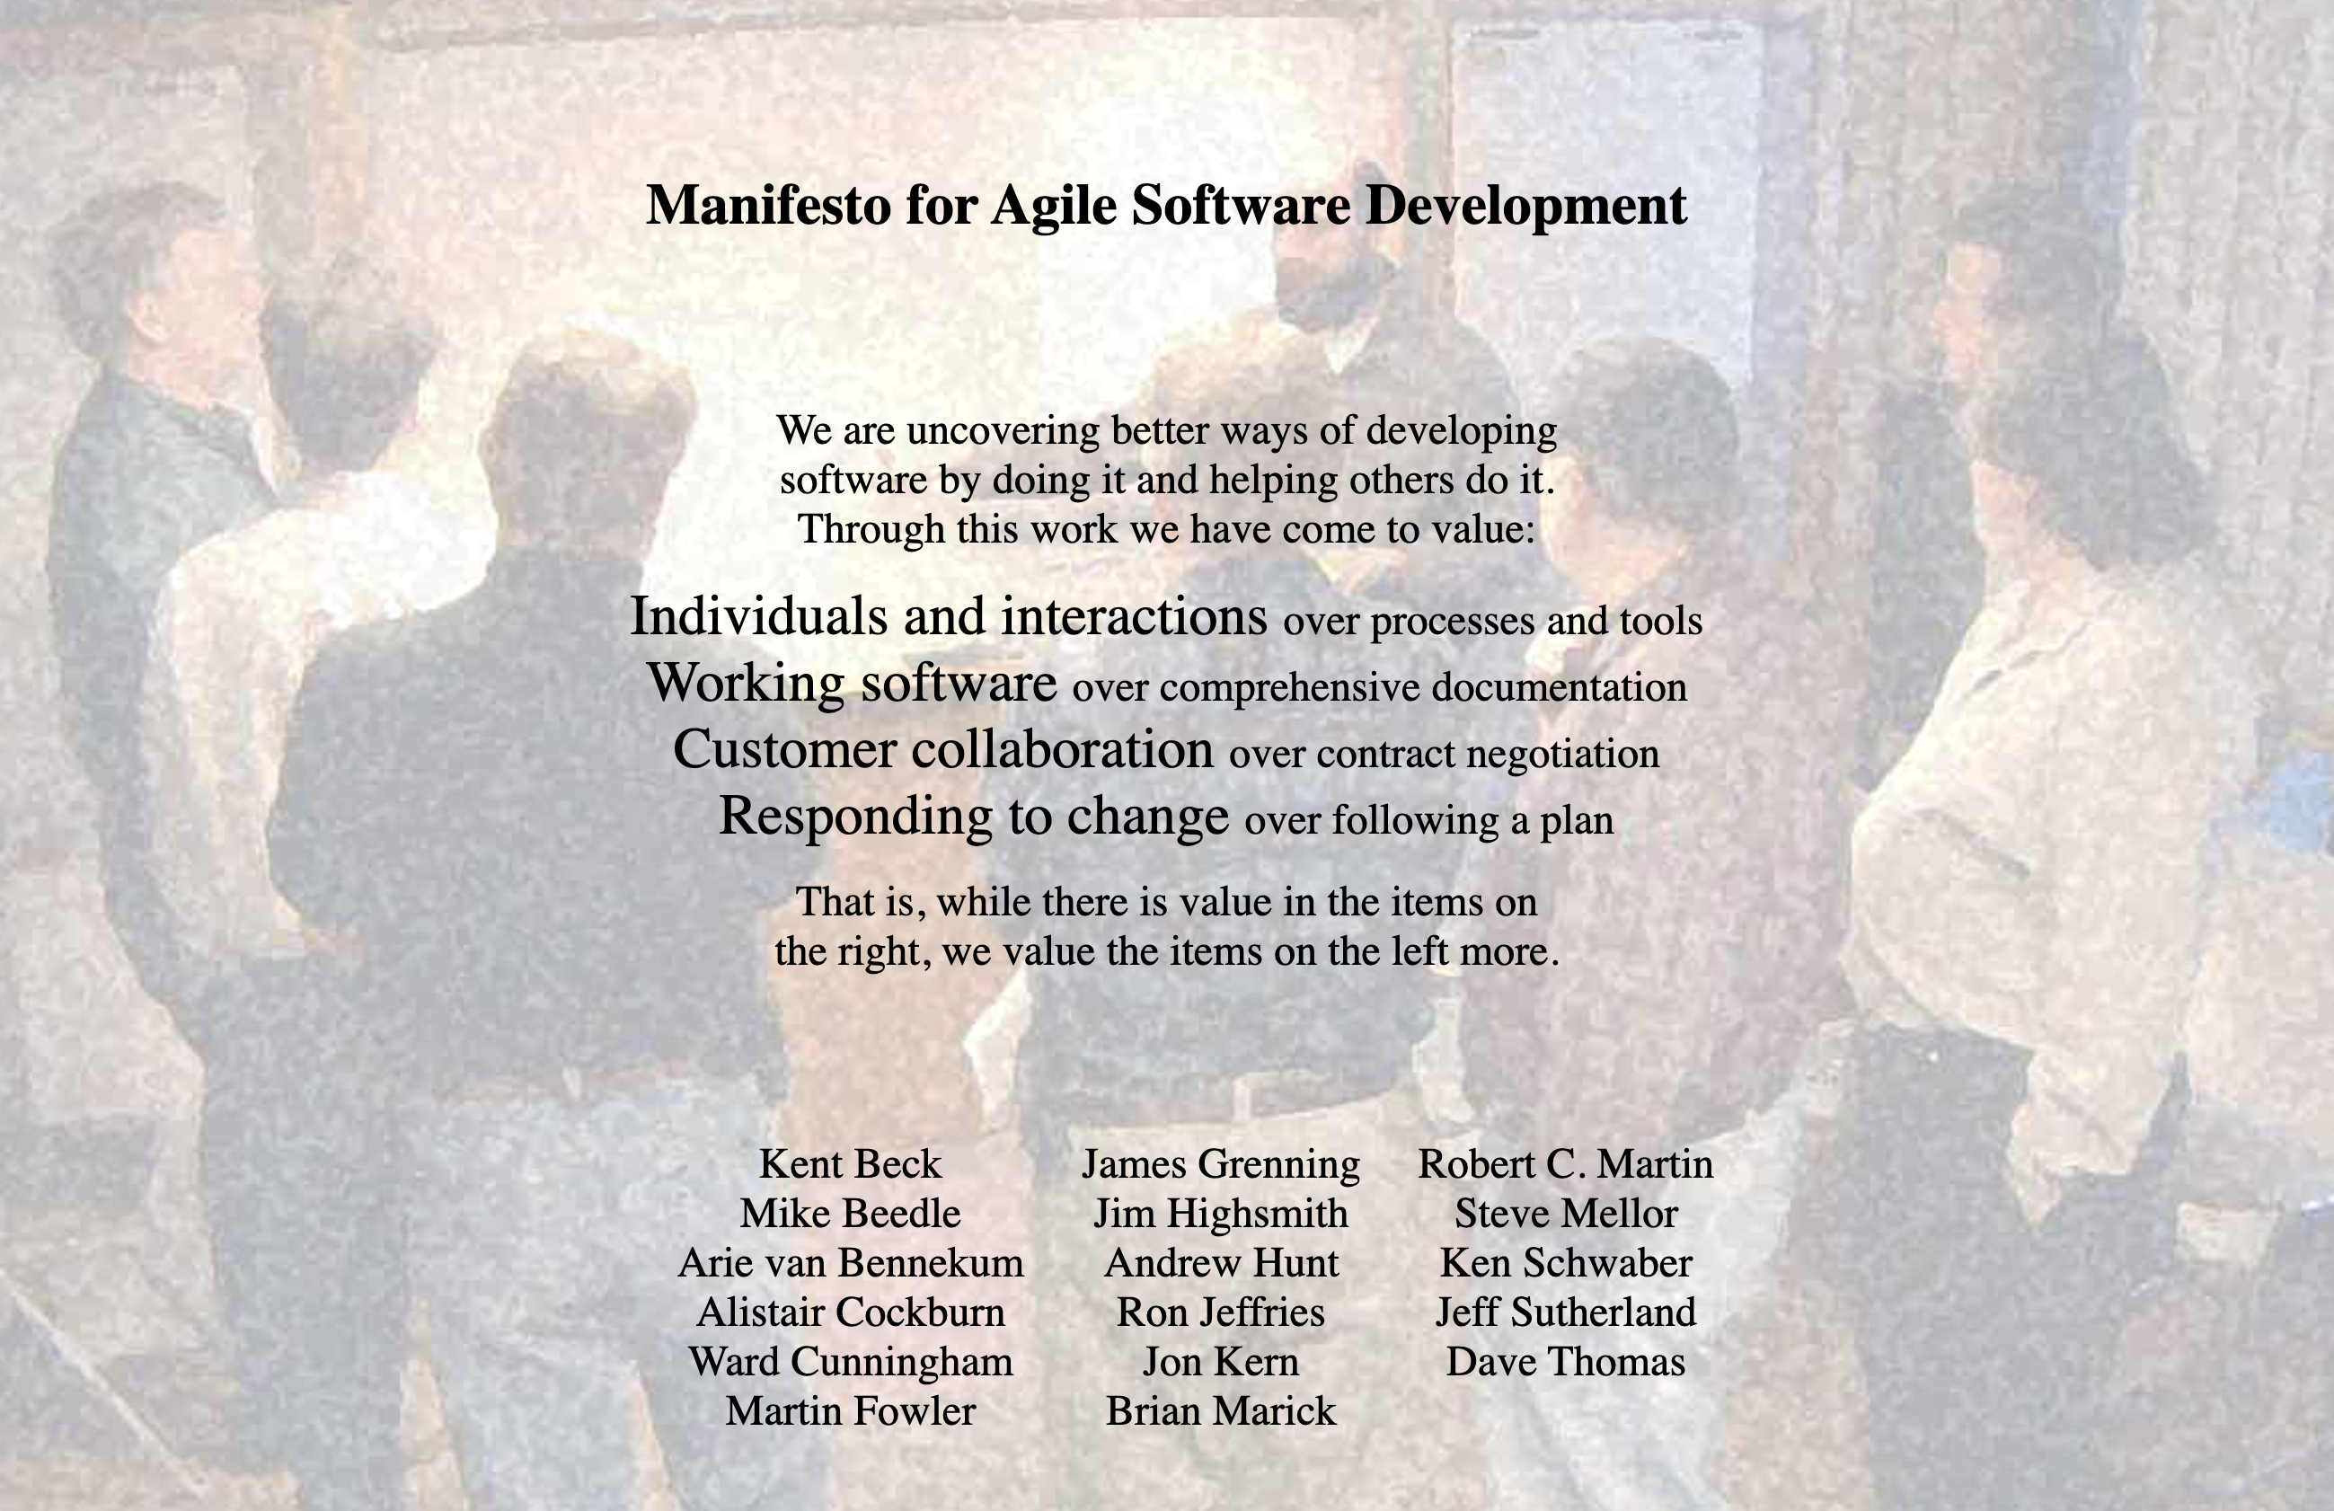
Agile Manifesto Day 2
Snowbird, Utah, 11-13 Feb 2001
10 am coffee break (10 min)
  Martin Fowler concerned about getting agreement
  8 people stayed in the room
Wrote Agile Values on White Board
  Individuals and Interactions over processes and tools
  Working Software over Comprehensive Documentation
  Customer Collaboration over Contract Negotiation
  Responding to Change over Following a Plan
Photo of Coffee Break

Slide 4

Agile Manifesto Day 2-3
Snowbird, Utah, 11-13 Feb 2001
On return from break, Ward Cunningham said the Agile values were awesome. They were accepted without edits
  Spent afternoon and next day writing twelve agile principles
We wrote it up and it ”put a dent in the universe.”
  Problem: 58% of Agile teams and 53% of Agile Transformations fail
Failure is the result of not understanding First Principles
  We had to completely reinvent Scrum Training and Scrum@Scale in 2016 and radically revise the Scrum Guide in 2020

Slide 5
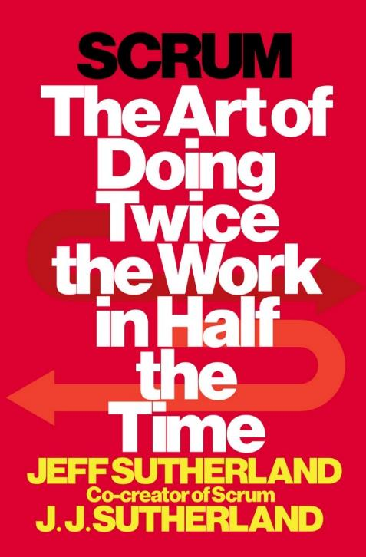
First Principles in Scrum
White papers for the Second Edition of Scrum: The Art of Doing Twice the Work in Half the Time
Incorporates answers to thousands of Agile and Scrum questions
Based on my training as a radiation physicist and Professor of Radiology
Supported by Tesla Investment Holdings LLC
  As Managing Partner, I regularly review First Principles used by Elon Musk to create Tesla, the world’s most Agile company.
Second
Edition

Slide 6
Working From First Principles – Six Layers
Responding to Change is the Way the Universe Works
🌀 Wolfram's Physics Project
  🎲 Computational irreducibility
  🤯 Universe = Unpredictable
🔬 Physics
  🚀 Force = ma
  🛠️ Work = Force x Distance
  ⏱️ Power = Work/Time
  🌌 Relativity & Quantum Physics: They just show up!
🌱 Evolution is Inspect and Adapt
  🎯 Predictive capability: Less surprise = More survival
  🧠 Friston's Free Energy: The secret sauce
🌐 Complex Adaptive Systems Emerge (CAS)
  🤖 Autonomous agents: Racing at the edge of chaos 🌀
🏉 Scrum Emerges as Framework for CAS
  💪 Empowerment
  🤝 Self-management
  🛡️ Leader who serves
  🌱 Sustainable pace
🌈 Four Agile Values Emerge as Guideposts
  💥 Unleash personal power: Build great teams
  🔄 Rapid iteration: Faster, better, cheaper products
  🤝 Make the customer & AI part of the team
  🌪️ Universe is unpredictable: Adapt or perish

Slide 7

Wolfram’s Physics Project
The most important advancement in physics in recent decades
🌀 Wolfram's Physics Project
  🎲 Computational irreducibility
  🤯 Universe = Unpredictable
Wolfram simulated the universe
  The ruliad - simple rules operating on nodes in space generate complex phenomena
  Time measured as the change in connections between the nodes in space
Outcomes of the simulation are unpredictable
  Empirical process control is essential
  This is the root of Agile as implemented by Scrum

Slide 8
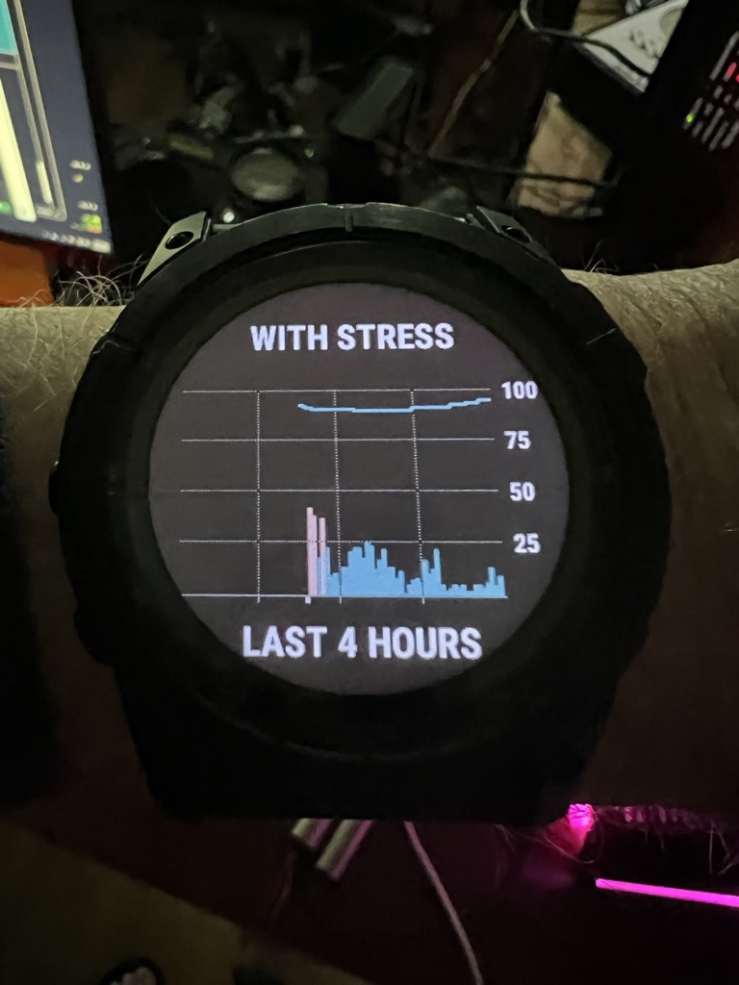
Newton’s Laws, Relativity, and Quantum Mechanics
They all emerge from the ruliad
🔬 Physics – applies to individuals, teams, and organizations
  🚀 Force = Mass x Acceleration
  🛠️ Work = Force x Distance
  ⏱️ Power = Work/Time
  🌌 Relativity & Quantum Physics: They just show up!
Twice the Work in Half the Time
  Requires four times the Power
  Personal Power is measurable
Power Depends on Twice the Energy with Half the Stress
  FirstBeat analytics for Olympic teams
  Incorporated into the Garmin watch
Better plan, fewer surprises, more innovation

Slide 9

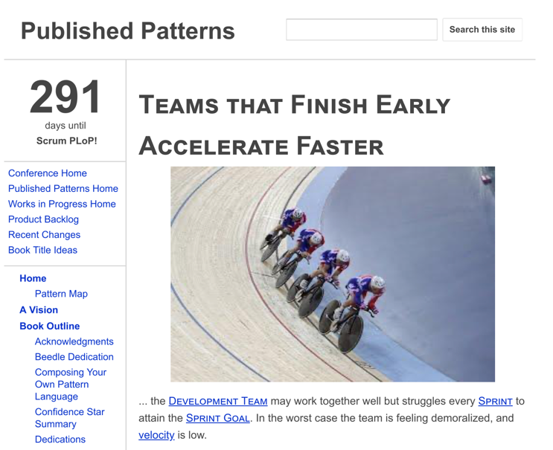
Biological Evolution – The Fittest Survive
The brain emerged as a prediction engine that tries to minimize surprise
🌱 Evolution is Inspect and Adapt
  🎯 Predictive capability: Less surprise = More survival
  🧠 Friston's Free Energy: The secret sauce
Failed Prediction Wastes Energy and Increases Stress
  Single most important metric for hyperproductive teams is pattern - Teams That Finish Early Accelerate Faster
  Finishing early requires Sustainable Pace
  Sustainable pace minimizes the Bayesian surprise (cost of mental/emotional reset)
  This avoids waste and saves energy for innovation

Slide 10

Complex Adaptive Systems
Cross-functional, autonomous teams collaborating to achieve a goal
🌐 Complex Adaptive Systems Emerge (CAS)
  🤖 Autonomous agents: Racing at the edge of chaos 🌀
Langton, at Los Alamos Labs, Mathematically Proved That Systems Operating at the Edge of Chaos Evolve Faster
  This was a fundamental insight that generated Scrum
  Also showed complex phenomena generated by simple rules cannot be predicted - forerunner of Wolfram’s Physic’s Project
  AI, robotics, and Scrum all evolved out of complex adaptive systems theory

Slide 11
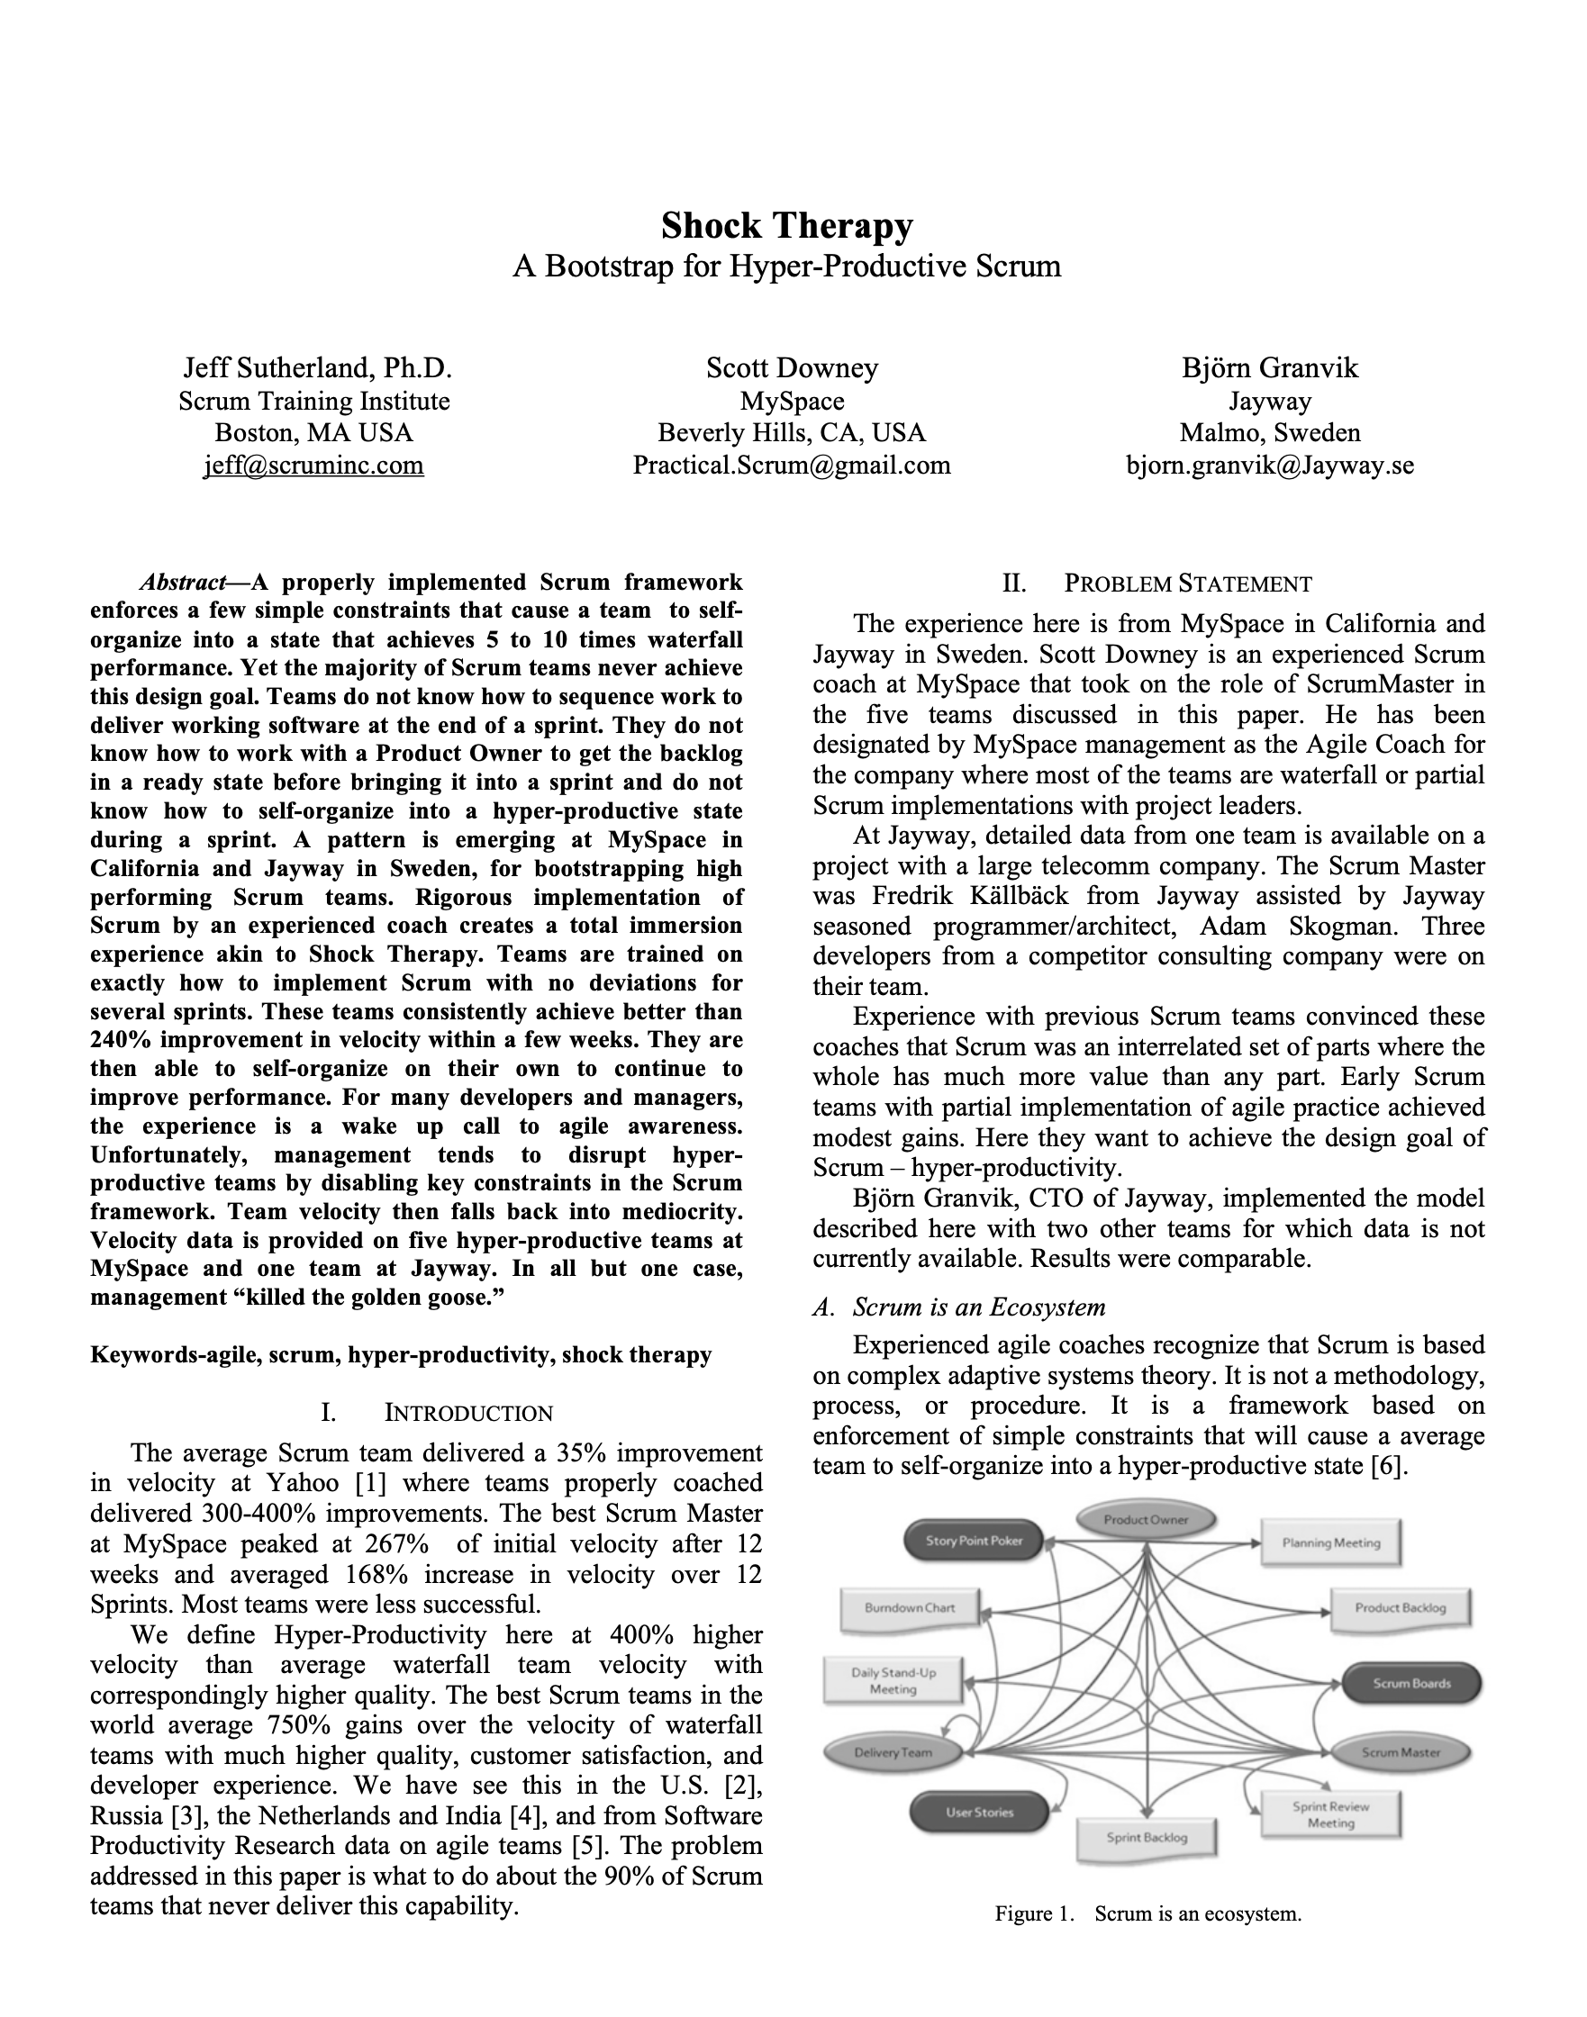
Autonomous Teams Emerge From Being Empowered
Empowerment is done systematically by Agile Leaders
The Ladder of Empowerment
  Phase 1: Command and Control
    Here is how we do it.
  Phase 2: Guided Discovery
    What do you see?
  Phase 3: Shared Analysis
    What do you think?
  Phase 4: Delegated Decision Making
    What should we do?
  Phase 5: Autonomous Operation
    How is it going?
See Shock Therapy Paper
This can be done in 1-2 one week sprints

Slide 12

Scrum: A Hyperproductive Pattern Language
Based on Complex Adaptive Systems and Working at the Edge of Chaos
🏉 Scrum Emerges as Framework for CAS
  💪 Empowerment
  🤝 Self-management
  🛡️ Leader who serves
  🌱 Sustainable pace
Empowered Teams Self-Manage
Leaders who serve empower teams
Teams That Finish Early Accelerate Faster emerges from Friston’s Free Energy Model of the brain. Requires sustainable pace.

Slide 13

Agile Emerged Out of Scrum and XP
It is a generalized set of values and principles
🌈 Four Agile Values Emerge as Guideposts
  💥 Unleash personal power: Build great teams
  🔄 Rapid iteration: Faster, better, cheaper products
  🤝 Make the customer & AI part of the team
  🌪️ Universe is unpredictable: Adapt or perish
Individuals and Interactions Over Processes and Tools
  A team is set of individuals with interactions that self-manage towards a common goal
  Adherence to First Principles determine success or failure
Individual Self-Managing Sustainable Pace

Slide 14

58% of Agile Teams Fail, 88% are Scrum Teams
They are late, over budget, with unhappy customers
🏉 Agile in Name Only
  💪 Lack of empowerment
  🤝 Lack of Self-management
  🛡️ Lack of Leader who serves
  🌱 Lack of Sustainable pace
Weaponization of Terms to Justify Failure
  Team members sometimes claim they can do anything they want because that is self-organization. Had to remove this term from the Scrum Guide.
  Scrum Masters claim they are servant leaders by being a secretary and taking notes. Had to remove this term from the Scrum Guide.

Slide 15
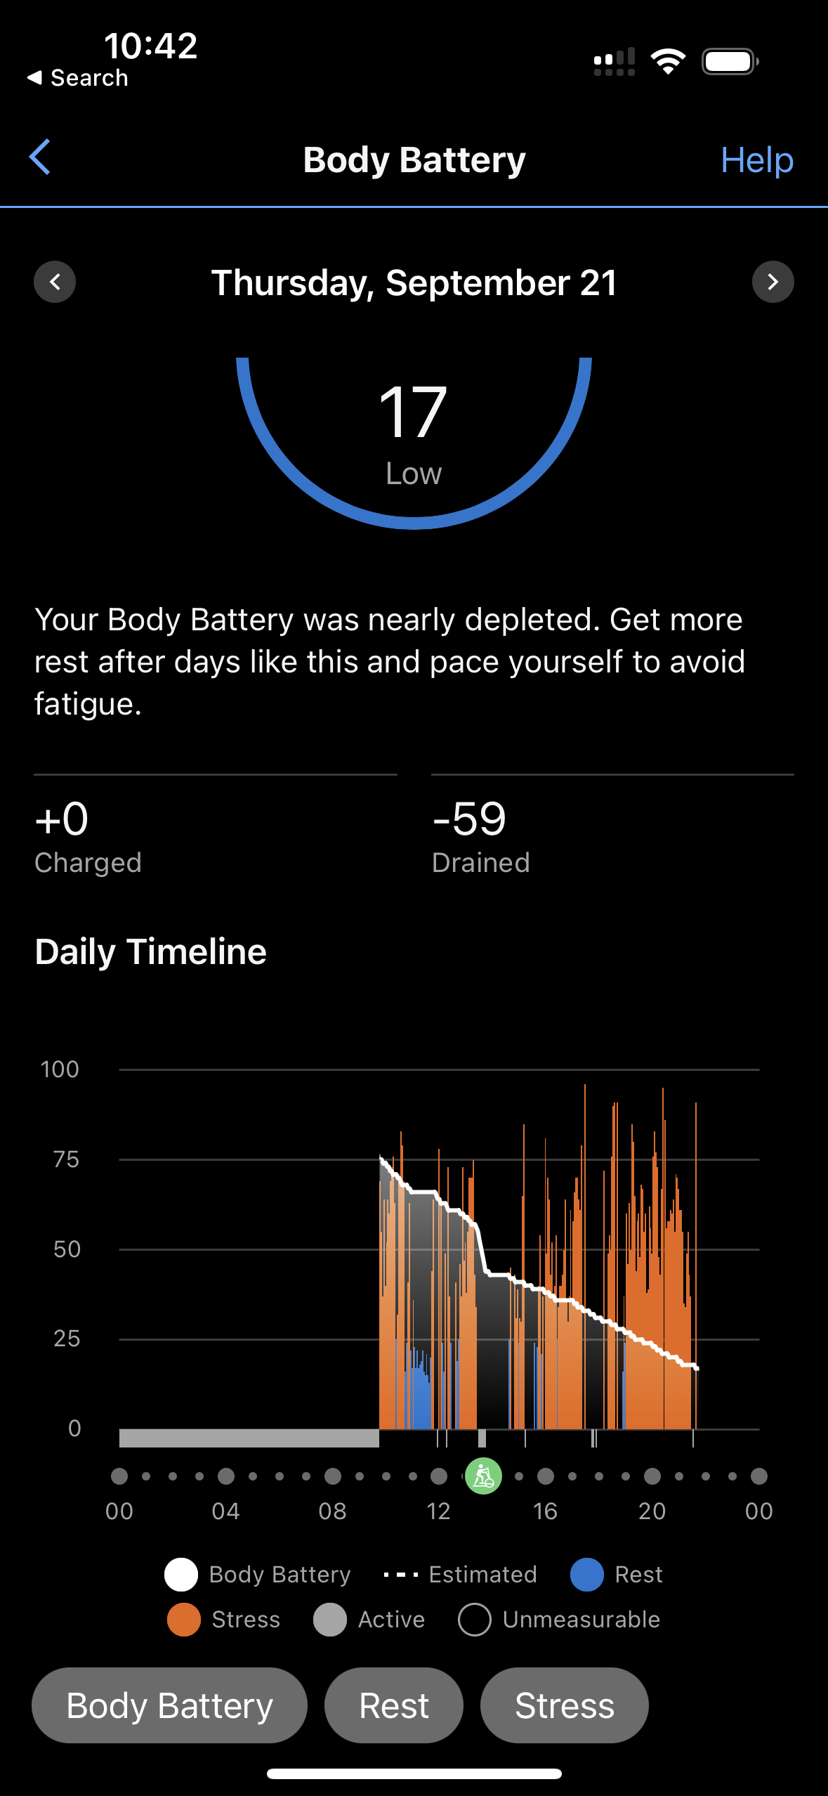
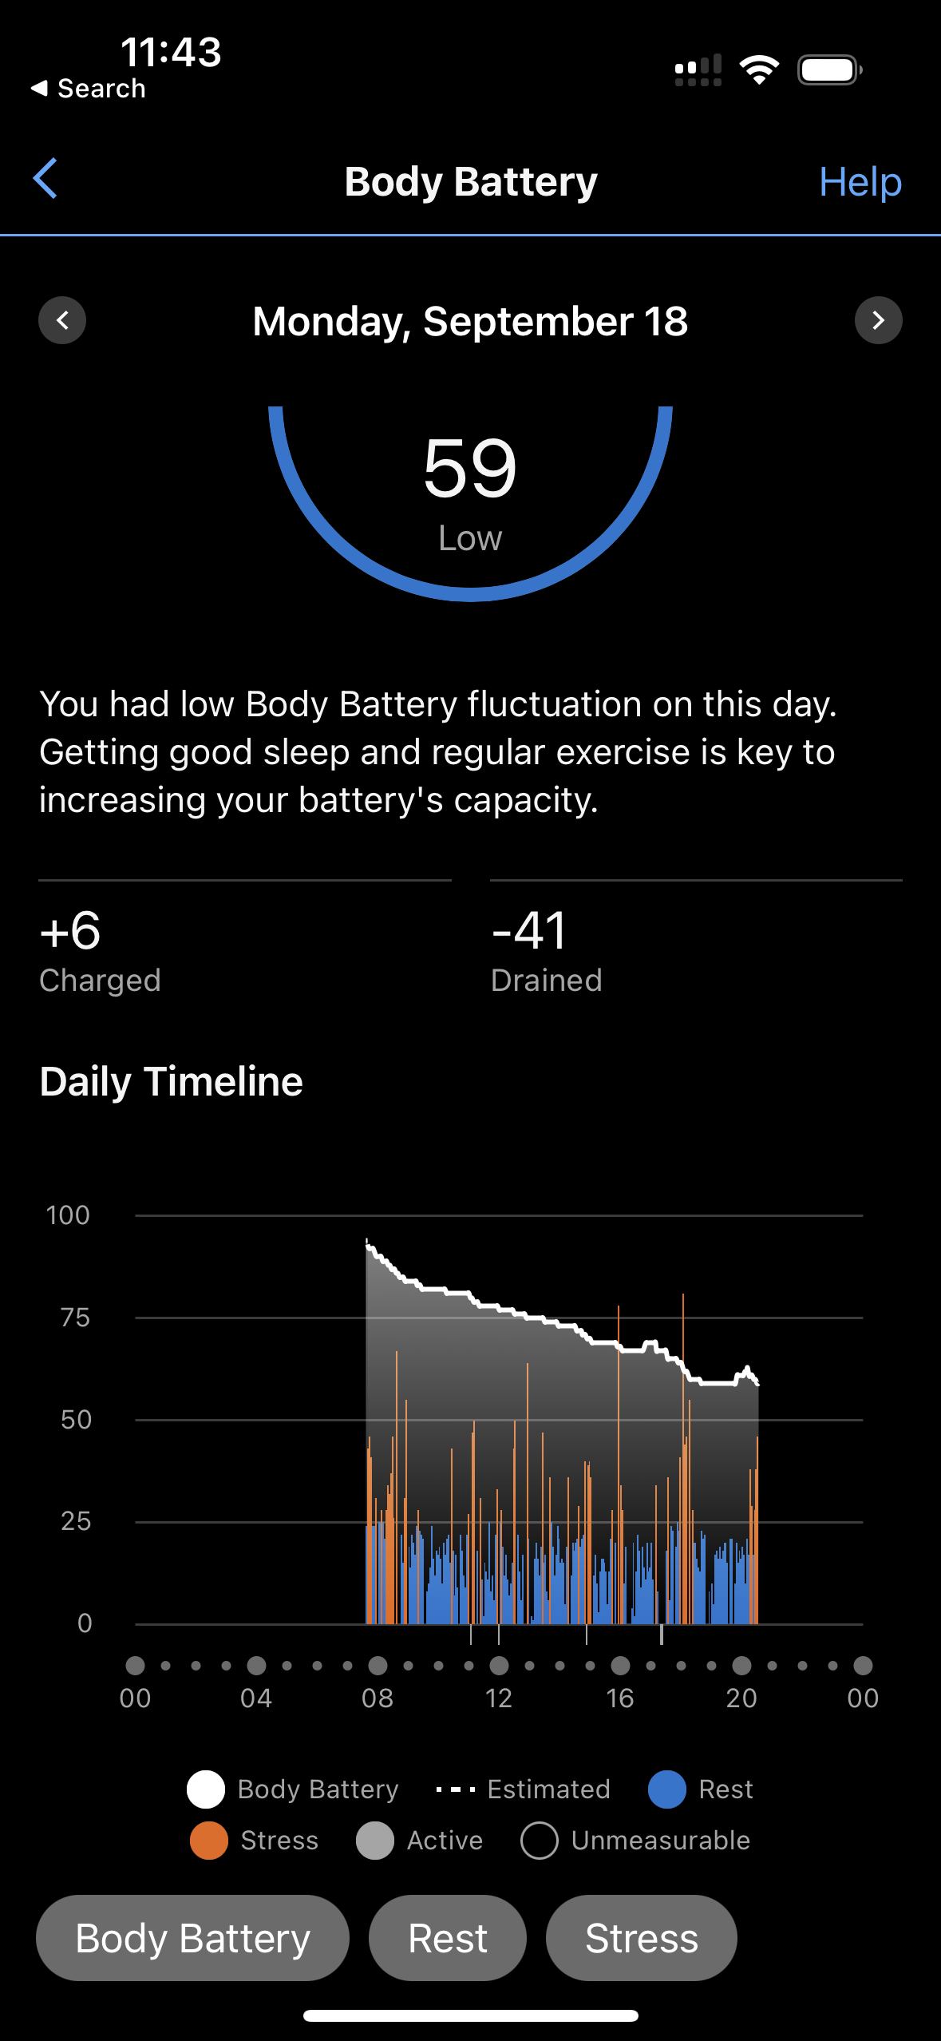
Weaponizing Sustainable Pace – A Cautionary Tale
How the misinterpretation of “Sustainable Pace” is sabotaging Agile teams
The Misuse:
Justifying Poor Performance
Misaligned Understanding
Lack of Accountability
The Original Intent:
Sustaining High Performance
Adaptability within Complex Systems
Team-Level Self-Management
Course Correction:
From "Servant Leadership" to "Leader Who Serves"
From "Self-Organizing" to "Self-Managing"
From "Sustainable Pace" to "Sustained High Performance"
Ohno says: You need to understand the essence of terms to prevent misuse, Implement checks and balances, and realign with Agile and Scrum principles

Slide 16
The Intent of Agile Manifesto Sustainable Pace
Principle 8: Agile processes promote sustainable development. The sponsors, developers, and users should be able to maintain a constant pace indefinitely.
Setting Up for Success:
Hyperproductive Patterns: Yesterday's Weather, Buffer Pattern
Master Pattern: Teams that Finish Early Accelerate Faster
The Individual Factor:
Aligning with the first value of the Agile Manifesto
Personal Responsibility & Team Support
Life-Work Balance for Sustained Performance
Measurable Metrics:
Olympic Team Training Analytics
Ohno says: The true meaning of "sustainable pace" is about sustaining high performance, both at the team and individual level. Measurement and adaptability are key.
Better plan, fewer surprises, more innovation

Slide 17

Using Sustainable Pace to Achieve Transcendence
The first Scrum team was a transcendent team
First Scrum team members said it was different that anything they had previously experienced
The looked forward to coming to work every day
Their work together was exhilerating
Fellow team members lifted them to a level beyond where they could go alone.
They learned how to finish sprints early
Yesterday’s weather, Interrupt buffer, Emergency procedure
Finished second monthly sprint in 4 days
They mastered the neuroscience accelerators
Better plan, fewer surprises, more innovation

Slide 18
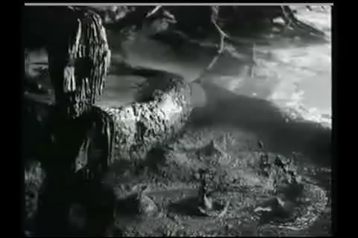
Neuroscience Accelerators Regulate Happiness and Productivity
Agile leaders need to understand how individuals and interactions work
Collaborative Environment and Social Neuroscience
Mirror Neuron Effect
Iterative Progress and the Zeigarnik Effect
Feedback Loops and Dopamine Reward System
Adaptive Change and Neuroplasticity
Empirical Process Control and Predictive Coding
Vagus Nerve Stimulation and Emotional Regulation
Haka stimulates vagus nerve
Aligns the team and make them fearless

Slide 19
Work Bottom Up From First Principles
The process that follows First Principles best will win
🌈 Four Agile Values Emerge as Guideposts
🏉 Scrum Emerges as Framework for implementing CAS
🌐 Complex Adaptive Systems Emerge from Evolution
🌱 Evolution Emerges from Physics
🔬 Physics emerges from First Principles
🌀 Wolfram's Physics Project
  Computational irreducibility
  The universe is unpredictable and GANTT charts are always wrong.
Emergence
The answer to every question lies in a layer below

Slide 20
References
Sutherland, J. (2023) First Principles in Scrum: Teams That Finish Early Accelerate Faster. Leanpub.com.
Sutherland, J. (2014). Scrum: The art of doing twice the work in half the time. Crown Business.
Takeuchi, H., & Nonaka, I. (1986). The new new product development game. Harvard Business Review, 64(1), 137-146.
Ohno, T. (1988). Toyota production system: beyond large-scale production. Productivity Press.
Womack, J. P., Jones, D. T., & Roos, D. (1990). The machine that changed the world: The story of lean production. Harper Perennial.
Sutherland, J. and Schwaber, K. (2023). The Scrum Guide. https://www.scrumguides.org/
Sutherland, J. (2021). The Scrum papers: Nuts, bolts, and origins of an agile process, Second Edition. Scruminc.com.
Tupy, J., & Pooley, G. (2022) Superabundance: The Story of Population Growth, Innovation, and Human Flourishing on an Infinitely Bountiful Planet. Cato Institute.

