Slide 1
Give Thanks for Scrum 2022
The Discipline of Scrum
Jeff Sutherland
Co-Creator of Scrum and Scrum@Scale

Slide 2




Scrum Discipline is all about MINDSET
Sun Tzu
孙子
Miyamoto Musashi
宫本武藏
Win WITHOUT firing people
Problem: 30% of your people do not want to change!
Sprints win the MARATHON
Problem: Short term emergencies cripple your long term strategy!
Cutting through the FOG and FRICTION
Problem: Things go wrong people blame someone else, you lose key people and confusion is rampant!
OODA Loop Situational Awareness
Solution: Rapid iterative response to opposing forces assures success!
Notes:
Learning Objectives:
Describe the OODA loop as it relates to overcoming resistance to change.
Discuss the significance of ’2-sword combat’ (e.g., balancing short and long term needs and goals) and ’winning a war without firing a single shot’ (e.g., an Agile transformation without firing a single person) in the context of business.

Slide 3

FLOW
Ask yourself whether you are happy and you cease to be so. John Stuart Mill
Don’t aim at success--the more you aim at it and make it a target, the more you are going to miss it. For success, like happiness, cannot be pursued; it must ensue… as the unintended side-effect of one’s personal dedication to a course greater than oneself. Viktor Frankel, Man’s Search for Meaning
We have all experience times when instead of being buffeted by anonymous forces, we feel in control of our actions, masters of our own fate. On the rare occasions when it happens, we feel a sense of exhilaration, a deep sense of enjoyment that is long cherished… This is what we mean by optimal experience.
Optimal Experience is … something we make happen. Mihaly Csikszentmihalyi, Flow
The Discipline of Scrum observed by Takeuchi and Nonaka and others created the first Scrum team and allowed the team to achieve the Optimal Experience.
The Discipline of Scrum creates the Optimal Experience

Slide 4

Scrum Discipline allowed Rocket Mortgage to achieve Flow
The largest mortage provider in the United States used SAFe to improve the performance of 22,000 people.
SAFe had 15 different specialized job titles generating large (and slow) teams
Implemented the Scrum 3-5-3. Only Scrum Master, Product Owner, and Developer roles. All developers were cross functional on small teams. The sweet spot is 5.
SAFe was not holding people accountable.
Only Scrum Masters who could improve team performance kept that role.
Only Product Owners who increased revenue per point kept that position.
SAFe had too many meeting focused on the wrong issues.
Meetings cut to only Scrum@Scale meetings, all focused on delivery. Cut quarterly deliveries to daily production releases.
Optimal Experience is … something we make happen. Mihaly Csikszentmihalyi, Flow
Rocket Mortgage cut average feature delivery time from 83.7 days to 11.6 days while improving quality by 721%. Rocket Mortgage Delivers Twice the Value at Half the Cost at Scale. Proceedings of the 55th Hawaii International Conference on System Sciences, 2022
The Discipline of Scrum allows daily production releases with radically higher quality.

Slide 5
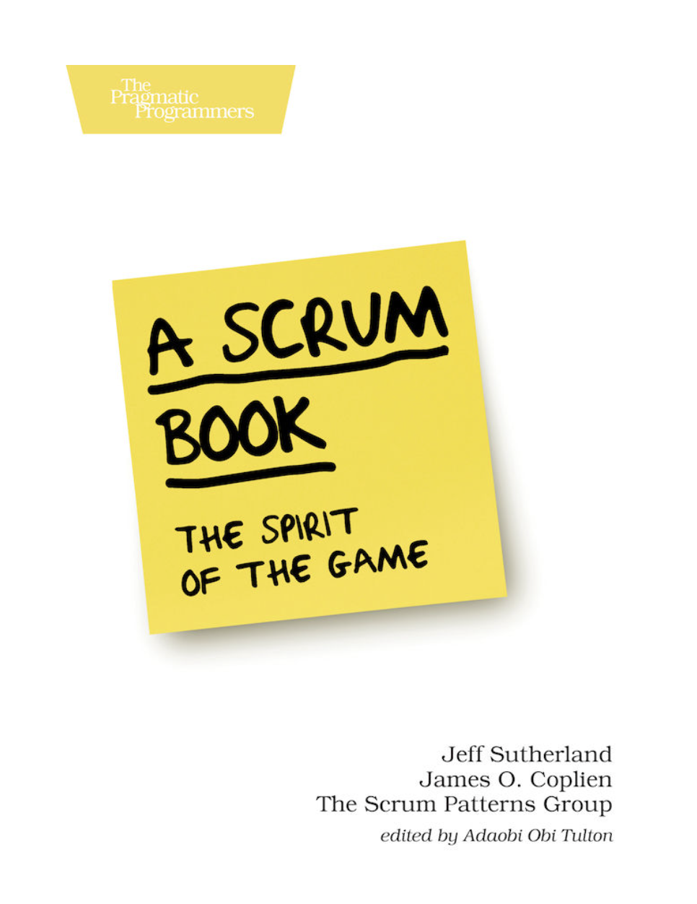
SWARMING: One-Piece Continuous Flow
Companies, teams, and individuals bring things to Done by working together on them. While it is the Product Owner’s responsibility to order the Product Backlog to maximize delivery, it is the responsibility of the Development Team to order the implementation of the Sprint Backlog to maximize flow of production. Sutherland and Coplien
Systematic measured Flow as average process efficiency of a story during a sprint.
Systematic doubled velocity of all teams by having all stories tested and production ready at the end of a sprint, a disciplined definition of Done.
Systematic then increased all team velocities 400% by having a standard checklist for Ready state of a story. Scrum and CMMI – Going from Good to Great: Are You Ready Ready to Be Done Done C. Jakobsen and J. Sutherland, in Agile 2009, Chicago, 2009.
Good Scrum Discipline means you measure Flow in every sprint. Process Efficiency – Adapting Flow to the Agile Improvement Effort F. Verbruggen, J. Sutherland, J. Martijn van der Werf, S. Brinkkemper, A. Sutherland, 52nd Hawaii International Conference on System Sciences, Wailea, Hawaii, 2019
Sytematic doubled velocity with Done and doubled it again with Ready!

Slide 6
Flow Efficiency
Velocity is a good measure of what happened, but a poor measure for helping teams improve.
Focus on velocity incentivizes teams to work harder and longer which makes it difficult to improve.
Focus on Flow Efficiency encourages teams to do root cause analysis of impediments that block flow.
Prowareness implement the Flow metric in their Scrum tool and increased team velocity 250% in one sprint by increasing flow from 10% to 80%.
When asked how they did this, they said they figured out putting three people on every story made it happen!
My Scrum Healthcare Startup Flow Efficiency is 83% and the team improved velocity 500%.
My new global Scrum web team Flow Efficiency was 23%. The team is very slow because of multiple hand offs with time wasted. I am training Product Owner and Scrum Master on how to improve Flow.
Jira plugins measure Flow Efficiency automatically.

Slide 7
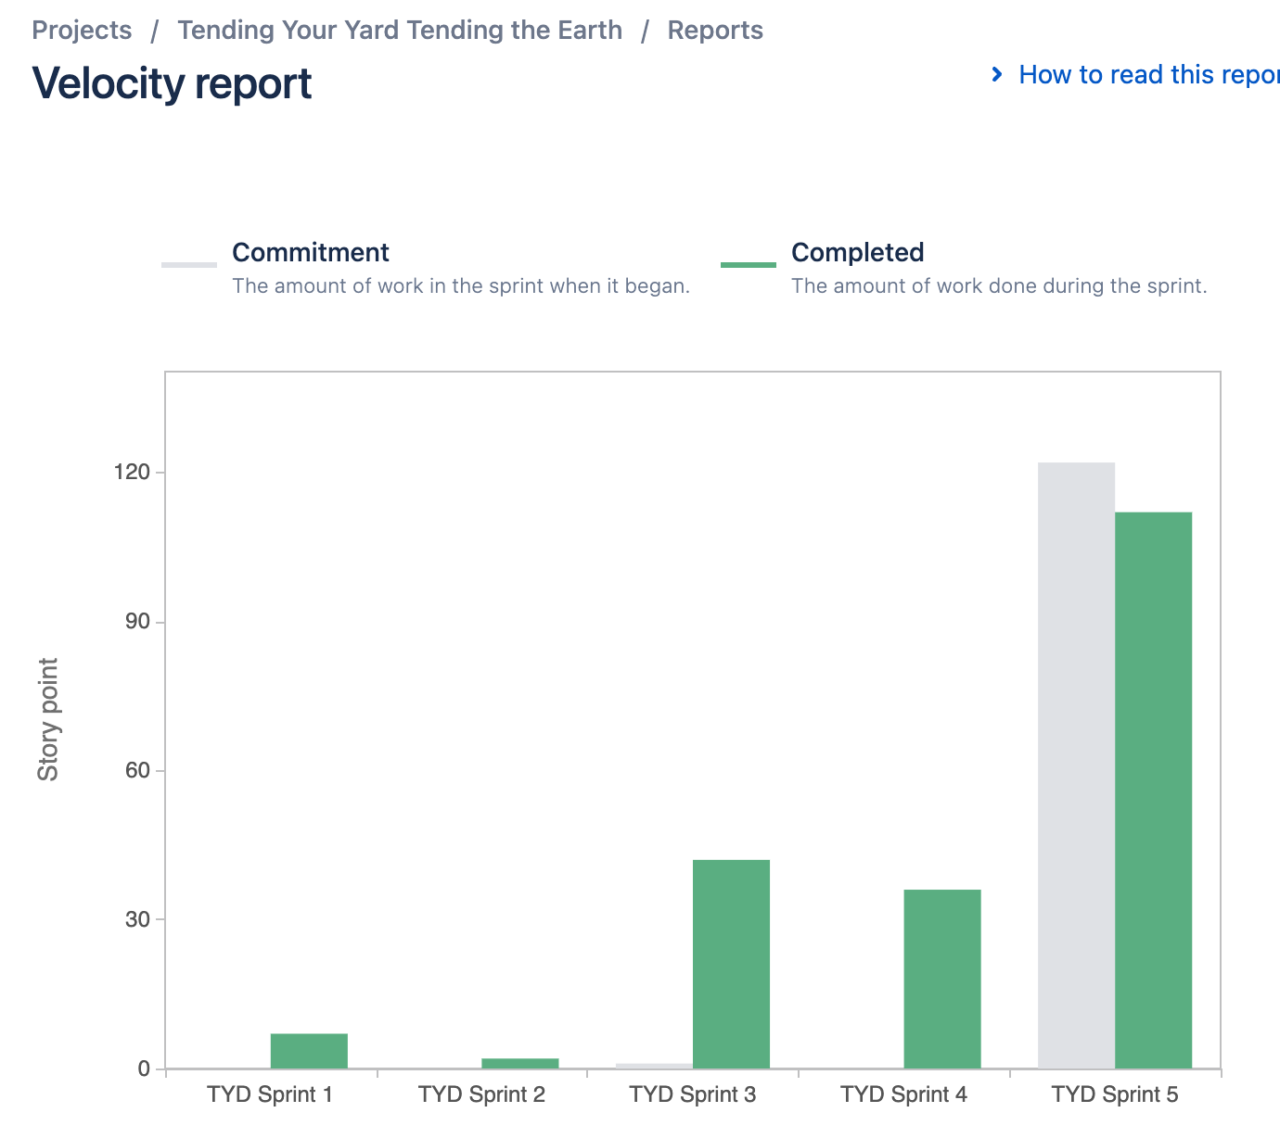
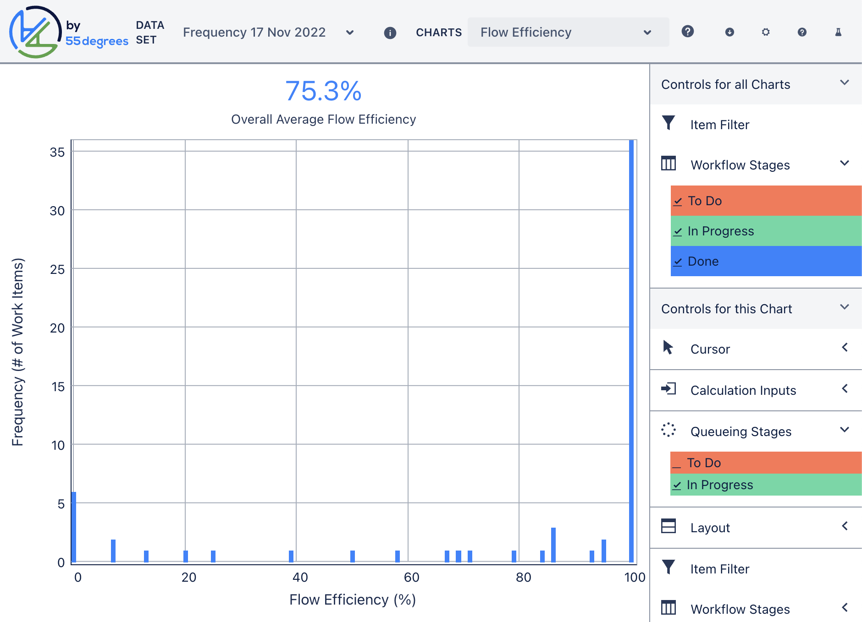
Global Web Team Flow -> Velocity (Work in Progress)
Notes:
Learning Objectives:
Describe the OODA loop as it relates to overcoming resistance to change.
Discuss the significance of ’2-sword combat’ (e.g., balancing short and long term needs and goals) and ’winning a war without firing a single shot’ (e.g., an Agile transformation without firing a single person) in the context of business.

Slide 8
It is not the Sprint but the Marathon than counts!
Sun Tzu
孙子
Miyamoto Musashi
宫本武藏
General Von Clausewitz
冯·克劳塞维茨将军
Colonel John Boyd
约翰-博伊德上校
Winning WITHOUT firing people
Problem: 30% of your people do not want to change!
Sprints win the MARATHON
Problem: Short term emergencies cripple your long term strategy!
Cutting through the FOG and FRICTION
Problem: When things go wrong people blame someone else, you lose key people and confusion is rampant!
OODA Loop Situational Awareness
Solution: Rapid iterative response to opposing forces assures success!
Notes:
Learning Objectives:
Describe the OODA loop as it relates to overcoming resistance to change.
Discuss the significance of ’2-sword combat’ (e.g., balancing short and long term needs and goals) and ’winning a war without firing a single shot’ (e.g., an Agile transformation without firing a single person) in the context of business.

Slide 9
It’s Not About the Sprint, It is About the Marathon!
When it comes to ultradistances, nothing can beat a Tarahumary runner—not a racehorse, not a cheetah, not an Olympic marathoner. Born to Run
They run for the joy of it at a sustainable pace that creates the Optimal Experience.
Only 14% of project teams achieve the Optimal Experience (”Pure Success” in the Standish Group database). Jim Johnson, Decision Latency Theory, CHAOS Report Series, 2018
By 2016, senior management at KDDI, a Toyota owned company, convinced us to radically change Scrum training and create the Registered Scrum program.
Lean principles and tools are fundamental to Scrum Discipline
Hyperproductive patterns are essential to high performing teams
Scrum@Scale is mandatory for those who want to deliver twice the value at half the cost
By 2016 all scaling frameworks had failed at Intel for thousands of Scrum teams
The Scrum Guide was written at the request of Microsoft who has based all their processes and tools on Scrum.
The Scrum@Scale Guide was written at the request of Intel after the senior management banned all scaling frameworks and the word “Scrum.”
The Way of Two Swords assures success. Miyamoto Musashi, Bookd of Five Rings

Slide 10
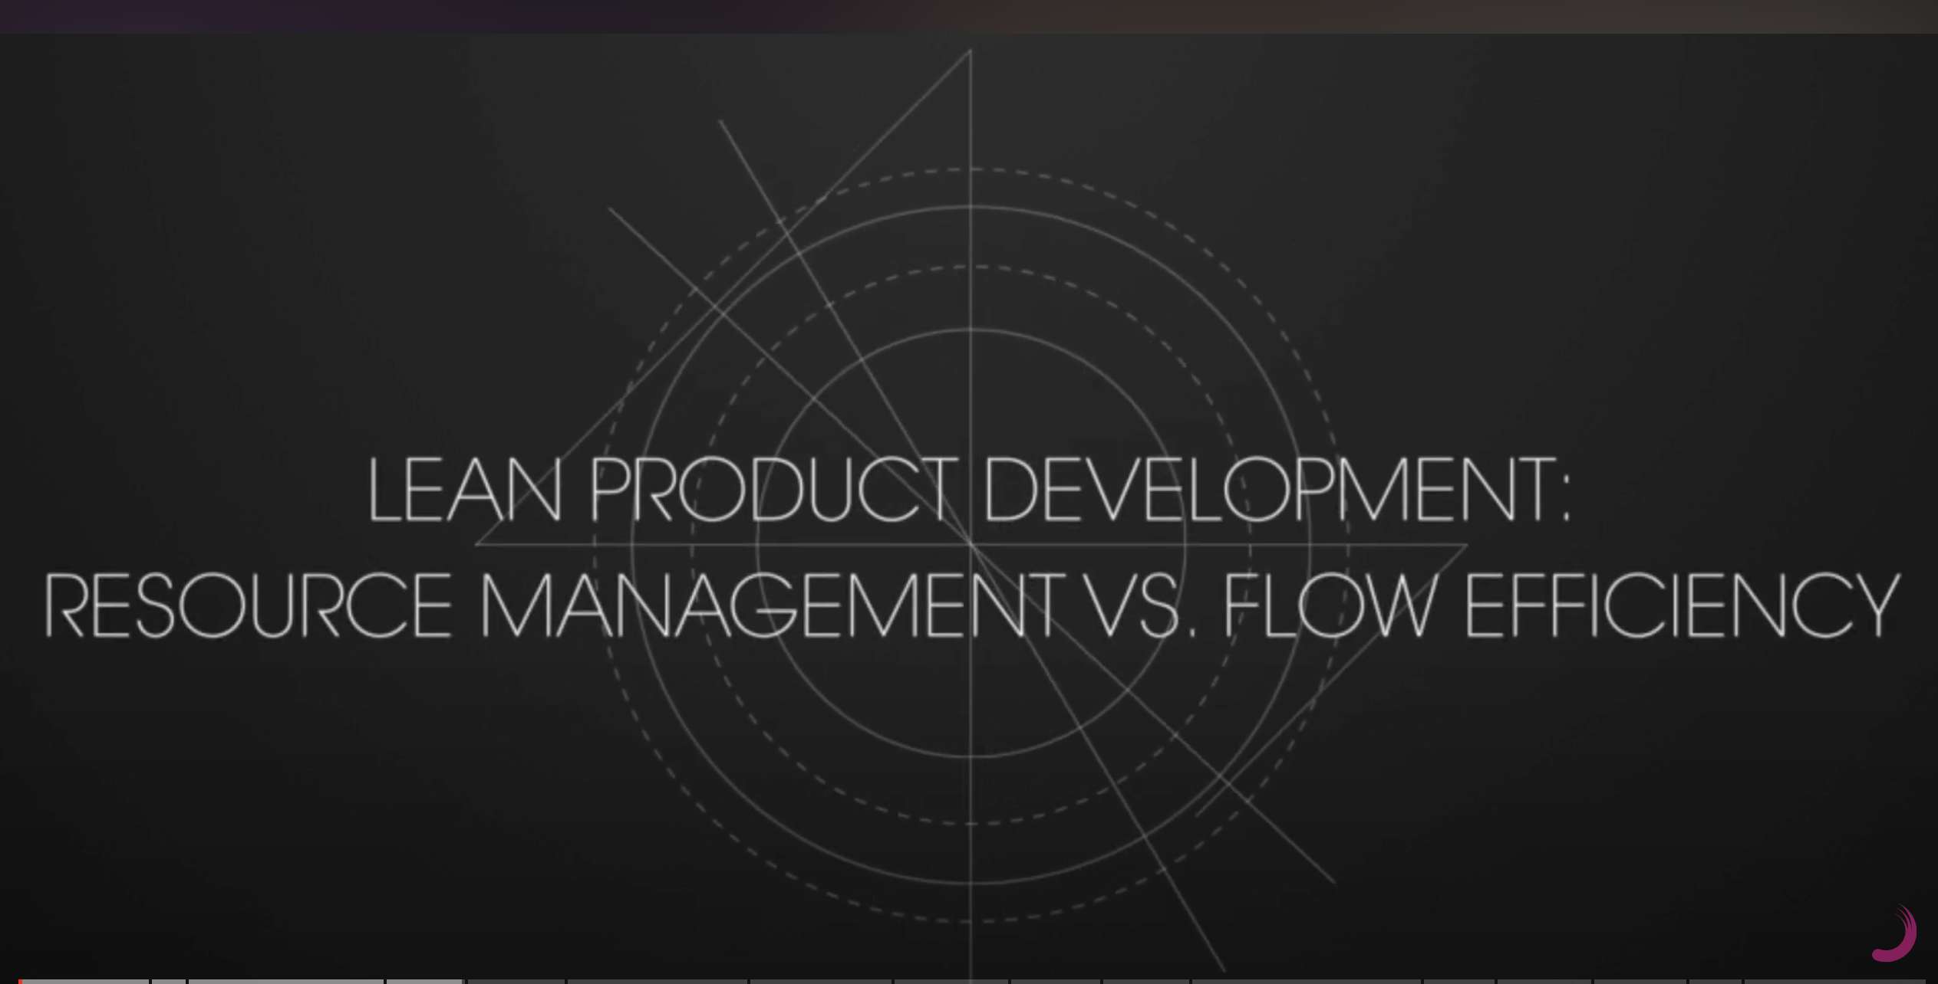
Abandoning Scrum Discipline Does Not Reduce Failure Rate
100 teams at the BBC convinced management that Scrum was old hat and Kanban was the latest thing.
They could not provide data on improvement of a single team!
The management complained they never knew when anything could ship.
I searched the internet and found one paper that showed a single BBC team improved cycle time by 30%. Rocket Mortgage did better than that with SAFe.
The most important metric in Scrum and Kanban is Flow Efficiency, actual work time divided by time to Done for each story.
Good teams have Flow Efficiency over 80%. Fumbling and stumbling teams have Flow Efficiency less than 50%.
If you don’t measure it, then it is probably low.
Management traditional beliefs reduce flow.

Slide 11
Scrum Discipline requires focus on system dynamics
Sun Tzu
孙子
Miyamoto Musashi
宫本武藏
General Von Clausewitz
冯·克劳塞维茨将军
Colonel John Boyd
约翰-博伊德上校
Winning WITHOUT firing people
Problem: 30% of your people do not want to change!
Sprints win the MARATHON
Problem: Short term emergencies cripple your long term strategy!
Cutting through the FOG and FRICTION
Problem: When things go wrong people blame someone else, you lose key people and confusion is rampant!
OODA Loop Situational Awareness
Solution: Rapid iterative response to opposing forces assures success!
Notes:
Learning Objectives:
Describe the OODA loop as it relates to overcoming resistance to change.
Discuss the significance of ’2-sword combat’ (e.g., balancing short and long term needs and goals) and ’winning a war without firing a single shot’ (e.g., an Agile transformation without firing a single person) in the context of business.

Slide 12
System Dynamics cause best intentions to fail
OpenView Venture Partners aggressivly removed all impediments
For every impediment they removed, 25 came back
They were like mosquitos. You need to drain the swamp.
Draining the swamp requires Lean A3 root cause analysis
Focusing on root cause analysis increased the velocity of 100% of teams by 300%.
For investment companies, focus on root cause analysis implemented twice the work in half the time. Even a call center at Intronis increase production 400% in a six month period.
You must understand System Dynamics that cause reduction in Flow.
Only eliminate the right impediments is a solution

Slide 13
The best-laid schemes o’ Mice an’ Men gang aft agley – Robert Burns
An’ lea’e us nought but grief an’ pain, for pomis’d joy!
The plan becomes distorted when implemented
High failure rates cause lots of finger pointing
More planning will certainly be the solution?
The only thing that is infinite is human stupidity. Albert Einstein
Example: The Scrum Guide
Had to change self-organization to self-management and connect to Sprint Goal and Product Goal
Had to change Servant Leader to Leader Who Serves
58% failure rate of Agile projects and 53% failure of Agile Transformations
Caused by undisciplined Scrum and waterfall management
You must understand System Dynamics that cause reduction in Flow.
These are often circular side effects, not main effects
Must have 360 degree situation awareness
Abandoning Scrum Discipline Does Not Reduce Failure Rate

Slide 14
Scrum Discipline focuses on the OODA Loop
Sun Tzu
孙子
Miyamoto Musashi
宫本武藏
General Von Clausewitz
冯·克劳塞维茨将军
Colonel John Boyd
约翰-博伊德上校
Winning WITHOUT firing people
Problem: 30% of your people do not want to change!
Sprints win the MARATHON
Problem: Short term emergencies cripple your long term strategy!
Cutting through the FOG and FRICTION
Problem: When things go wrong people blame someone else, you lose key people and confusion is rampant!
OODA Loop Situational Awareness
Solution: Rapid iterative response to opposing forces assures success!
Notes:
Learning Objectives:
Describe the OODA loop as it relates to overcoming resistance to change.
Discuss the significance of ’2-sword combat’ (e.g., balancing short and long term needs and goals) and ’winning a war without firing a single shot’ (e.g., an Agile transformation without firing a single person) in the context of business.

Slide 15
Certain to Win – the OODA Loop for Business
Blitzkrieg in Business
Speed of innovation is the determining factor for successful business today
Observe and identify a big problem that is relevant to your capabilities
Reorient and restructure your business to go after the problem
Decide to innovate faster than your competition. Remember Tesla is releasing new products and features 1000 times faster than the competition. No matter how fast you are going it is not fast enough.
Act to reduce delivery time to daily for a new feature. Remember Amazon delivers new features in less than a second every day.
Scrum discipline from the John Boyd and Taiichi Ohno
Chet Richards: My plan … is to introduce Boyd’s philosophy of conflict, for which I’ll use the term “maneuver conflict,” by examining how it works in the two primary areas where it has been applied: in armed conflict as maneuver warfare and in manufacturing as the Toyota Production System, or as it is more widely known, “lean production.” This is a technique Boyd called “many sided, implicit cross referencing,” which means to slice the problem a number of ways, draw ideas from acoss a range of disciplines, and see if we can discern common patterns.
Business Schools have destroyed our industry by focusing on the wrong metrics. Will Hopper, The Puritan Gift

Slide 16
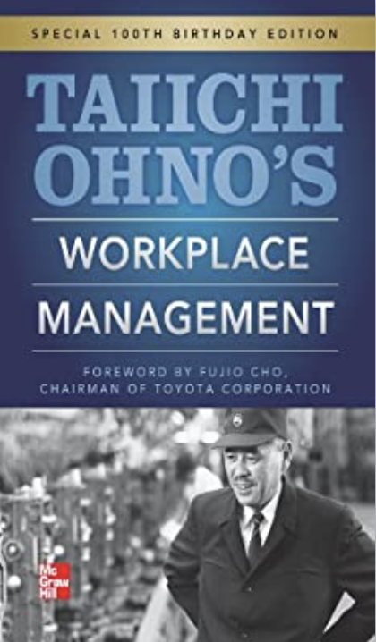
Stand on the Shoulders of Giants
Taiichi Ohno’s Workplace Management
People’s ideas are unreliable things, and I would be impressed if we were right even half of the time.
Confucius says, “The wise will mend their ways” and “the wise man should not hesitate to correct themselves.”
Engineers, in particular, tend to hold on tightly to things they have said or to their ideas. Engineers are often said to be inflexible or stubborn, but I think it is important for them to quickly correct themselves, just as the wise mend their ways.
Therefore the most important Discipline of Scrum is:
Every day you come into work you assume that at least half of what you think is wrong.
Most of the day is spent on discovery of where your mindset is dysfunctional.
The rest of the day is spent on removing impediments you helped to create with your dysfunctional mindset.
Run the OODA Loop on yourself.
If you are humble enough to face reality then you will find the truth and “the truth will set you free.”
The Disipline of Scrum: The Truth Will Set You Free

