Slide 1
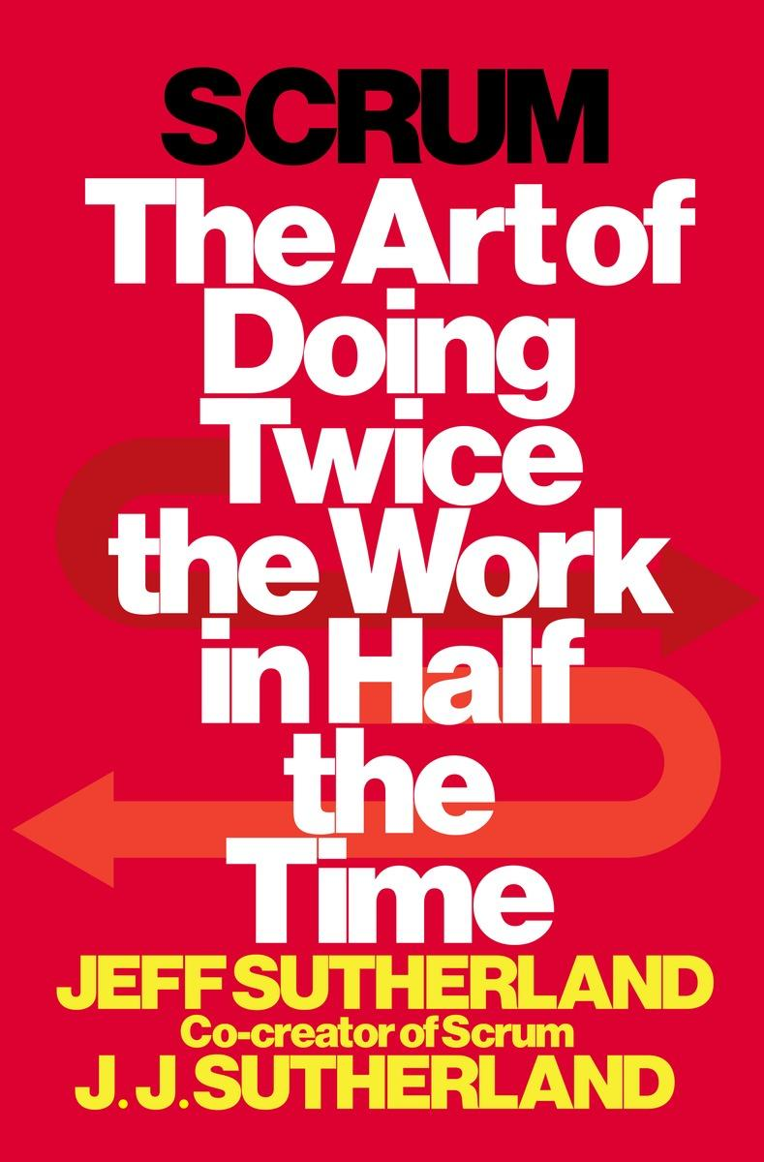

Scrum and Scrum@Scale Origins
Jeff Sutherland
1 July 2022
“I think speed is the fundamental determinant of the competitiveness of any company especially when any technology is involved. The rate of innovation fundamentally determines which companies succeed.” Elon Musk

Slide 2
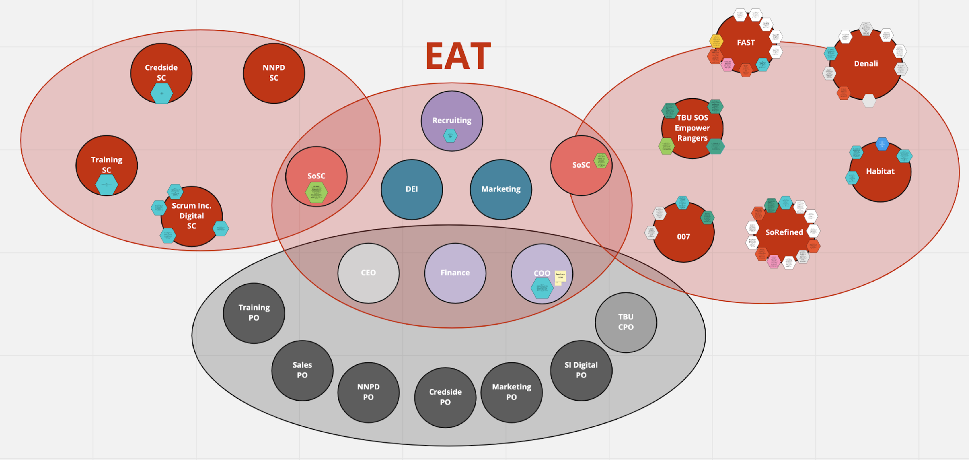
Scrum@Scale Organization at Scrum Inc
EMS
Crowley, Jessica J, An Analysis of Scrum Inc. and it’s Organizational Design. Johnson & Wales University, 20 June 2022

Slide 3
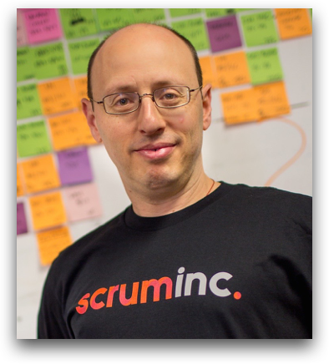
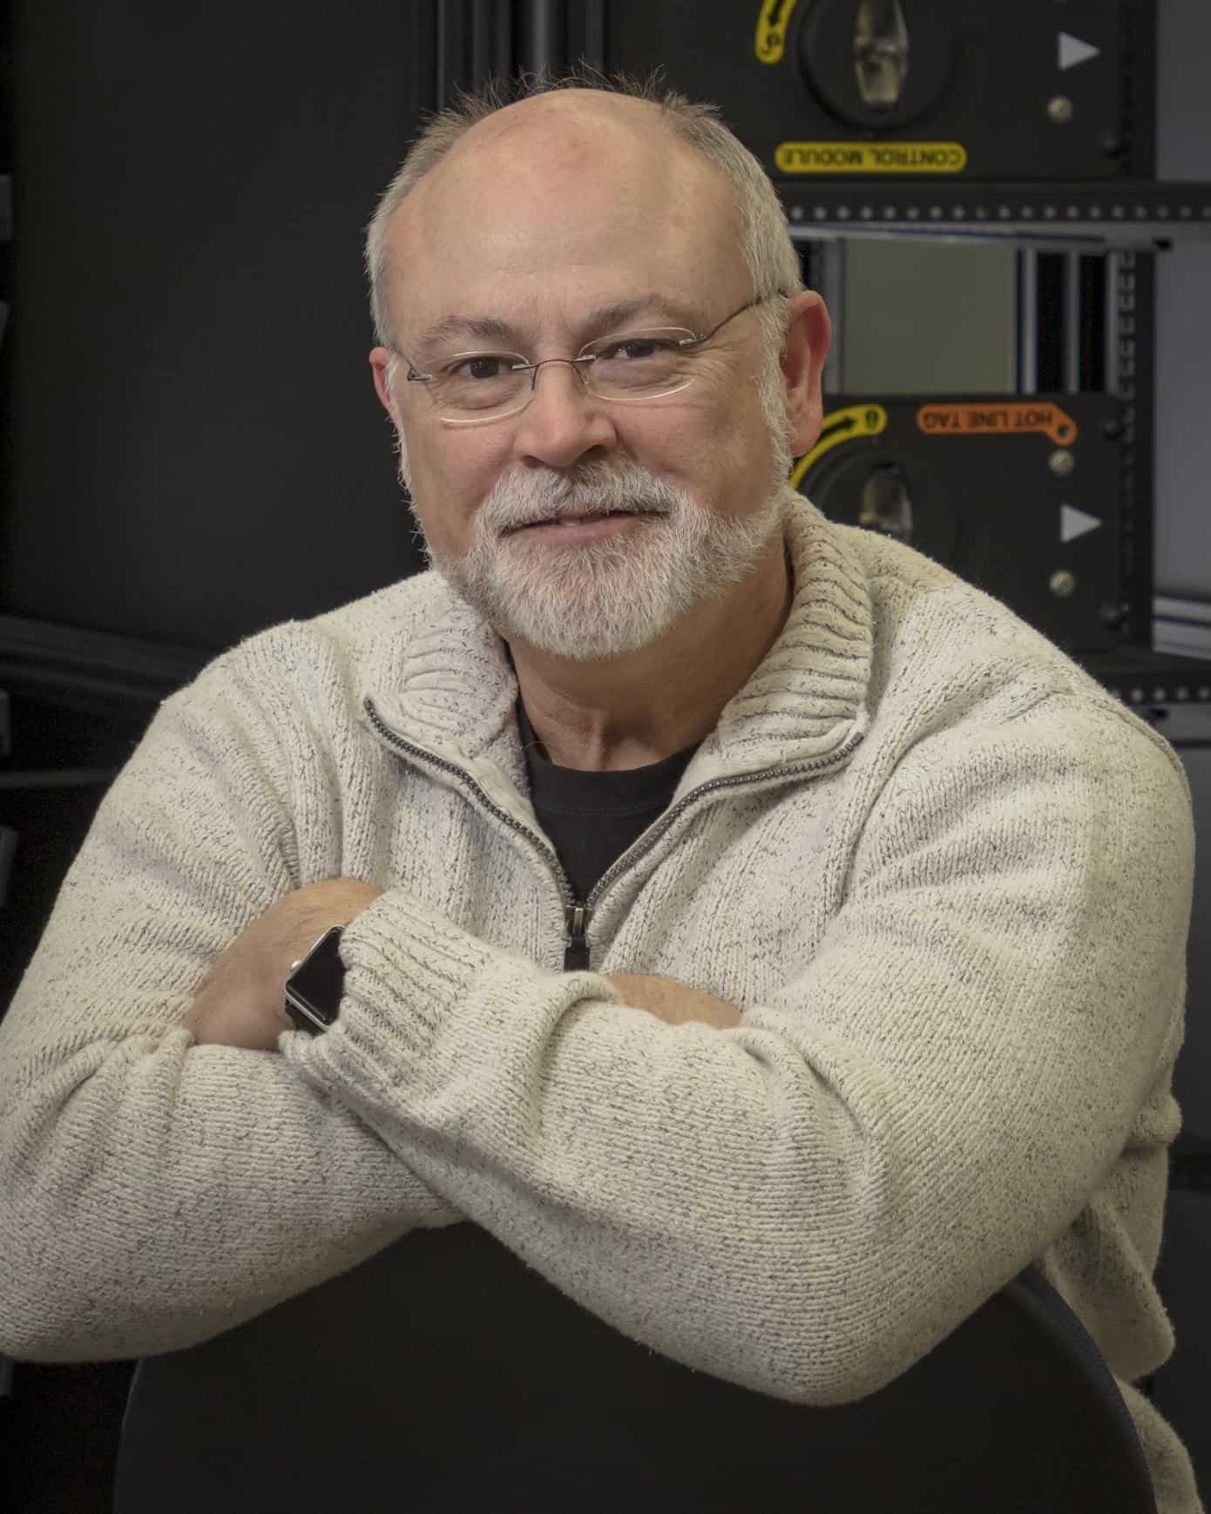
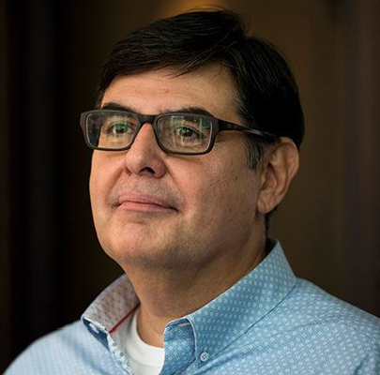
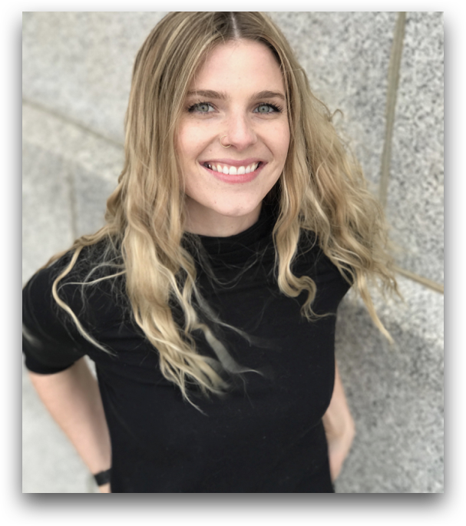

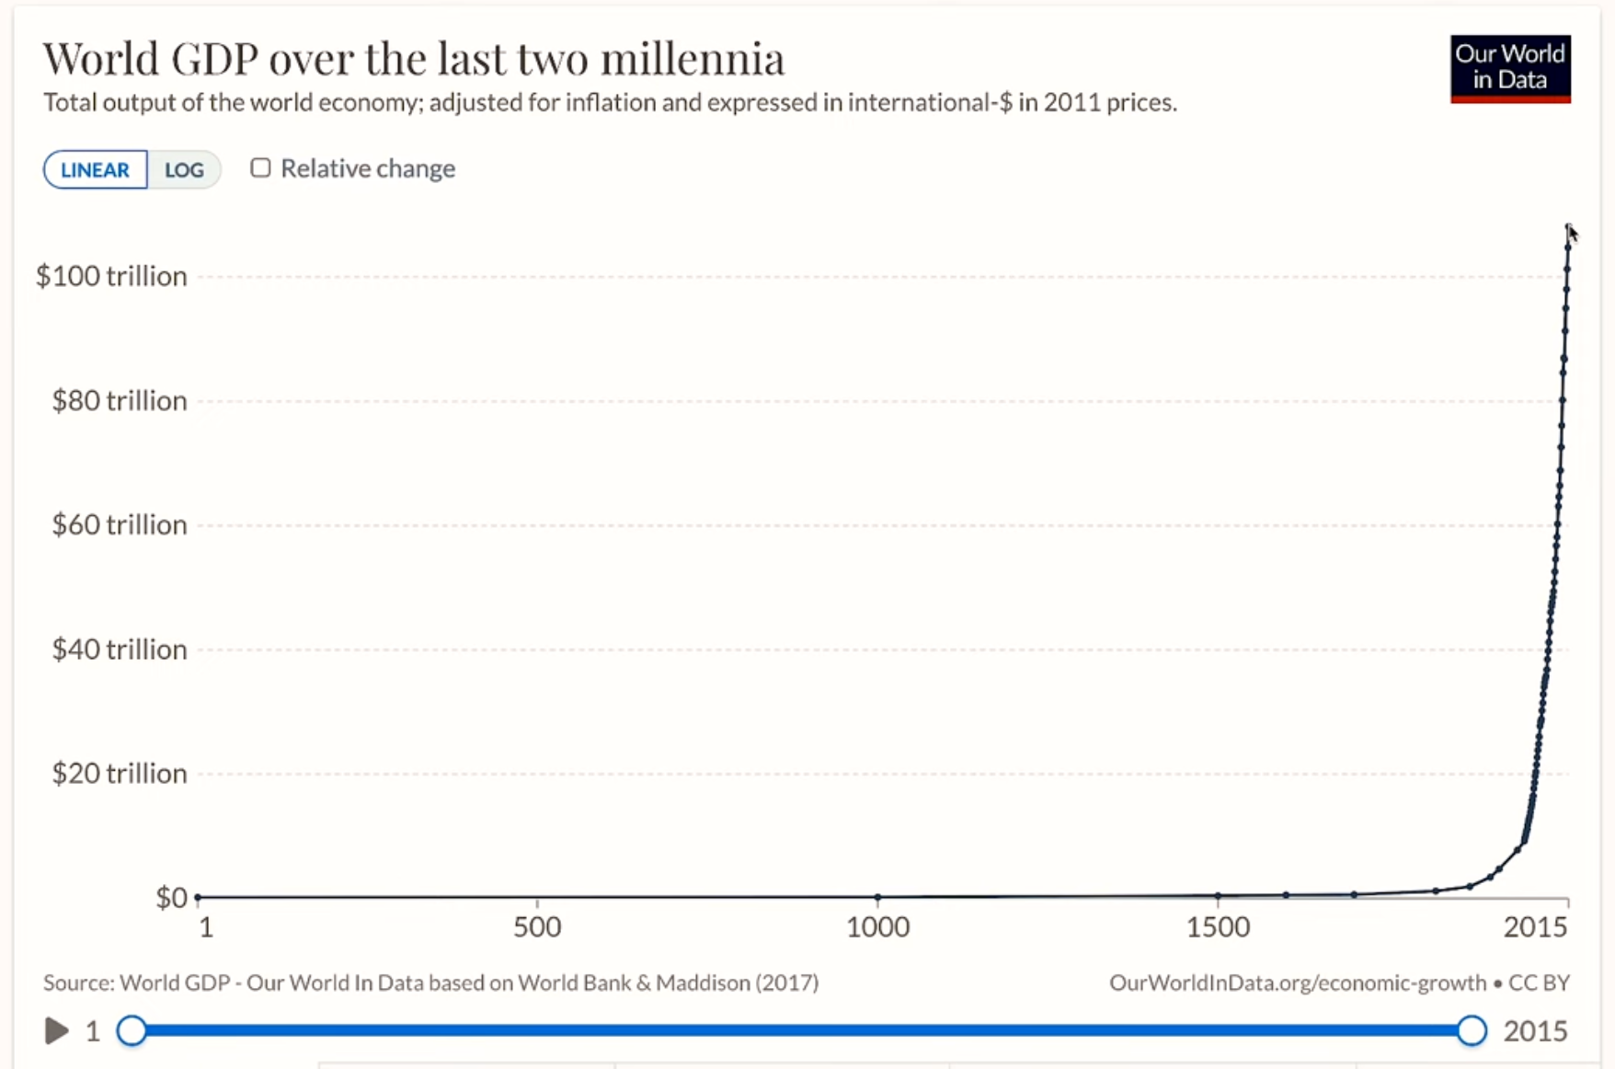
World GDP S Curve

Slide 4
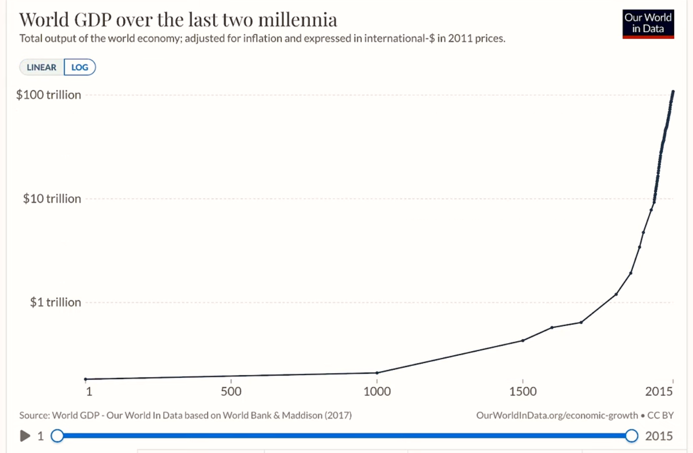
Log GDP Should Be Straight Line!

Slide 5
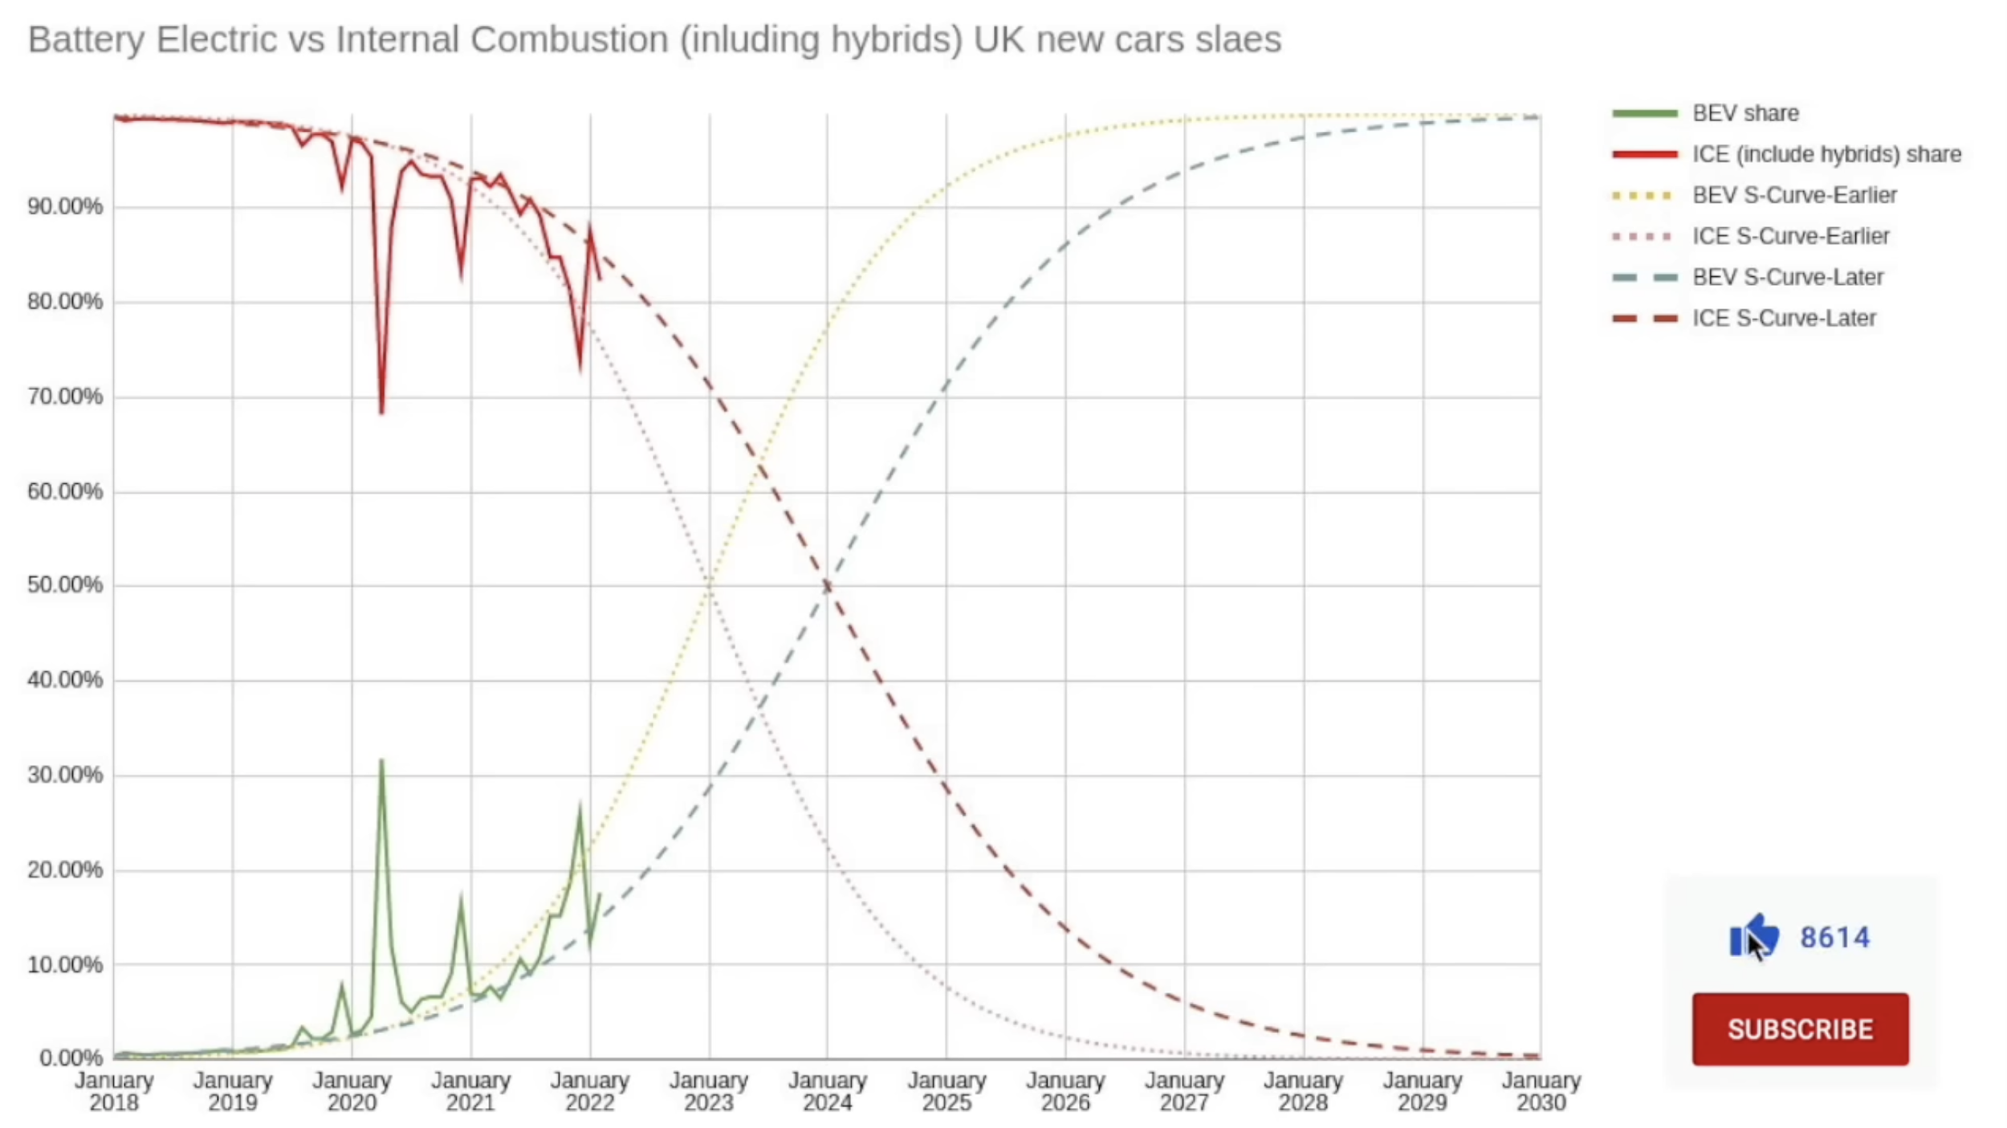
UK Cancels All EV Incentives
June 2022

Slide 6
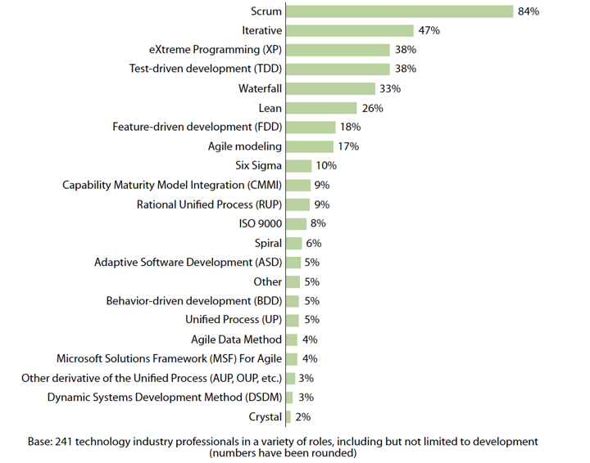
From 1993 to 2009 Scrum Gained 84% Market Share
In 2018 over 77% of Agile Transformations were based on Scrum.
Source: THE ELUSIVE AGILE ENTERPRISE: How the Right Leadership Mindset, Workforce and Culture Can Transform Your Organization. Forbes 2018

Slide 7
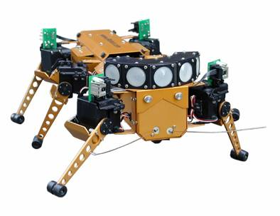
Roots of Scrum
Making the world a better place
  Japanese manufacturing - Edward Deming
  Team process – Silicon Valley entrepreneurs (Creative Initiative)
  Micro enterprise development – Accion and Grameen Bank
Process innovation and productivity research
  Alan Kay and Xerox Parc
  Takeuchi and Nonaka - knowledge generation/lean
  IBM Surgical Team (Mythical Man Month)
  Coplien review of Borland Quattro Project
  Complex adaptive systems and iRobot subsumption architecture

Slide 8





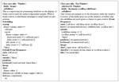
How we invented Scrum:
Alan Kay’s innovation strategy at Xerox Parc
Personal Workstation Mouse (SRI) Ethernet
Windows Interface Laser Printer Smalltalk
  CSM v 11.03 © Jeff Sutherland 1993-2010

Slide 9
Alan Kay’s Innovation Strategy
Incremental - NO
Cross Discipline - NO
Extreme data points - ONLY LOOK AT THIS!
X
  CSM v 11.03 © Jeff Sutherland 1993-2010

Slide 10
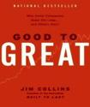
Benchmarked Out of the Box
Scrum looked at projects off the chart
  (IBM Surgical Team) F. P. Brooks, The Mythical Man Month: Essays on Software Engineering: Addison-Wesley, 1995.
  Takeuchi and Nonaka. The New New Product Development Game. Harvard Business Review, 1986
  J. O. Coplien, "Borland Software Craftsmanship: A New Look at Process, Quality and Productivity," in 5th Annual Borland International Conference, Orlando, FL, 1994.
Scrum: A Pattern Language for Hyperproductive Software Development
  By M. Beedle, M. Devos, Y. Sharon, K. Schwaber, and J. Sutherland. In Pattern Languages of Program Design. vol. 4, N. Harrison, Ed. Boston: Addison-Wesley, 1999, pp. 637-651.
Every team can achieve hyperproductivity
  J. Sutherland, S. Downey, and B. Granvik, "Shock Therapy: A Bootstrap for a Hyper-Productive Scrum" in Agile 2009, Chicago, 2009.
  C. Jakobsen and J. Sutherland, "Scrum and CMMI – Going from Good to Great: are you ready-ready to be done-done?," in Agile 2009, Chicago, 2009.
  CSM v 11.03 © Jeff Sutherland 1993-2010

Slide 11
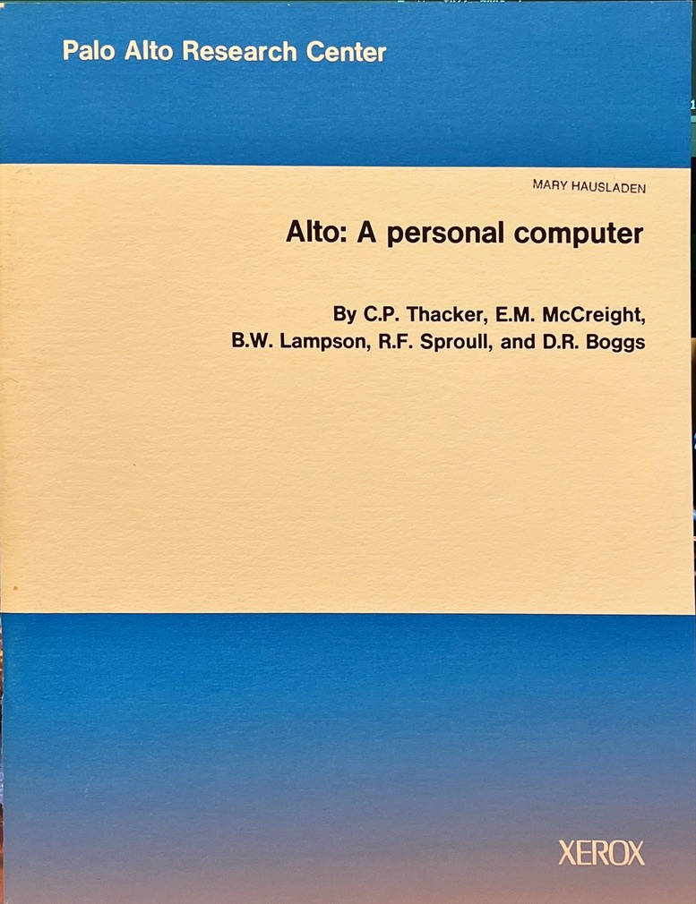


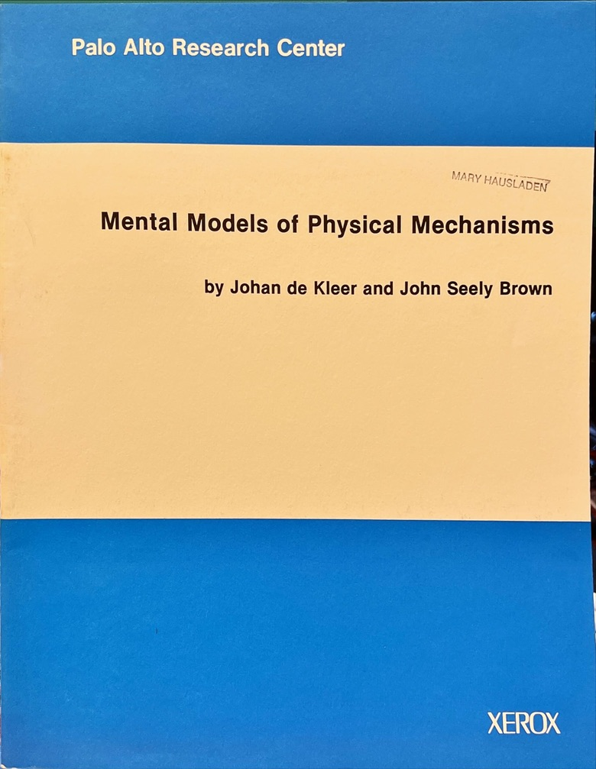
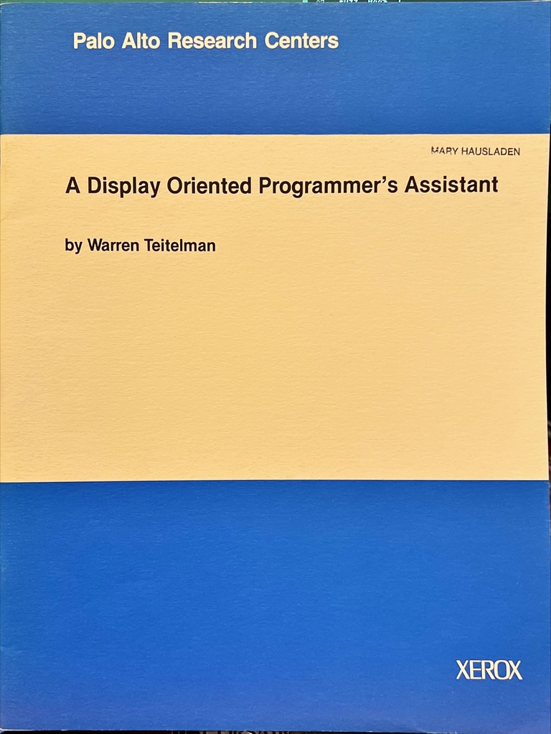
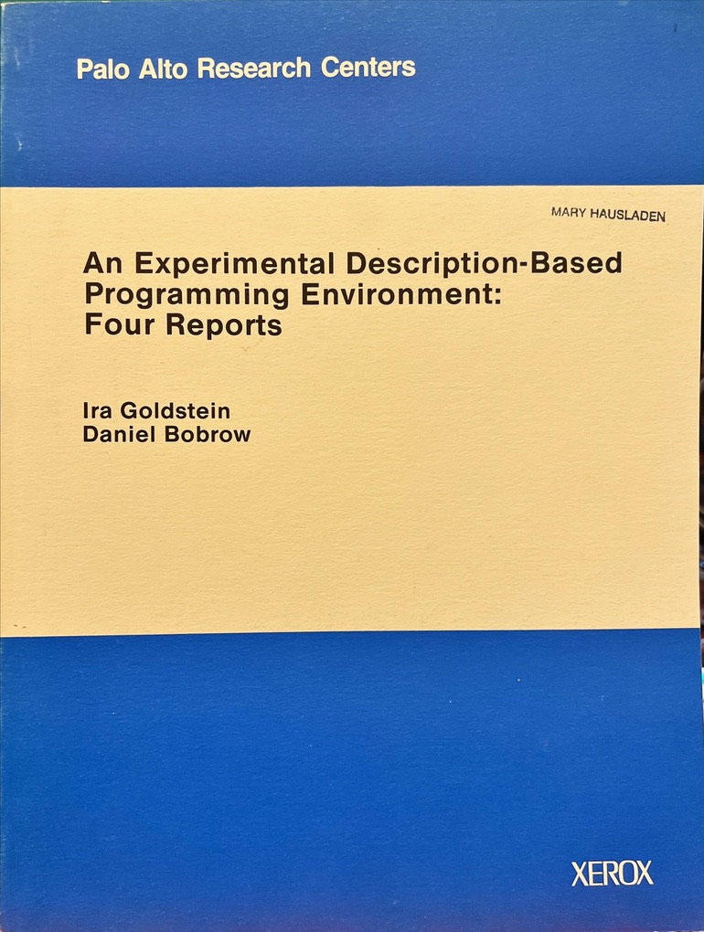
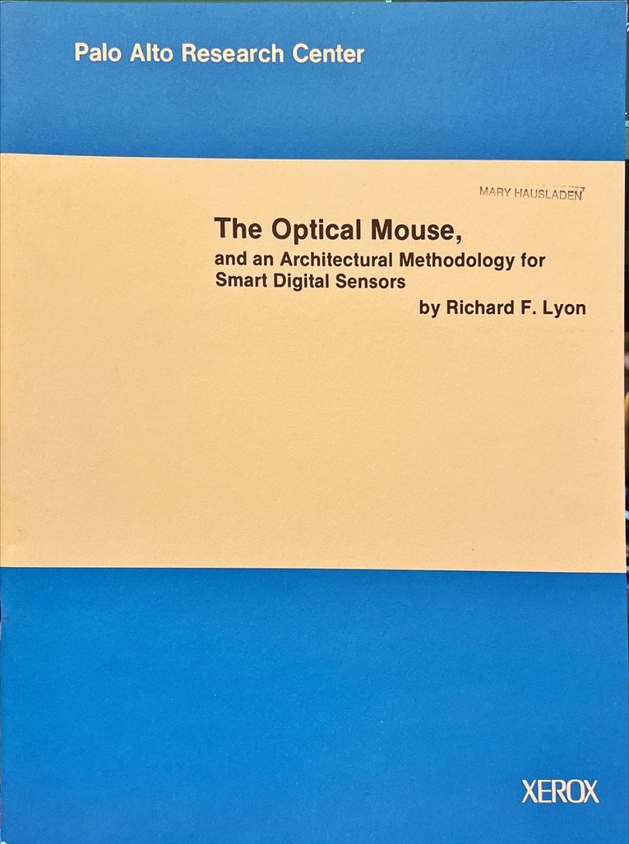
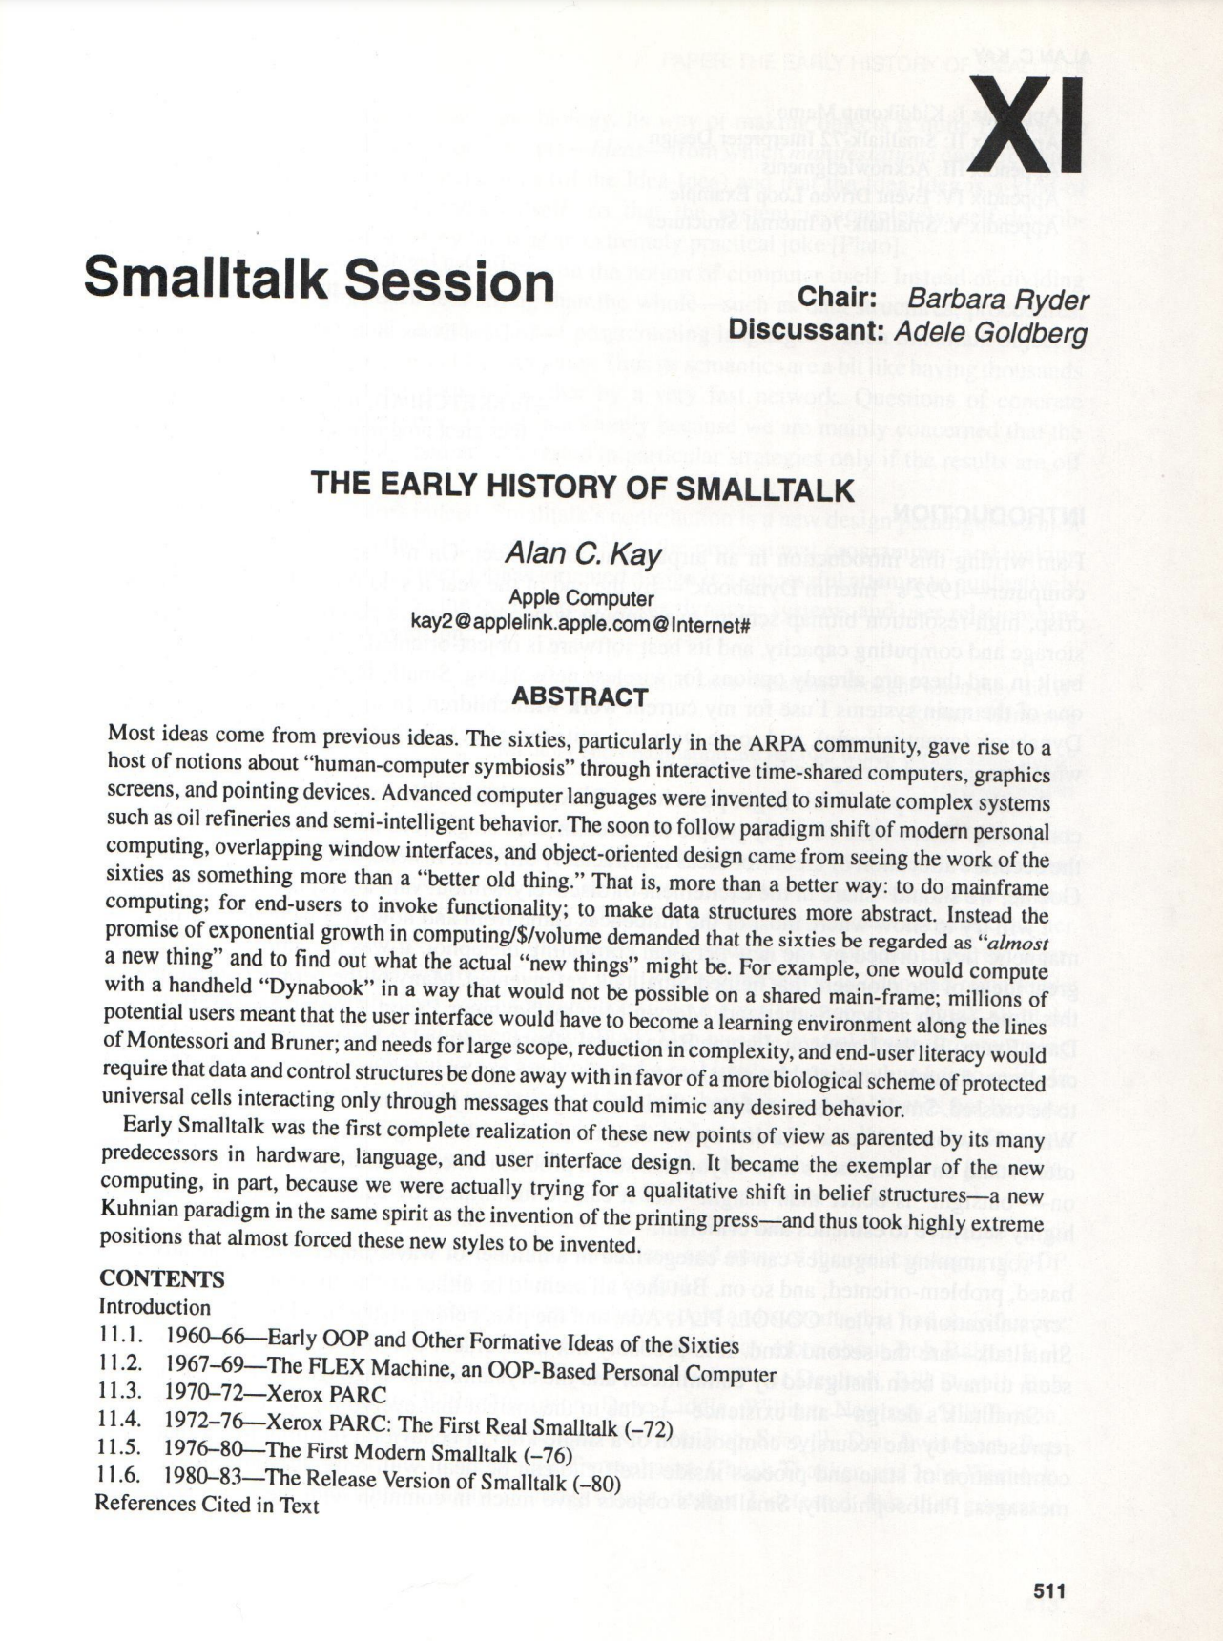
Source Documents: Creation of Personal Computer

Slide 12
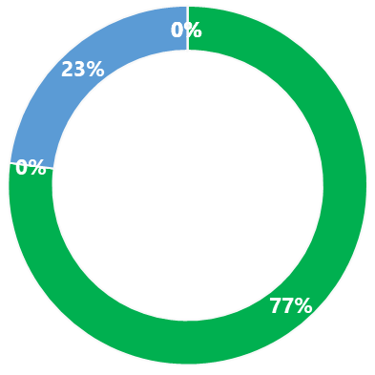
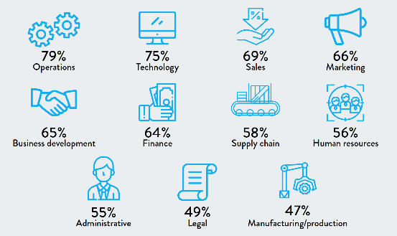
Agile Transformations (77% Scrum) are in 100% of Major Companies Worldwide
77% Scrum
Deployed Widely Throughout the Enterprise
Source: THE ELUSIVE AGILE ENTERPRISE: How the Right Leadership Mindset, Workforce and Culture Can Transform Your Organization. Forbes 2018

Slide 13
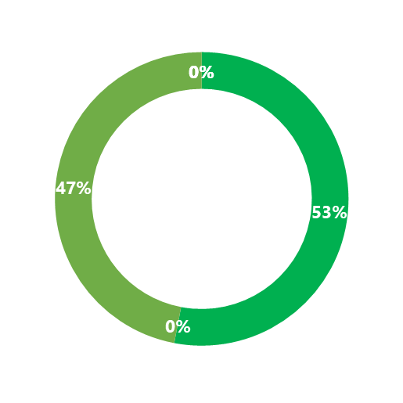
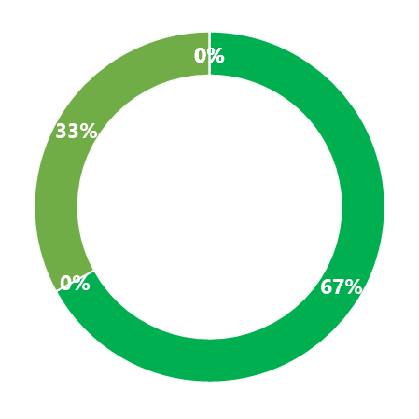
Agile Transformation Failure
If You Can’t Scrum You Can’t Scale
67% of Failures are Terminal
53% Fail
Source: Forbes Insights and MIT Sloan Management Review

Slide 14
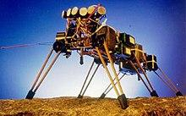
Self-Organization: Why Scrum Fails
Self organization
  Central planning will destroy it
No single point of control
  Command and control will crush it
Interdisciplinary teams
  Isolated activities and lack of transparency will cripple it
Emergent behavior
  Failure to remove impediments will ensure emergence of mediocrity
Outcomes emerge in context
  Empirical process requires inspect and adapt
Team performance far greater than sum of individuals
  More product in less time at less cost with higher quality, higher customer satisfaction, and a better life for both producer and end user
For 30 years MIT created robots that failed because of central control. Only when they went to self-organized behavior did they create the first autonomous robot.
J. Sutherland, A. Viktorov, and J. Blount, Adaptive Engineering of Large Software Projects with Distributed/Outsourced Teams, in International Conference on Complex Systems, Boston, MA, USA, 2006.

Slide 15
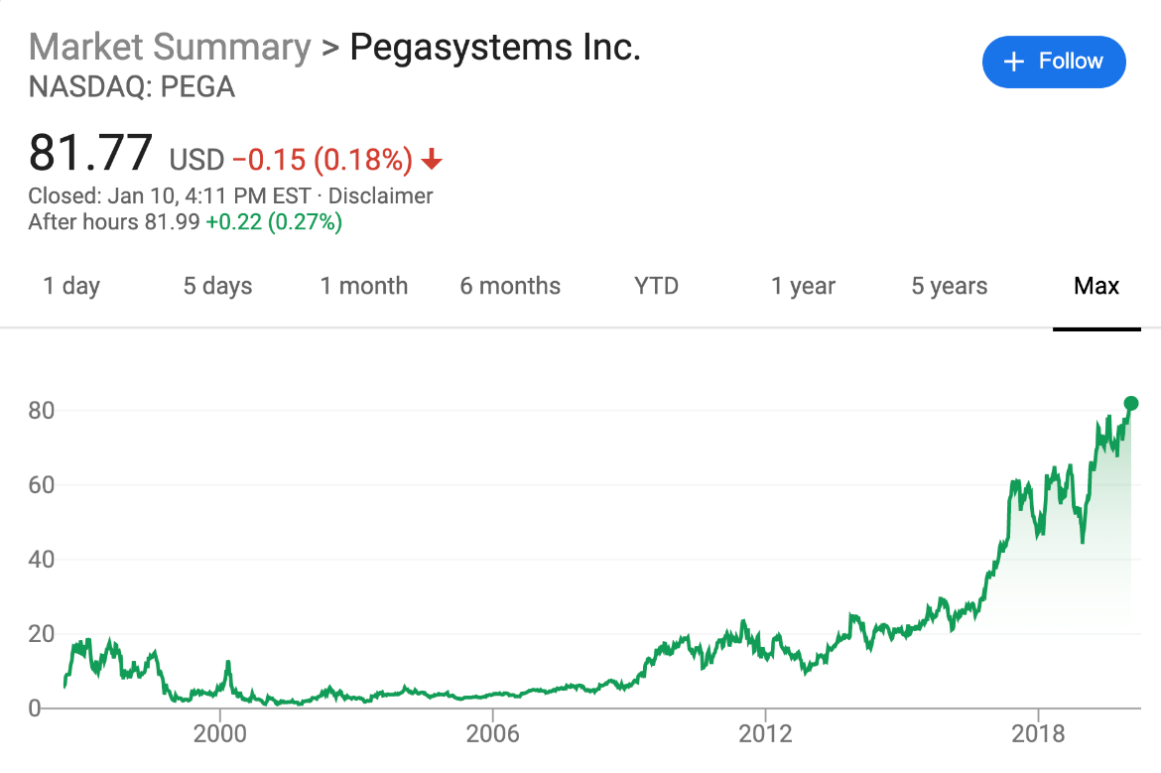
Scrum@Scale Mission
Agile Education Program:
Mission
Replace the traditional corporate operating system which produces unhappy customers, disengaged workers, and poor financial results.
Introduce a disruptive technology that is 10 times better at enabling organizational performance that drives company valuation, stock market performance, and non-profit objectives.
Deliver a fractal organization that enables linear scalability.
Enable a minimum viable bureaucracy.
Hitting The Wall: What to Do When High Performing Scrum Teams Overwhelm Operations
J. Sutherland and R. Frohman, IEEE HICSS 44th Hawaii International Conference on System Sciences, Kauai, Hawaii, 2011.

Slide 16
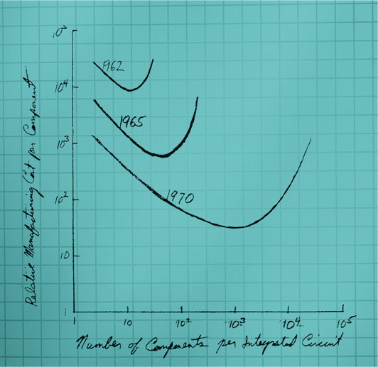
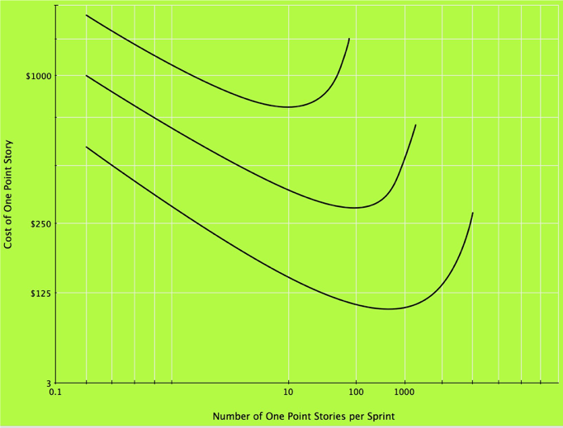
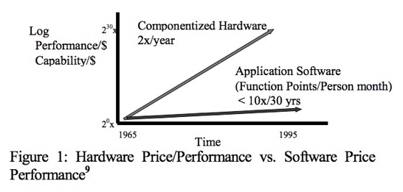

Strategy: Moore’s Law Applied
Transistors on a Chip
Stories in a Sprint
Moore, Gordon E. 1965 Cramming More Components on Integrated Circuits. Electronics 38:8
Jeff Sutherland (2009) ACM StandardView: Volume 6 Issue 1, March 1998

Slide 17

Brooke’s Law Makes it Hard to Scale
Brooks Law Makes It Difficult to Scale
“Adding people to a late project makes it later.” Fred Brooks
Communication overhead explodes when adding more people to a project reducing productivity per person.
If a 6-person team takes 11 months to finish a project, a 10-person team takes 17 months. https://www.qsm.com/process_improvement_01.html
The same phenomenon occurs at the team level. Adding teams reduces productivity per team.

Slide 18
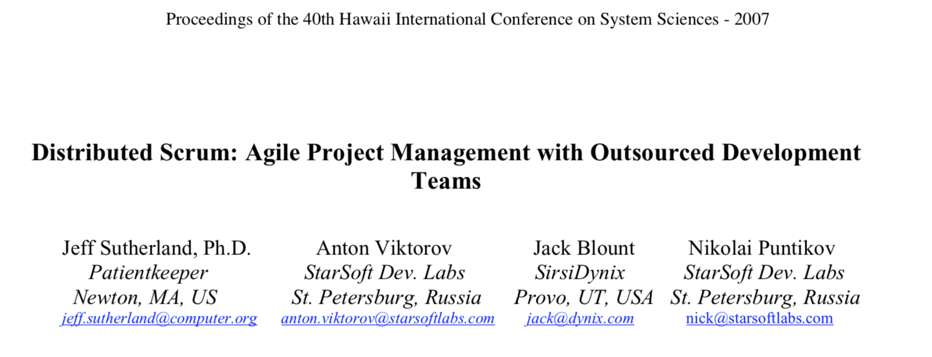


The First Published Project to Overcome Brooks Law!

Slide 19

Scrum@Scale Avoids Brooks Law
Scrum@Scale Avoids the Limitations of Brooks Law
”Adding people to a late project makes it later.” Fred Brooks
Productivity per person and per team always goes down as project size increases in waterfall projects and most agile projects.
The only way to avoid this is to have only the patterns mentioned here with no additional bureaucracy.
We call this a Minimum Viable Bureaucracy. —an organization that manages function without diminishing timely delivery of value to the customer

Slide 20
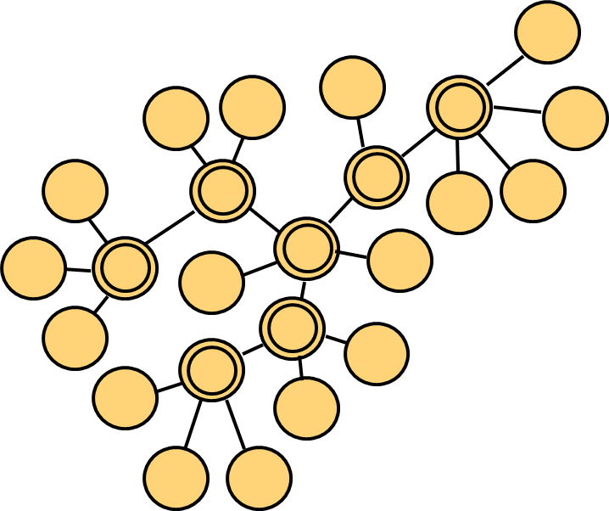

Scaling Without Losing Productivity Per Team: Linear Scalability
Scaling Without Losing Productivity Per Team: Linear Scalability
Requires a fractal-like design. Every component looks like every other component.
Small teams with object-oriented information hiding radically reduces communication paths.
Network design with information transparency. Everyone can see what is going on at all levels.
These architectures are seen everywhere in nature, social networks, and chip design. They are called scale free architectures.

Slide 21
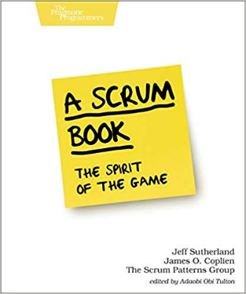
Using Patterns to Overcome Brook’s Law
Using Patterns to Overcome Brook’s Law
It took a decade of meetings of Scrum experts to create the patterns book.
Throughout this work, our Product Owner, Jim Coplien, repeated asserted “there are no scaling patterns.”
Scrum@Scale was created with this in mind.

Slide 22
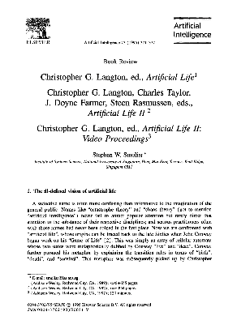
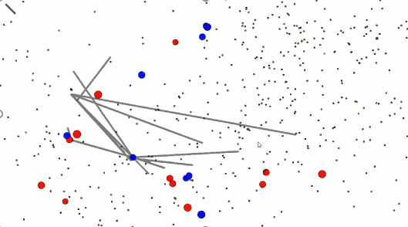
Complex Adaptive Systems:
Sante Fe Institute
Christopher Langdon at Center for Nonlinear Studies, Los Alamos National Laboratory and the Sante Fe Institute published a lemma (mathematical proof).
Increasing degrees of freedom of a system causes faster evolution of the system up to the edge of uncertainty.
Removing control to speed up system evolution was the goal of Scrum.
Ken Schwaber created the controlchaos.com website.

Slide 23
iRobot Genghis Khan Self-Organizes to Achieve a Goal – 1990-92
No database – the world is the database
No program – the neural net figures it out
“Do you think a team could self-organize to achieve a goal faster if it implemented some of the basic principles of Genghis Khan?” Jeff Sutherland
“Why don’t you try it?” Rodney Brooks
Genghis was a six legged insect-like robot that was created by roboticist Rodney Brooks at MIT. Brooks wanted to solve the problem of how to make robots intelligent and suggested that it is possible to create robots that displayed intelligence by using a "subsumption architecture" which is a type of reactive robotic architecture where a robot can react to the world around them.^{[1]} His paper "Intelligence Without Representation", which is still widely respected in the fields of robotics and Artificial Intelligence, further outlines his theories on this. Wikipedia
iRobot Genghis Khan Self-Organizes to Achieve a Goal

Slide 24
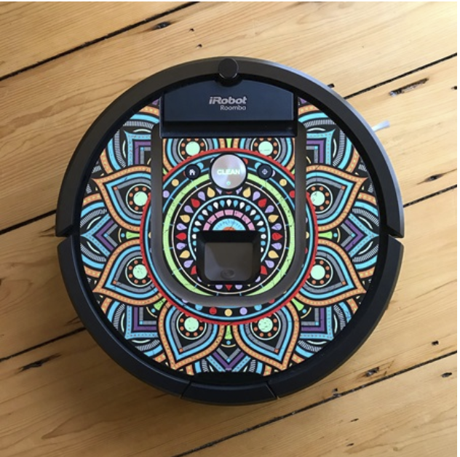
Self-Managing Teams
Self-Organization is a concept from complex adaptive systems theory.
An intelligent system self-organizes to achieve a goal.
When it bangs into an impediment it works around it or removes it to accelerate towards the goal faster.
Teams are self-managing to achieve a Sprint Goal. This is self-organization.
Shared at irobot.nl

Slide 25
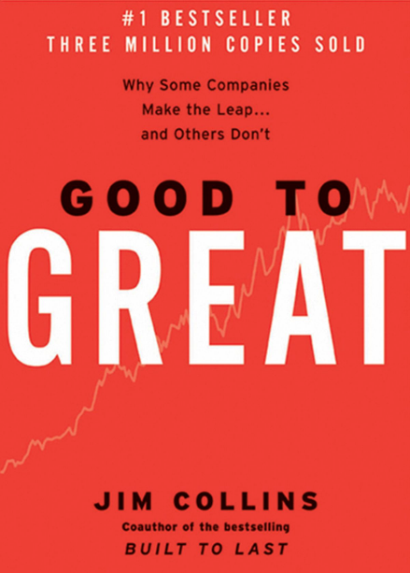
A Leader Who Serves
Servant Leadership
A Servant Leader gets the right people on the bus and asks what is the best way to achieve a Goal.
Corollary: If the wrong person is on the bus, the servant leader gets them off the bus.
To do the full job requires a Leader Who Serves.

Slide 26
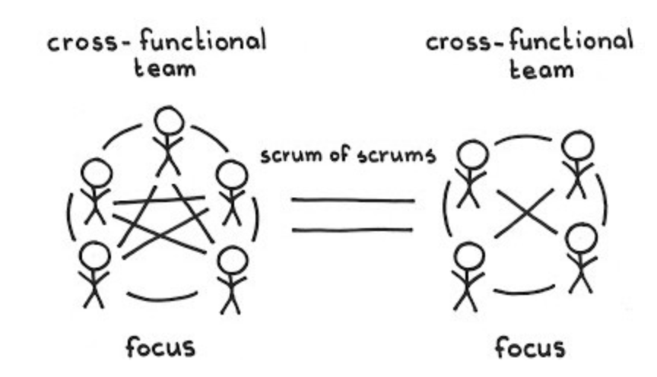
Mitosis—Self Organizing at Scale
Mitosis – self-organizing at scale
One should grow a Scrum Team in an incremental, piecemeal fashion, but eventually the team just becomes too large to remain efficient.
Differentiate a single large Development Team into two small teams after it gradually grows to the point of inefficiency—about seven people in the old team.
Members of separate teams should continue to coordinate with each other informally, and as necessary, through the daily rhythm of Scrum of Scrums events.

Slide 27
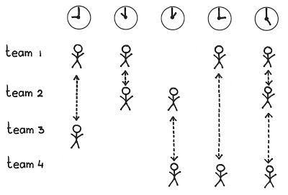
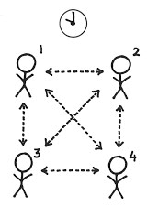
Pattern: Scrum of Scrums
A Scrum of Scrumsa Scrum Team is working on a single product with multiple Development Teams. The Development Teams need to coordinate dependencies and shared work. Unresolved dependencies within individual teams are a shared challenge of all teams. When multiple teams work independently of each other they tend to focus myopically on their own concerns and lose sight of any common goals.
Organizations might revert to a command-and-control approach in the false belief that agility only works at the scale of one team, but complexity has grown, not diminished, in this circumstance. Hierarchical control increases delays and reduces the responsiveness of the teams and the wider organization to business and technology changes.

Slide 28
Scrum of Scrums Done Right
The Scrum of Scrums is a set of teams that delivers a product increment at the end of a sprint.
The IDX Scrum of Scrums that is the origin of the pattern is a release team.
The Scaled Daily Scrum requires many experts other than Scrum Master to deliver a product increment.
The IDX Scrum of Scrums was responsible for creating a potentially shippable increment of product at least once a sprint and deploying on a regular cadence.

Slide 29

Scaled Daily Scrum: A Scrum of Scrums
“Establish a regular Scrum of Scrums event, perhaps daily, after the teams’ Daily Scrum events, to resolve emergent dependencies and issues, and to get things to Done (see Definition of Done).
“The Scrum of Scrums is a well-established pattern, first implemented at IDX Systems (now GE Healthcare) in 1996. Jeff Sutherland was Senior Vice-President of Engineering, with Ken Schwaber on board as a consultant to help roll out Scrum. There were eight business units, each with multiple product lines. Each product had its own Scrum of Scrums.”
The first Scrum of Scrums

Slide 30
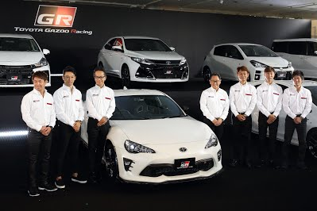
Product Owner Team
The Product Owner has more to do than a single person can handle well
Therefore:
Create a Product Owner Team, led by the Chief Product Owner, whose members together carry out product ownership.
The Product Owner Team realizes the Vision by ordering the Product Backlog Items through a single Product Backlog.
Source: Sutherland and Coplien (2019) A Scrum Book: The Spirit of the Game

Slide 31
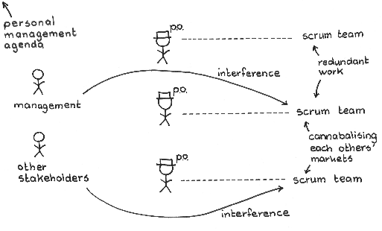
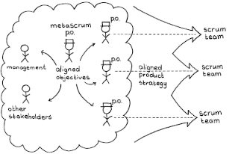
MetaScrum
Scrum Teams are in place, but direction (or the threat of interference) from legacy management structures causes confusion about the locus of control over product content and direction.
Therefore:
Create a MetaScrum as a forum where the entire enterprise can align behind the Product Owners’ backlogs at every level of Scrum in the organization.

Slide 32
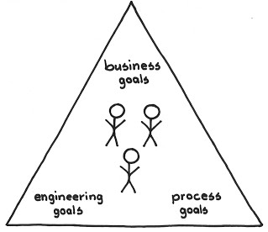
Executive Action Team: A Scrum Team
Executive Action Team:
A Scrum Team
Many great Visions are beyond the reach of solo efforts, and to achieve such a Vision you need to build the complex product, bring it to the market and leverage feedback. In this case the Product is an Agile Organization.
Therefore:
Form a team that has all the necessary competencies: the people who can make and deliver the product (a Development Team), a Product Owner who guides product direction, and a ScrumMaster who facilitates learning.

Slide 33

Scrum@Scale Patterns
Scrum@Scale Patterns
Mitosis
Scrum Team
Scrum of Scrums
Product Owner Team
MetaScrum
Executive Action Team
There is a Scrum Team that owns the agile implementation called an Executive Action Team (EAT)
There is a Product Owner Team called an Executive MetaScrum Team (EMT) that owns the organization’s backlog.

Slide 34
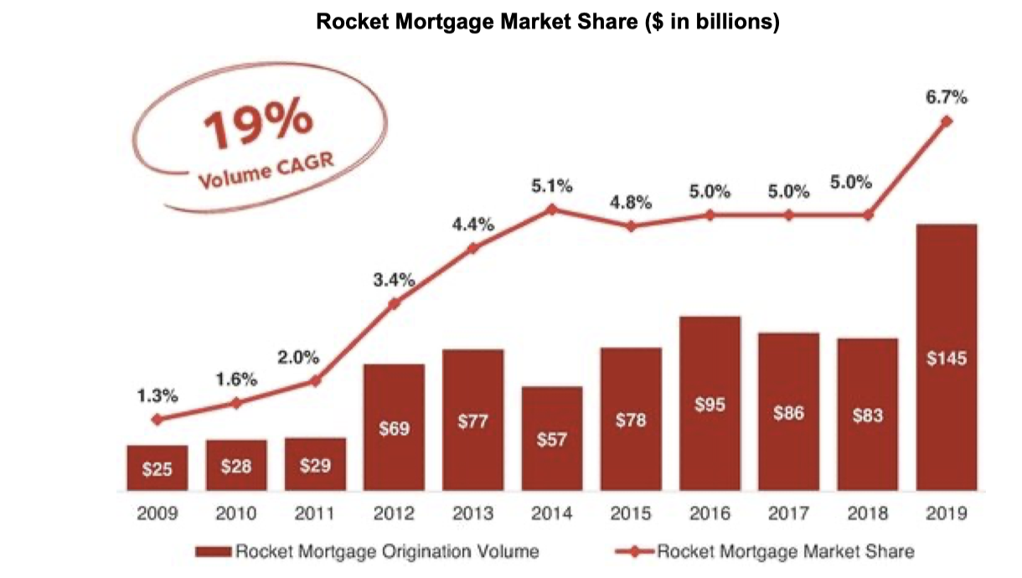
Rocket Mortgage Delivers Twice the Value in Half the Time at Scale
How to Do Twice the Work in Half the Time at Scale
Implemented scaled agile framework with 26 release trains for 17000 people growing to 22000 team members and 41 release trains in 2021.
  Cycle time for feature development dropped from 86 days to 42 days.
The Brand Marketing release train, the digital storefront deployed scaled scrum patterns.
  Scaled scrum patterns reduced average cycle time to 11.6 days which was 720% better than original baseline.

Slide 35
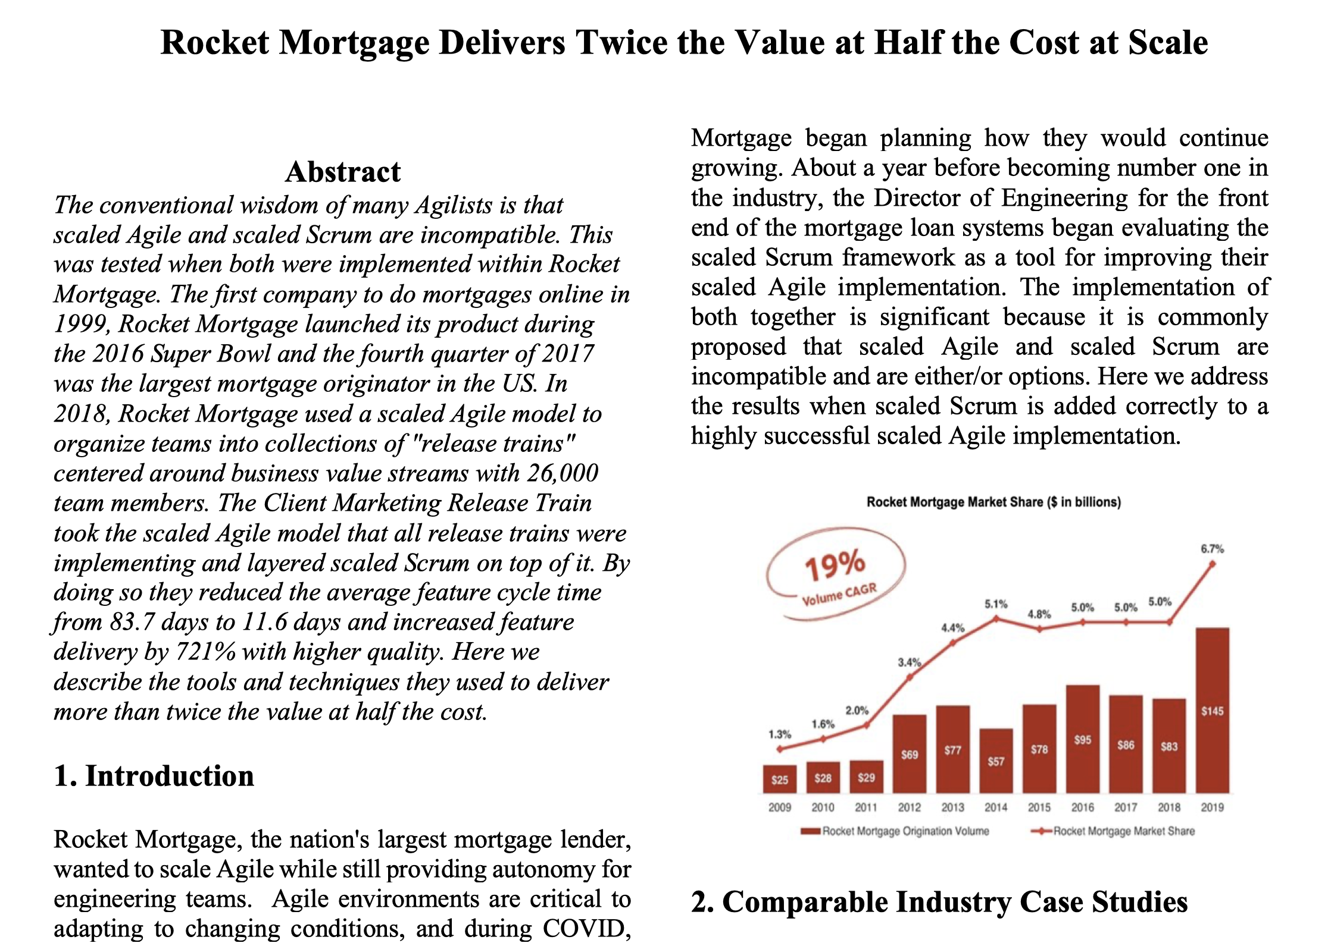
Moving from a SAFe Culture to a Delivery Culture
Standardize and improve Scrum
Streamline organization and meetings
Total focus on delivery
Strong DevOps implementation
Went from delivering every quarter to delivering multiple times a day
Used new capabilities to bring up COVID testing system for city of Detroit in one week.

Slide 36
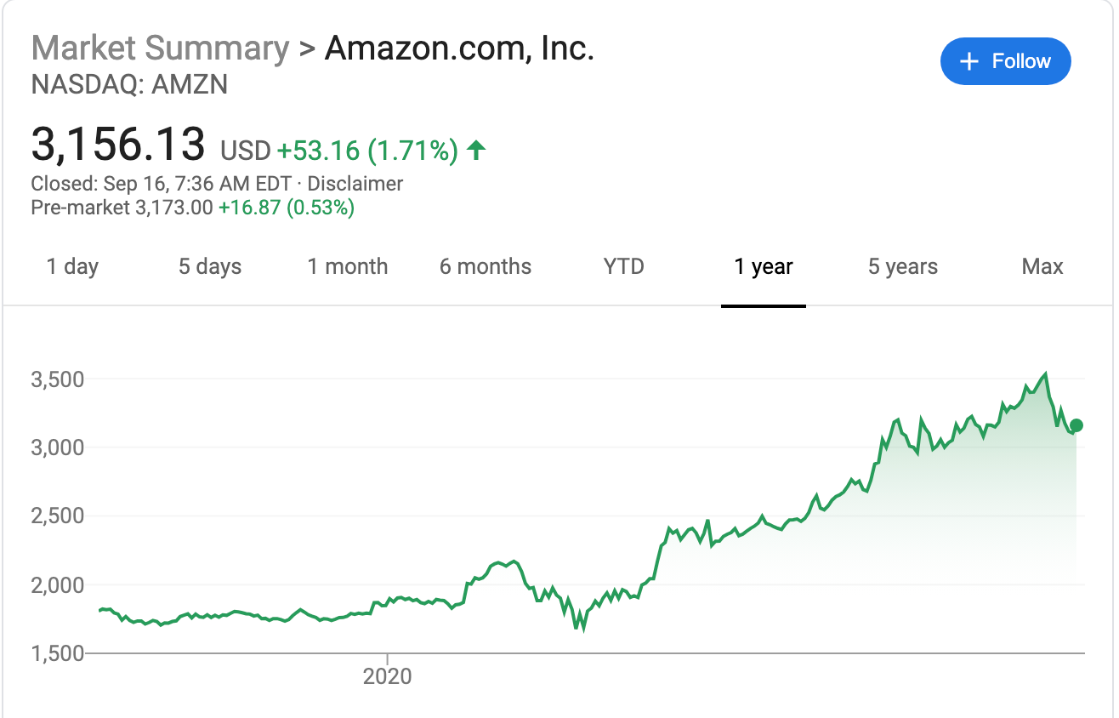
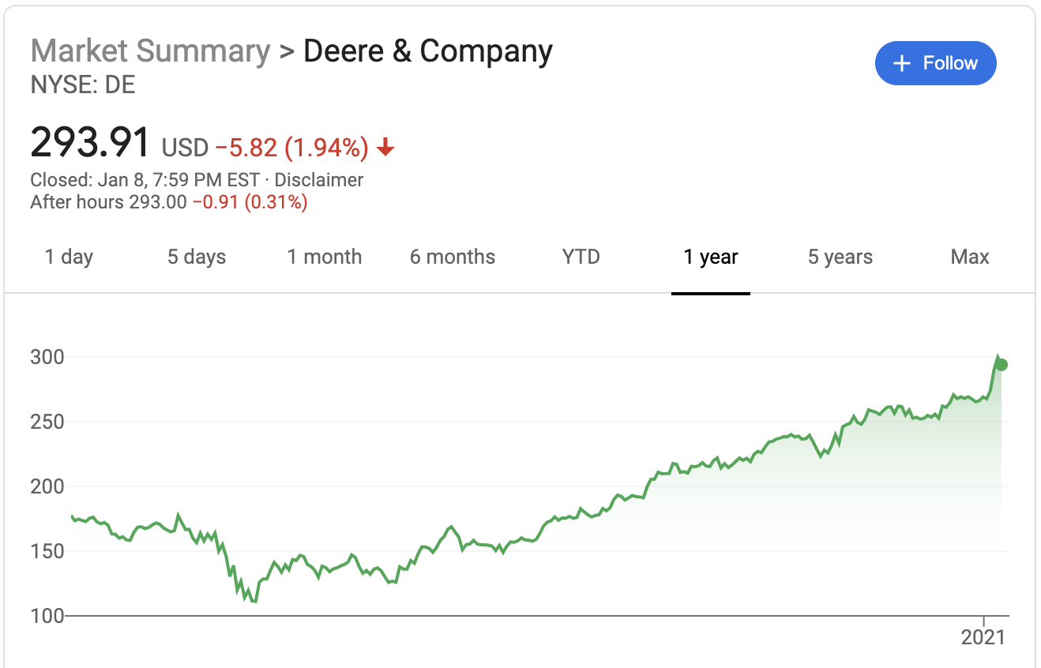
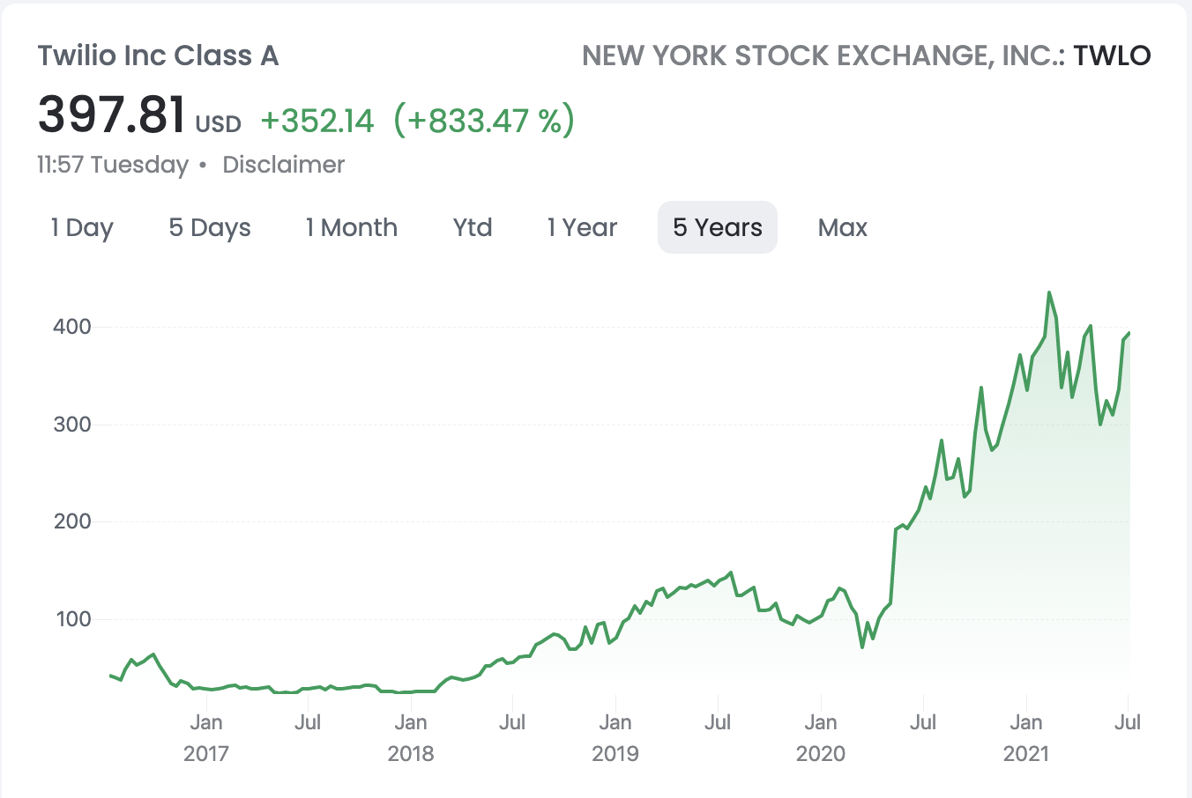
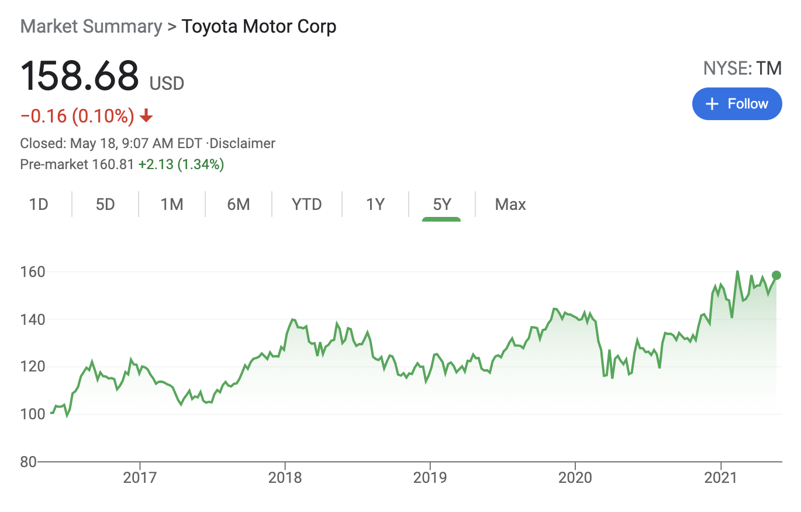
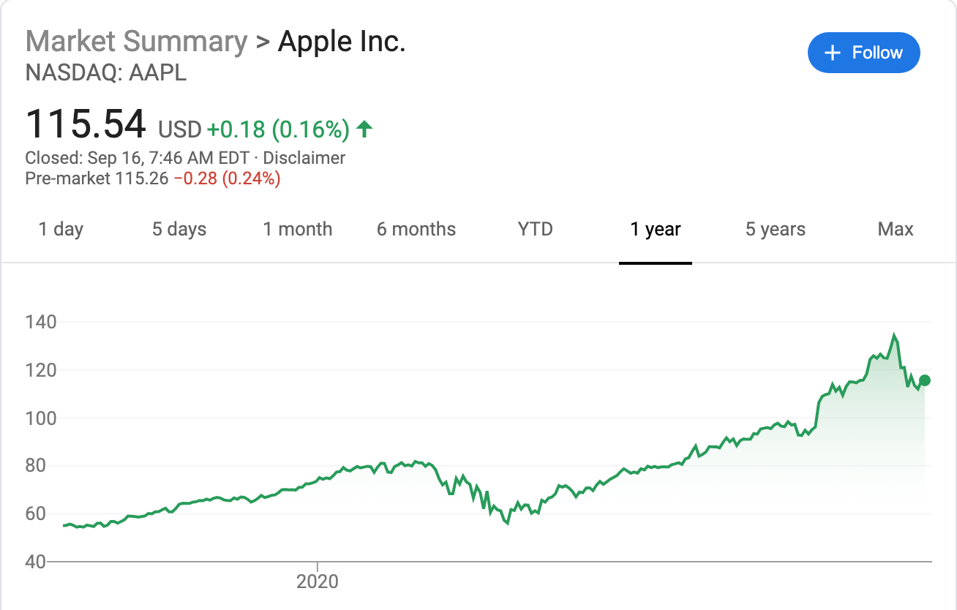
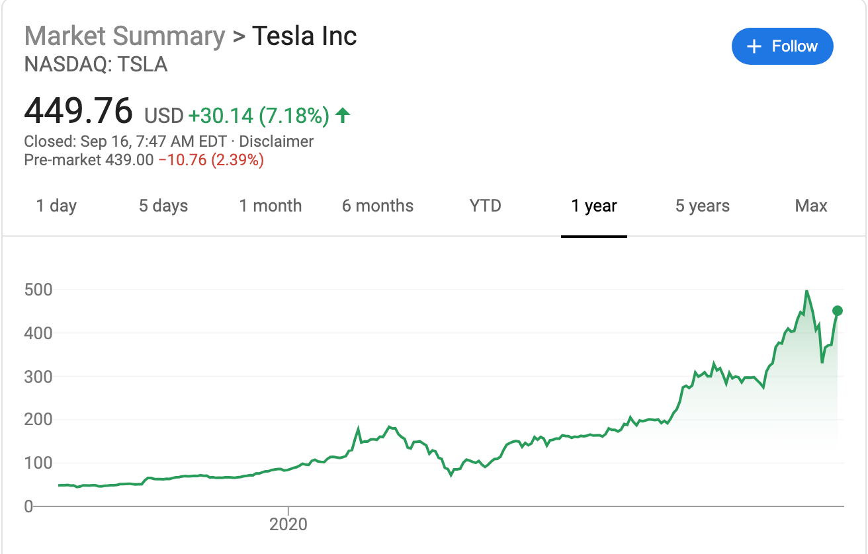
Business Agility Drives Stock Price in COVID
3600 non-agile companies went bankrupt in the first half of 2020

Slide 37

Enterprise Agility Drives Performance
Output up at least 165% 产出至少增长165%
Time to Market reduced by 65% or more. 上市时间缩短了超过65%
Employee Net Promoter Score is up 20-points 员工的推荐指数(NPS)上升了20个点
Return on investment is estimated to be greater than 100% 投资回报比估计超过100%
An empowering culture where agility is part of the John Deere DNA 赋能的敏捷文化已经深入到了John Deere的基因中。

